Slide 1
The monetary policy instruments of the Magyar Nemzeti Bank
MNB, Directorate Monetary Policy Instruments, Foreign Exchange Reserves, And Risk Management
20 February 2020

Slide 2
TOPICS
Monetary policy instruments from January 2019
Modification of monetary policy instruments in the 2013-2018 period
Determinants of interbank liquidity, shocks hitting the liquidity of the banking system and their management
Role of monetary policy instruments in the inflation targeting regime

Slide 3
Objectives of monetary policy
Primary objective
To achieve price stability - keeping inflation low through the conduct of predictable and credible monetary policy
„The primary objective of the MNB shall be to achieve and maintain price stability”.
Strategy: inflation targeting – announcement of a numerical explicit medium-term inflation target
Intermediate target
inflation forecast to be close to the inflation target
the medium-term target of the MNB: 3% (consumer price index) +/- 1% (tolerance band)
https://www.mnb.hu/en/publications/reports/inflation-report
Direct, operational target
Short-term market interest rates to be consistent with the central bank base rate and with the expectations of it
short term: 3-6 months

Slide 4
Monetary policy framework of the MNB
Primary goal:
Price stability
Intermediate target:
Inflation forecast=
= medium-term inflation target
Operational target:
Short-term interest rates= expected base rate
Key policy instrument:
Minimum reserves

Slide 5
Decision-making mechanism of the MNB
Monetary Council (MC): Decision on the level of interest rate
Financial stability analysis
Money market analysis
Information
Inflation and real economic forecast
Effects of transmission channels originating from the change in the interest rate
Monetary policy instruments
Short-term interest rates should adjust to the base rate

Slide 6
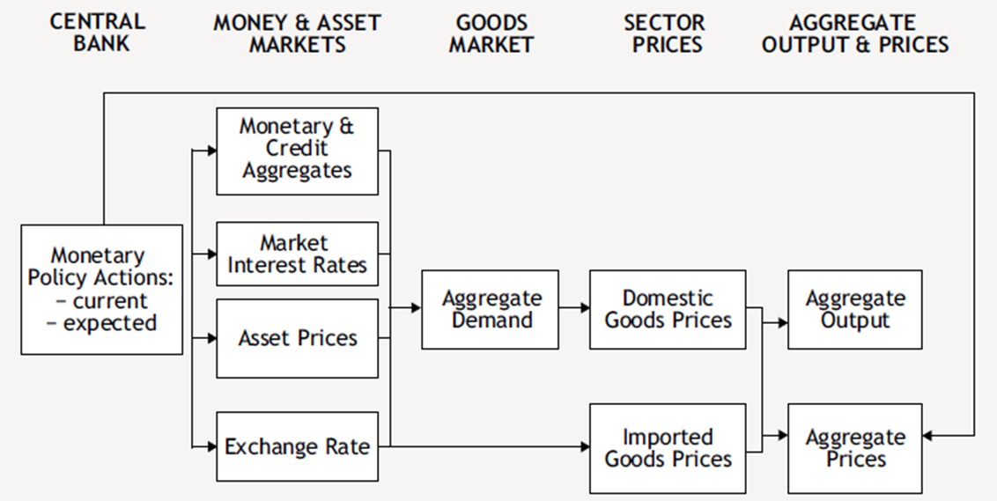
Transmission channels: the way monetary policy decisions affect output and inflation
Announcements by the central bank influence economic agents’ expectations too.
Source: Monetary policy in Hungary (2012)

Slide 7
Monetary policy instruments and the MNB’s objectives
Set of monetary policy instruments: the whole range of the forint and foreign currency operations of the central bank.
The primary objective of the central bank shall be to achieve and maintain price stability, which is provided by the following provisions:
  to implement an effective transmission of central bank interest rates,
  to assist banks’ liquidity management,
  to contribute to financial stability,
Beyond the above mentioned aspects without risking it’s primary objective the MNB:
  supports the maintenance of the stability of the financial intermeditation system, endeavours to improve the effectiveness of the financial intermediary operations and to enchance competition in money market
  supports the government’s economic policy with the available instruments thereby contributing to sustainable economic growth.

Slide 8
Principles of the monetary policy instruments
Contribution
to market
building
Transparent,
secure,
cost-efficient structure
Equal
treatment
of market
counterparties
Market-
conform
operation
(indirect instruments)

Slide 9
Counterparties of the MNB
Counterparties: all domestic credit institutions subject to reserve requirements if they meet the appropriate technical requirements:
  they are direct members of the Hungarian real-time gross settlement system (VIBER) or of the Interbank Clearing System (BKR),
  in the case of collateralised loans and securities transactions they have a securities account with central securities depository and security settlement system (KELER)
In line with the objectives of the various instruments (e. g. in case of instruments aimed at quick intervention) counterparties may be different:
  In case of particular FX instruments non-residents also involved
  In case of quick tenders only banks
  In case of mortgage bond purchase program (2018) only mortgage banks

Slide 10
Eligible collaterals
Central bank credit can only be granted against collateral under normal circumstances.
Eligible securities: government securities, mortgage bonds, bonds with adequate rating (of banks, companies) – Collateral valuation – Historical prices
Collateral management in practice (Description of the Central Bank’s Collateral Management System):
  Collateralised loan and not classical repo (securities repurchase agreement) facility
  Pooling (one single securities portfolio for all traditional central bank loans)
  Haircut (deduction) dependent on the type and maturity of collateral
  Risk Management Parameters Applied to Eligible Collaterals Accepted by the MNB (effective from July 1, 2019)
  Daily revaluation, call for additional collateral if necessary

Slide 11
Simplified central bank balance sheet and instruments
Assets
Liabilities
Foreign-exchange reserves
FGS-loan
Forint mortgage bonds
O/N loan
Other central bank loans
(1-week collateralised loan)
Other assets
Cash
Single Treasy Account
Minimum reserves
O/N deposit
Other central bank deposits
(Preferential deposit)
Other liabilities
Off-balance sheet items
Foreign-exchange swaps (FX-swap)
Interest rate swaps (IRS)

Slide 12
TOPICS
Monetary policy instruments from January 2019
Modification of monetary policy instruments in the 2013-2018 period
Determinants of interbank liquidity, shocks hitting the liquidity of the banking system and their management
Role of monetary policy instruments in the inflation targeting regime

Slide 13
The frame of central bank instruments affecting short-term yields
Main elements of the MNB’s monetary policy instruments
Quantitative restriction
Interest rate corridor
Central bank FX-swap instrument
Minimum reserves
Preferential deposit
Loan tenders

Slide 14
Quantitative restriction
Form: Between October 2016 and September 2018 the key policy instrument of the MNB (3-month deposit) was available for banks in a limited amount
Objective: direct liquidity for encouraging lending, support of self-financing and decrease relevant market yields without change of key interest rate
Schematic illustration of directing liquidity:
In the quantitative restriction system the MNB determines quarterly the edge values of the band of liquidity crowded-out. The MNB manages liquidity shocks by fine-tuning instruments.
Modification of the terms of the three-month policy instrument
Unlimited 3-month deposit
The liquidity crowded out from key policy instrument had a yield-reducing effect on all relevant markets.
Quantitative restriction - under the stability of key interest rate – looses monetary conditions.
Liquidity Risk
Yield
Government bond
Preferential
deposit (limited)
3-month
deposit (limited)
O/N deposit, excess reserves
Interbank market (unsecured depo, FX-swap)

Slide 15
Interest rate corridor and the overnight interest rates
Form: Currently asymmetric corridor between the interest rates on central bank overnight (O/N) lending and deposit facilities
Simultaneous central bank standing facilities on the assets and liabilities side
Objective: to moderate the volatility of money market interest rates with small deviations from the key policy rate
    On the top of the corridor the MNB provides unlimited liquidity for banks by the overnight lending facility (O/N loan) against security collateral restricting the rise of interbank interest rates.
    On the bottom of the corridor the MNB accept unlimitedly temporary liquidity surplus from the money market by the overnight deposit facility (O/N deposit) restricting the fall of interbank interest rates under the O/N deposit rate.
In the (uncovered) interbank market overnight rates fluctuate between the two edges of the interest rate corridor

Slide 16
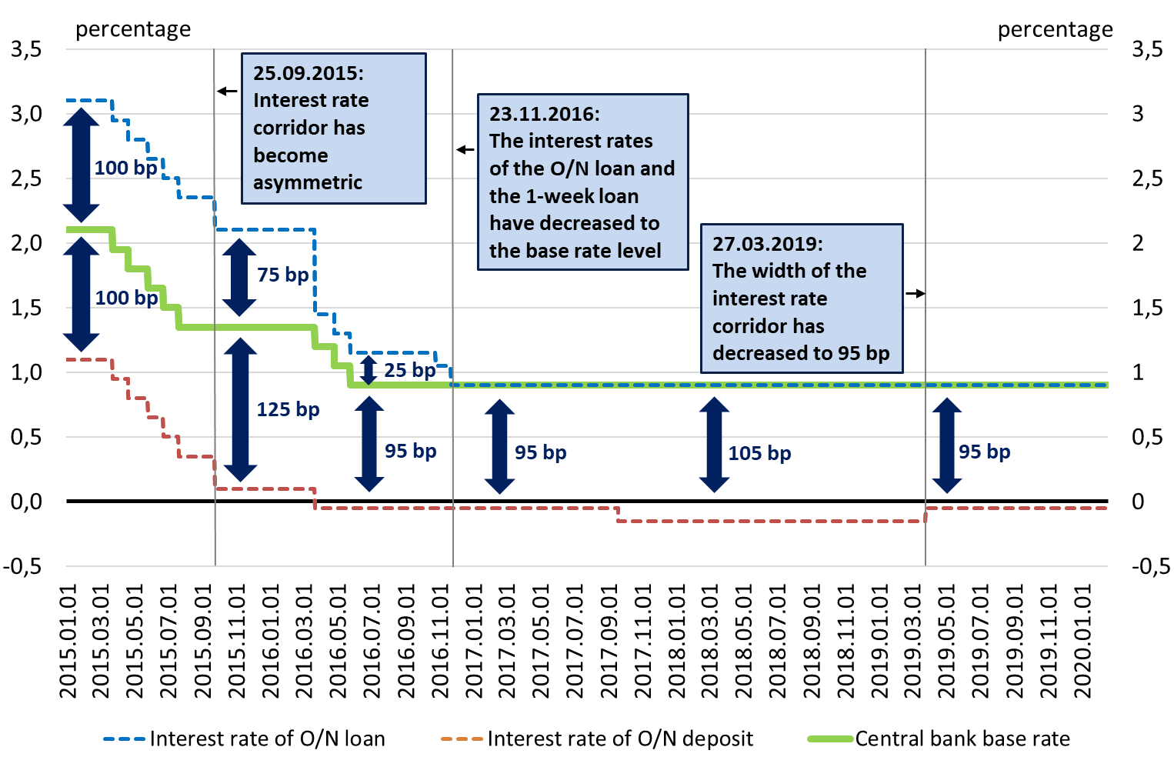
Modifications of the interest rate corridor (2015-2020)

Slide 17
FX-swap instruments providing forint liquidity
Form: EUR-HUF FX-swap instruments providing forint liquidity with 1-week, 1-month, 3-month, 6-month and 12-month maturities
Objective: neutralisation of liquidity flows obstructing the achieving of the crowding-out effect
At the autumn of 2016, simoultaneously with the implementation of the quantitative restriction system the short-term fine-tuning FX-swap instruments have been introduced
Since the spring of 2017 the 6-month and 12-month maturities have become available
The MNB can manage the enduring and significant shifts of liquidity path by fine-tuning instruments providing the effectivity of the quantitative restriction.
At the autumn of 2016 beyond the FX-swap instruments providing forint liquidity the MNB created the 1-week central bank deposit instrument applied on an ad hoc basis in order to absorb excessively high liquidity surplus (the MNB didn’t use it between 2016 and 2019).

Slide 18
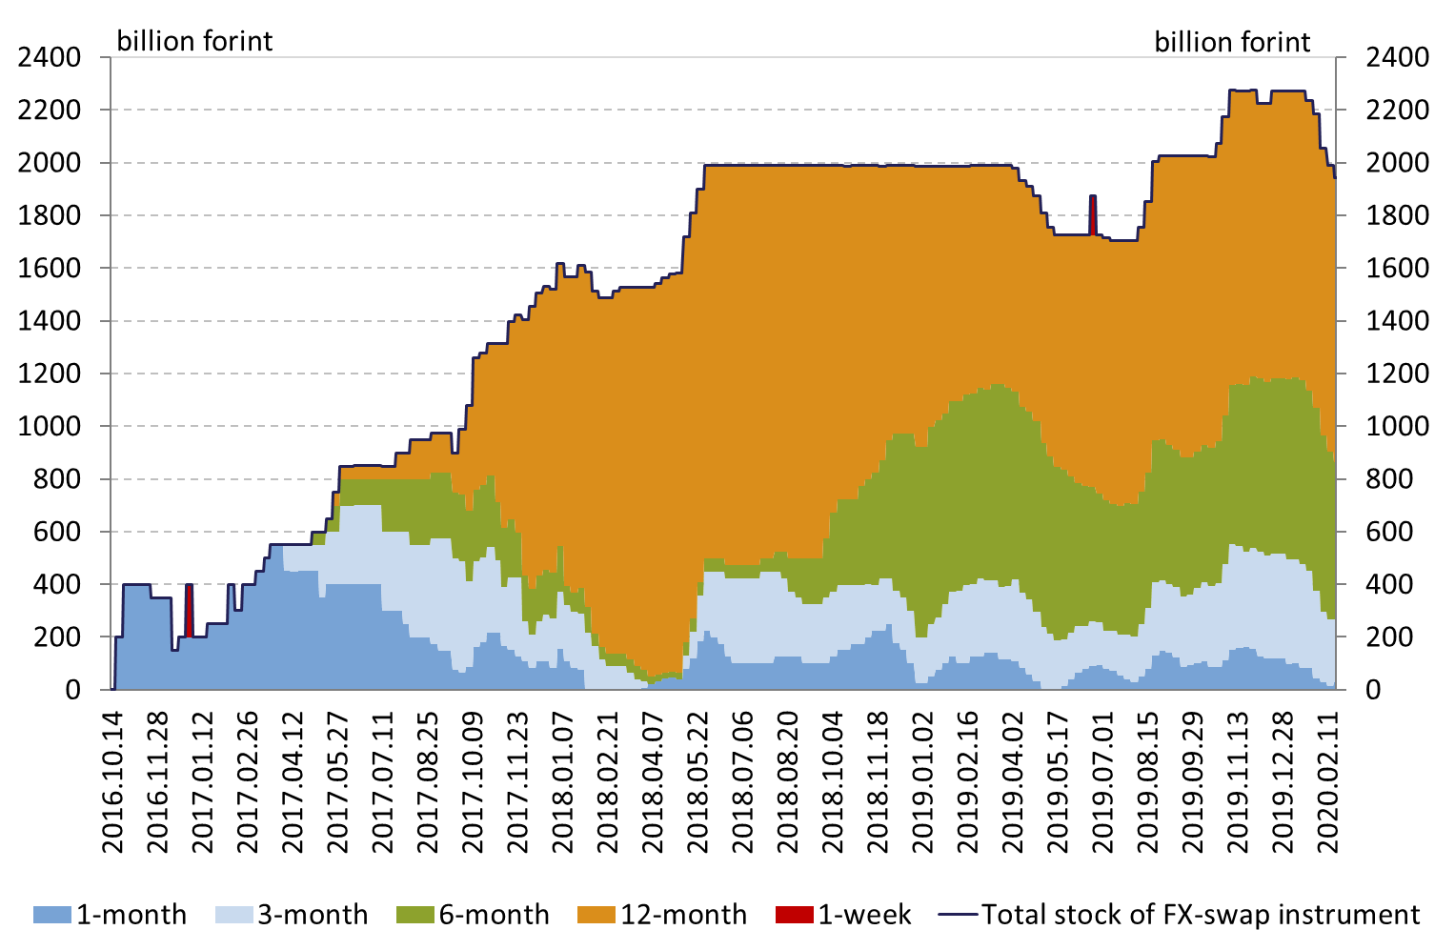
The development of the FX-swap stock of the MNB until 20.02.2020

Slide 19
The role of minimum reserve requirements
  Form: Banks are required to maintain reserves against a part of their liabilities (2% of the liability items subject to reserve requirements with a maturity less than 2 years) in their settlement accounts with the central bank
  Objective: to moderate the volatility of money market interest rates
  Averaging mechanism: reserve requirements have to be met on a monthly average basis*
  The MNB pays the central bank base rate on the minimum reserves. Banks have to pay a penalty interest rate equal with the central bank base rate if they hold less minimum reserves than required. In case of excess reserves holding banks have to pay a penalty interest rate (either the O/N deposit minus 0,15% or 0%, which one is lower) on the amount above the minimum reserves.
  Since 1st December 2016 the minimum reserves rate has decreased from 2% to 1%:
    Support the quantitative restriction of the 3-month deposit by increasing the liquidity of the banking system
    Harmonization to the practice of the European Central Bank
  Since 19th December 2018 the minimum reserves has become the key monetary policy instrument
*Banks can maintain their required reserve account balance lower in case of temporary liquidity deficit or
higher in case of temporary liquidity surplus

Slide 20
The reform of the BUBOR-market
  Since May 2016 the MNB has transformed the BUBOR’s quotation system in order to increase the reliability and information content of BUBOR’s quotations. Therefore:
      A dealing obligation-based quotation system has been created to strengthen the reliability of quoted interest rates and increase the role of market-based transactions;
      The BUBOR has become able to fulfill better the role of reference rate, quotations have become less „sticky” to the central bank base rate.
  The system started from 2nd May 2016 with the participation of 9 BUBOR-quoting panel banks, to which 3 other banks joined during the summer.
  During Autumn of 2016 the MNB took over the management of BUBOR and other financial benchmark indicators from the ACI Hungary and made additional modifications of the rules of indicators’ calculation. By the modifications the information content of the quotations has significantly increased.

Slide 21
Preferential deposit
Form: The preferential deposit account is a deposit account separated from the Counterparty’s bank account, where the Counterparty can place an overnight deposit on any VIBER business day specified in the settlement calendar, solely by the way of a transfer from its bank account held with the MNB.
Objective: sterilising the surplus liquidity that derives from disbursements of the Funding for Growth Scheme Fix (FGS fix) from March 2019 and the Bond Funding for Growth Scheme (BFGS) from July 2019 at the central bank base rate
Banks can use this preferential deposit facility, if fulfill at least one of the following conditions:
  Participating in the FGS fix as direct counterparty;
  Owning securities belonging to a series of securitites purchased by the MNB in the frame of BFGS, or banks’ affiliates* owning these kind of securities** which are banks’ corresponding credit institutions***
Until February 2019 the preferential deposit facility was available for banks committed to lend SMEs in the frame of Market-Based Lending Scheme (MLS) started at the beginning of 2016.
      In February 2019 the Market-Based Lending Scheme was terminated, therefore the preferential deposit facility linked to MLS was also terminated causing the decrease of preferential deposit in March 2019 and the increase of the stock of O/N deposit.
*according to Terms and conditions of the operations of the central bank in forint and foreign currency markets
**securities belonging to a series of securitites purchased by the MNB in the frame of BFGS
***according to MNB Decree 10/2005 (VI. 11.) on the Calculation, the Method of Allocation and Placement of the Minimum Reserves

Slide 22
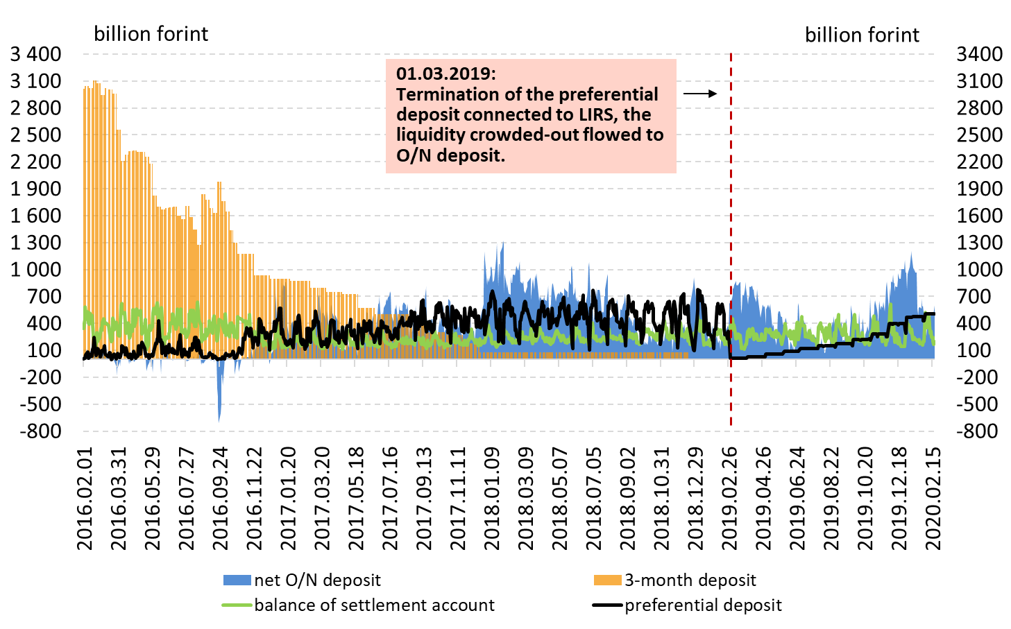
Development of the stock of preferential deposit until 19.02.2020

Slide 23
Loan tenders
Form: 1-week, fixed-rate collateralised loan tender*
Objective: provide liquidity to banks in case of temporary lack of liquidity or ad hoc, unforeseen liquidity-absorbing shock(s)
Available for banks from 30.09.2015 on a weekly basis
The MNB may settle the concluded trades even if the securities collateral is insufficient. In this case, after the collateral revaluation, the counterparty receives the minimum balance set for its bank account.
The interest rate applied in the transaction is fixed during the tender, since 23.11.2016 it has been equal with the central bank base rate
The counterparty is not allowed to make prepayments
From autumn of 2017 transaction was not made, until autumn of 2017 transactions were made in a sum of Bn 260 HUF, in 2016 in a sum of Bn 8699 HUF, from autumn until December 2015 in a sum of Bn 1267 HUF
*In 7th December 2016 the MNB discontinued its 3-month, variable-rate collateralised loan tender

Slide 24
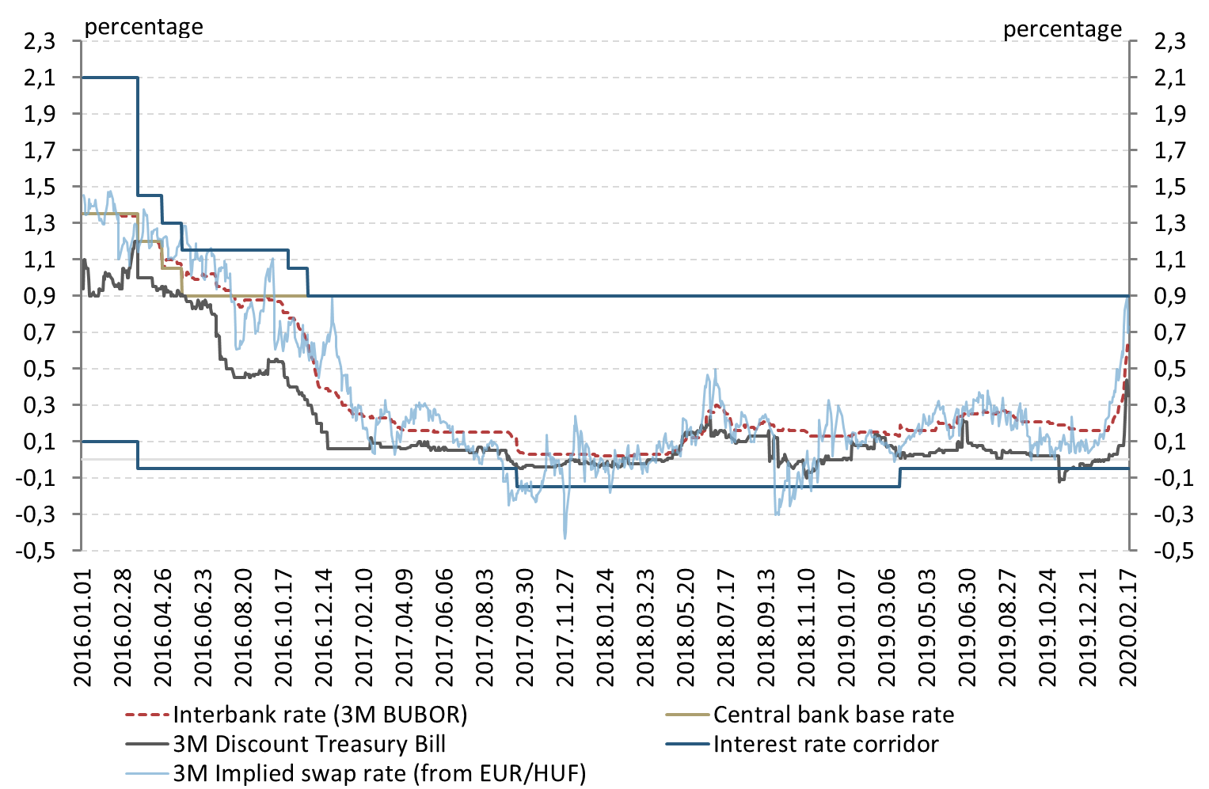
Short-term market interest rates in the central bank interest rate corridor from 01.01.2016 till 20.02.2020

Slide 25
The MNB’s strategic framework of monetary policy instruments published in September 2018 (1)
  The Monetary Council announced in September 2018 that the MNB is prepared for the gradual and cautious normalisation of monetary policy.
  The future monetary policy-making begins with the modification of unconventional instruments:
  During the formulation of monetary policy, the MNB applies the optimal combination of the measures related to the Bank’s foreign exchange swap instrument and the interest rate corridor.
      The MNB regards the foreign exchange swap instrument as a strategic element of monetary policy instruments, also in the future. The MNB maintains part of the FX-swap portfolio persistently and on a stable basis and maintains its presence in the FX-swap market on all presently existing maturities (1W, 1M, 3M, 6M, 12M).

Slide 26
The MNB’s strategic framework of monetary policy instruments published in September 2018 (2)
      The stock of central bank FX-swap instrument may change, but won’t decrease to zero in the mid-term. The MNB hold permanently the substantial part of its FX-swap portfolio in its balance sheet.
    In terms of the transmission of monetary policy, the MNB regards the deposit and loan instruments, and thus the width and symmetry of the interest rate corridor, equally important.
    The MNB continues to decide regularly on the crowding-out from instruments bearing interest at the base rate and on its swap instrument portfolio.
    The current BUBOR market framework and the minimum reserve ratio won’t change. The preferential deposit – connecting to the FGS fix recently started – remains part of the set of monetary policy instruments.

Slide 27
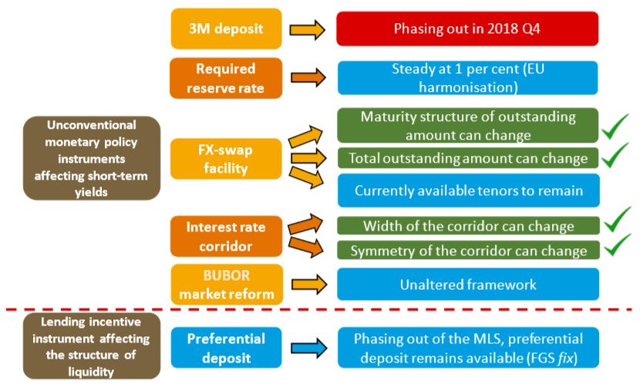
Strategy about the set of monetary policy instruments affecting short-term yields

Slide 28
Funding for Growth Scheme Fix (FGS fix)
Form: a source of refinancing for banks at a 0% interest rate, which banks can lend to SMEs with an interest margin of up to 2,5% to finance new investments in forint
Objective: to have a significant impact on the structure of SME-lending
Launched at the beginning of 2019 by the MNB with a total amount of HUF 1,000 billion
In terms of its most important parameters and its operation, the new scheme will be identical with the previous phases of the FGS, they differ in a few points below (more targetted):
loans may only be provided for maturities longer than 3 years
loans may only be provided for investment, and within that the range of utilisation will be narrower compared to the third phase
the scheme is neutral in terms of liquidity, as the excess liquidity arising from the program will be sterilized at base rate by the preferential deposit

Slide 29
Bond Funding for Growth Scheme (BGS)
Form: Within the scope of the scheme, for a facility amount of HUF 300 billion the central bank will purchase bonds with good ratings issued by non-financial corporations based in Hungary as well as securities backed by corporate loans
The Scheme complementing the FGS fix started from 1st July 2019 with a facility amount of HUF 300 billion
Objective: the increase of the liquidity of the corporate bond-market (providing an alternative to bank financing primarily for larger companies), improving the efficiency of monetary policy transmission
  as the market becomes more liquid, credit claims on SMEs may also later appear in securitised form, which may result in a further improvement in financing conditions in the SME sector
The MNB intends to sterilise the excess volume of funds resulting from the program with the preferential deposit facility
The purpose, conditions and operation of BGS heavily relies on the European Central Bank’s corporate sector purchase programme (CSPP)
  Credit rating of the bonds to be purchased is at least B+, original maturity of the bonds is minimum 3 years, maximum 10 years, denomination of the bonds is forint
  Proportion of MNB’s purchase per bond series is maximum 70%
  Maximum exposure of the MNB per corporate group is HUF 20 billion
  Minimum volume per issuance is HUF 1 billion

Slide 30
TOPICS
Monetary policy instruments from January 2019
Modification of monetary policy instruments in the 2013-2018 period
Determinants of interbank liquidity, shocks hitting the liquidity of the banking system and their management
Role of monetary policy instruments in the inflation targeting regime

Slide 31
Provisions about the set of monetary policy instruments (2013-2018)
Introduction of instruments connecting to settlement and conversion of FX loans
1W, 3M
loan-tenders
Central bank LIRS tenders + prefential deposit facility
Minimum reserve ratio: 1%
MIRS
tenders
IRS
tenders
Start of the 3rd phase of the Funding for Growth Scheme
Introduction of mortgage bond purchasing program
1W and 1M FX-swap tenders
Announcing the Self-financing programme
3M, 6M, 12M FX-swap tenders
3M deposit, as the key policy instrument
2013
2014
2015
2016
2017
2018
2019
Start of Funding for Growth Scheme (FGS)
Start of the 2nd phase of the Funding for Growth Scheme
Start of Funding for Growth Scheme Plus (FGS+)
Phasing out of 3M deposit, new key policy instument: minimum reserves
*: unconventional (UC)

Slide 32
Funding for Growth Scheme (FGS)
Form: MNB gave refinancing loan to credit institutions at a 0% interest rate, from which banks can lend SMEs with a capped interest margin (maximum 2,5%)
  pillar: SME loans (as well as factoring és leasing)
  pillar: conversion of foreign currency loans to forint loans, redemption of loan for the pre-financing of EU subsidies
  Objective: to alleviate disruptions observed in lending to small and medium-sized enterprises (SME), strengthening financial stability and reducing the external vulnerability of the country
  Participation in the Scheme was bound to the following condition: banks had to lend SMEs with the amount equivalent with central bank loans banks received from the MNB in the I. and II. pillars of the program. (In case of III. pillar the reduction of short-term external debt of the credit instritution was the condition.)
  The 1st phase of the FGS started the beginning of June 2013
  The 2nd phase of the FGS started in October 2013. In September 2014 the Monetary Council decided to increase the overall amount available of the 2nd phase.
  In March 2015 FGS was complemented with the FGS+ facility
  The 3rd phase of FGS started in January 2016

Slide 33
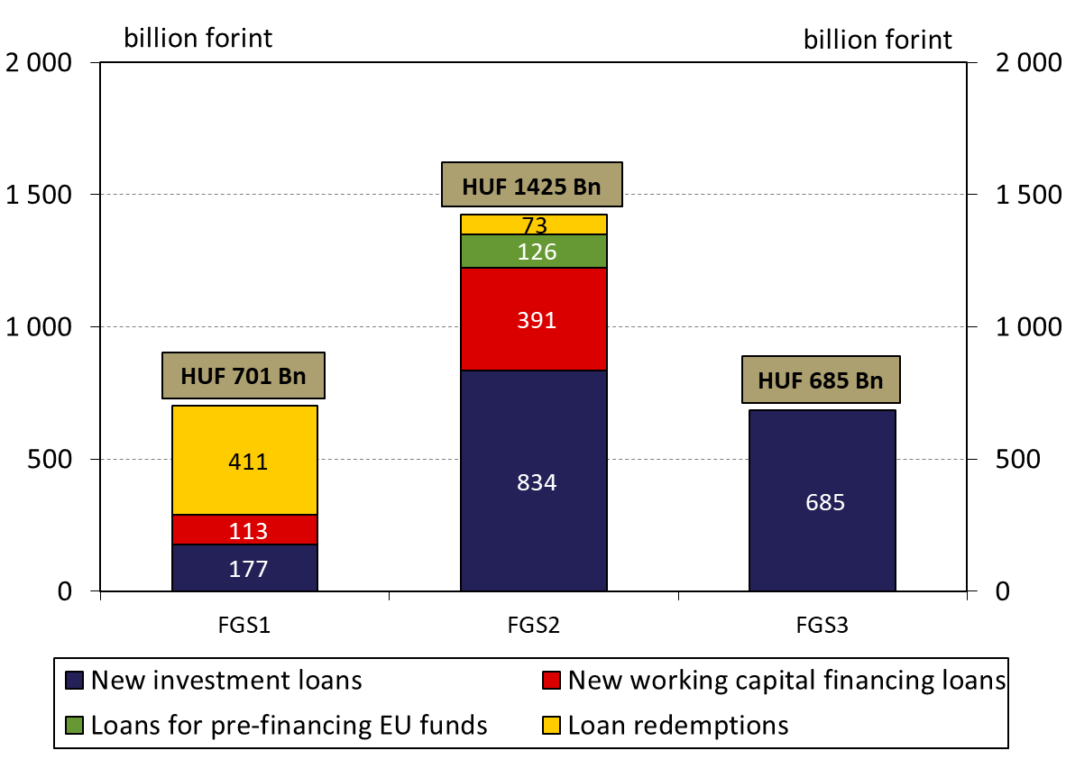
FGS’s impact on the lending activity
A total of Bn 2800 HUF had been drawn down by around 40 000 enterprises between 2013 and 2016.
Distribution of loan purposes in the different phases of FGS
Sum of loan types in the 3 phases :
HUF 1696 billion investment loans and leasing
HUF 504 billion working capital financing loans,
HUF 126 billion loans for pre-financing EU funds
HUF 484 billion loans remptions
The role of investment loans increased (the 60% of the total amount)
Note: data for the 2nd phase of the FGS include the loans extended under the FGS+, worths Bn 23 HUF

Slide 34
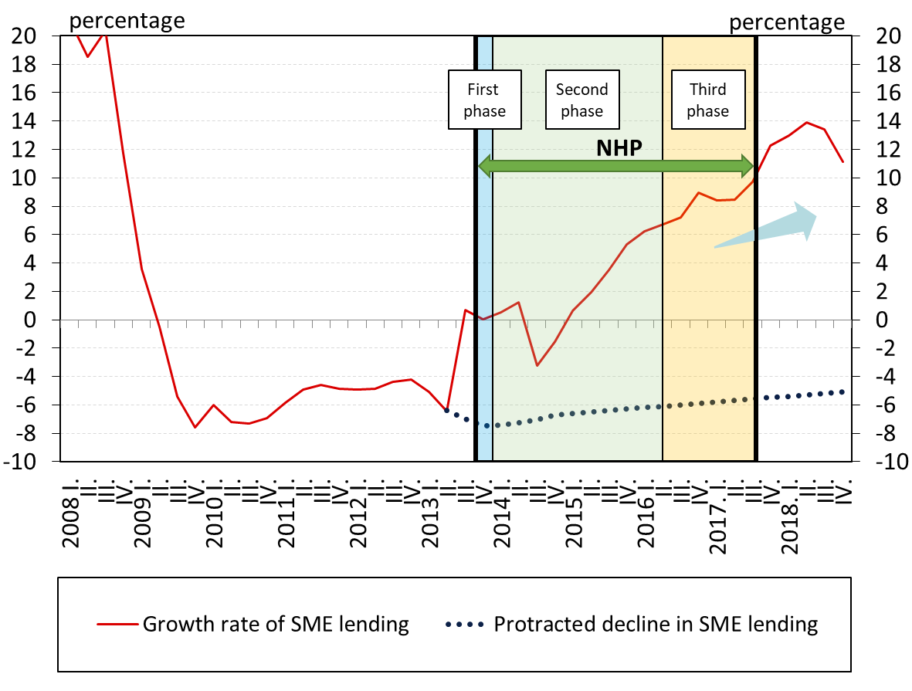
The FGS contributed to turnaround in SME lending and also had a significant impact on the real economy
Based on the MNB’s latest estimates, the impact of the FGS on economic growth was around 3.5 percent between 2013 and 2018 through easing credit conditions and thereby supporting investments.
Further analysises can be found at MNB/Monetary Policy/Funding for Growth Scheme (FGS)

Slide 35
Self-financing programme
On 24 April 2014, MNB announced the Self-financing programme that aimed to support reduction of external vulnerability.
In order to increase the share of domestic sources within the total financing structure:
  Debt Management Agency renewed the maturing FX-bonds with forint denominated issuances,
  that became achievable by the gradual shift from FX to forint issuances and,
  the increase in the domestic demand
MNB supported the implementation of the self-financing concept by the modification of certain parameters of its monetary policy instruments

Slide 36
The whole set of moneraty policy instruments of the MNB has been renewed during the Self-financing programme

Slide 37
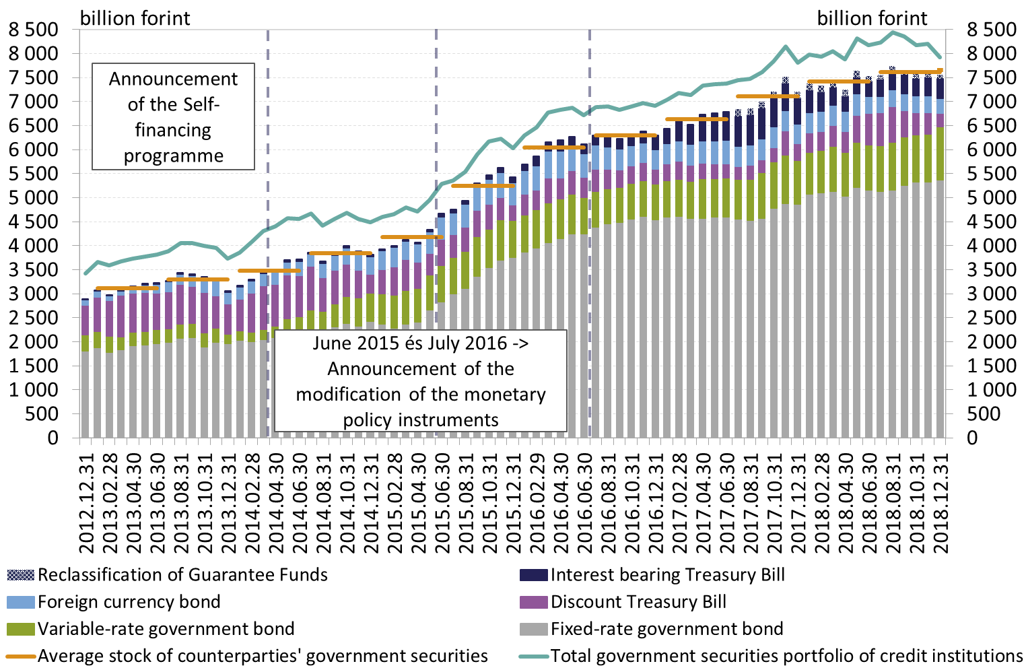
In the active phase of the Self-financing programme (2014-2016) the stock of banks’ liquid securities increased significantly
The government securities portfolio of counterparties by type of securities, and the development of total government securities portfolio of credit institutions

Slide 38
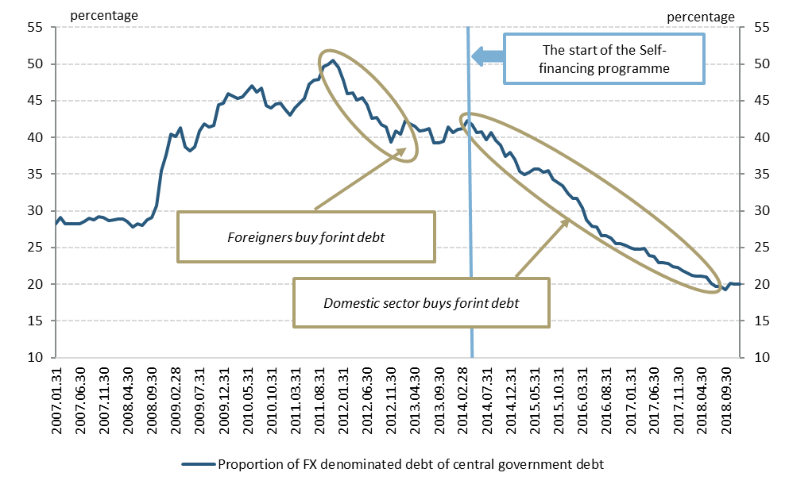
As the result of the programme the proportion of the FX denominated debt of the central government debt decreased significantly by the end of 2018
The proportion of the FX denominated dept of the central government debt between 2007 and 2018

Slide 39
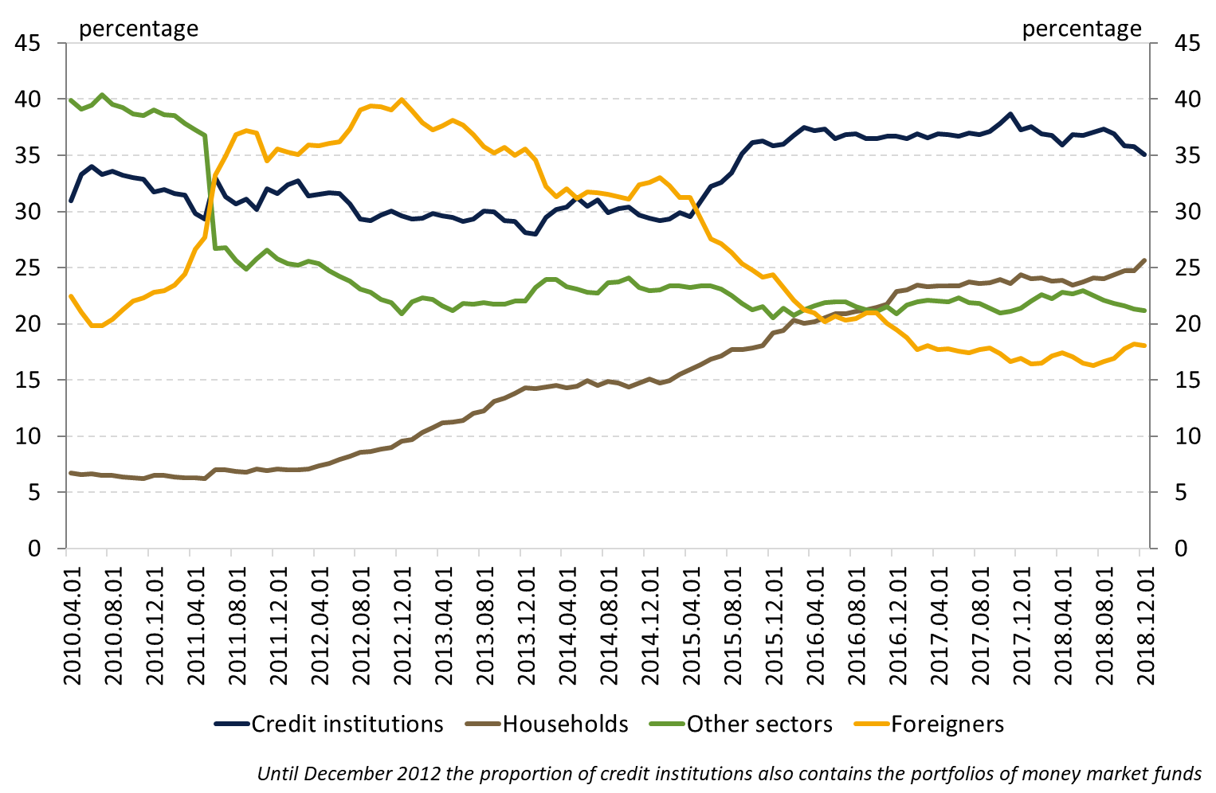
As the result of the programme the proportion of banks and households at the forint government securities market increased while the proportion of foreigners decreased significantly by the end of 2018
Proportion of owners at the forint government securities market

Slide 40
FX spot tenders related to the phasing out of foreign currency consumer loans
After 2013 the MNB determined the phasing out of foreign currency consumer loans as a strategic goal, the conversion of these loans occurred at the first possible date, in 2014-2015.
Euro sale tenders (October 2014 – March 2015) related to settlement and conversion of foreign currency consumer loans and Swiss franc sale tenders related to forint conversion of foreign currency non-mortgage consumer loans (August - September 2015):
  Form:
    Euro sale tenders (HUF 9,1 billion):
      Conditional instrument: EUR/HUF spot + 1-week EUR/HUF FX-swaps rolled over until 30.03.2016 at the latest;
      Unconditional instrument: cross-currency interest rate swap (CIRS) combined with a spot transaction facility
    Swiss franc sale tenders (HUF 0,6 billion): CHF/HUF spot + CHF/HUF FX-swaps rolled at the most until the 52nd week following the first tender
  Objective: to manage/reduce the currency risk of banks
  In case of conditional instrument: condition on the reduction in short-term (with a residual maturity of less than one year) external debt
  Expected effect, result:
    FX spot tenders contribute to the reduction of foreign currency exposure of the private sector and the short-term external debt of domestic banks, thereby to the mitigation of the country’s external vulnerability
    Decrease of the MNB’s total assets, which can improve the profitability of the central bank

Slide 41
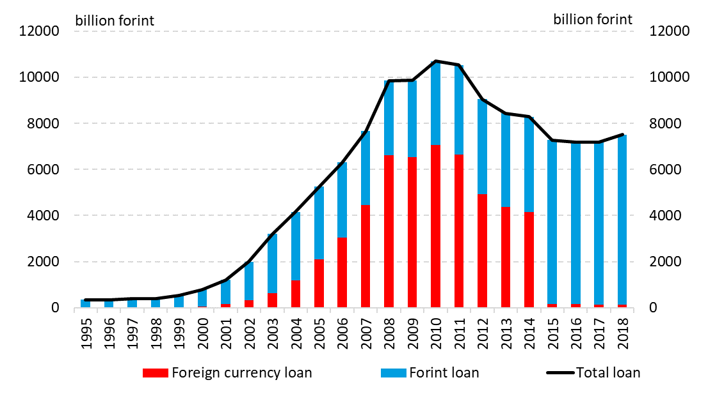
Evolution of foreign currency and forint loan portfolios of households
By phasing out of foreign currency consumer loans the Hungarian financial system has taken an important step towards a healthy balance sheet structure, while the interest rate transmission and financial stability have also improved substantially.
Evolution of foreign currency and forint loan portfolios of households

Slide 42
Growth Supporting Programme: Market-Based Lending Scheme (MLS)
In January 2016, the MNB launched the Growth Supporting Programme (GSP), which facilitates banks’ return to market-based lending with a gradual phase-out of the Funding for Growth Scheme (FGS) and the announcement of the new Market-Based Lending Scheme (MLS).
Market-Based Lending Scheme aimed to reduce credit risk and boost economic growth through lending to SMEs. As part of the programme MNB introduced:
  Interest rate swap conditional on lending activity (LIRS tender)
    3-years IRS that helps to manage banks' interest rate risk arising from lending to SMEs, through partially taking over of this risk by the MNB
    All swaps matured at the end of February 2019
  Preferential deposit facility
    Designed to help banks’ liquidity management and provides an incentive to boost their lending activity
    Phased out at the end of February 2019

Slide 43
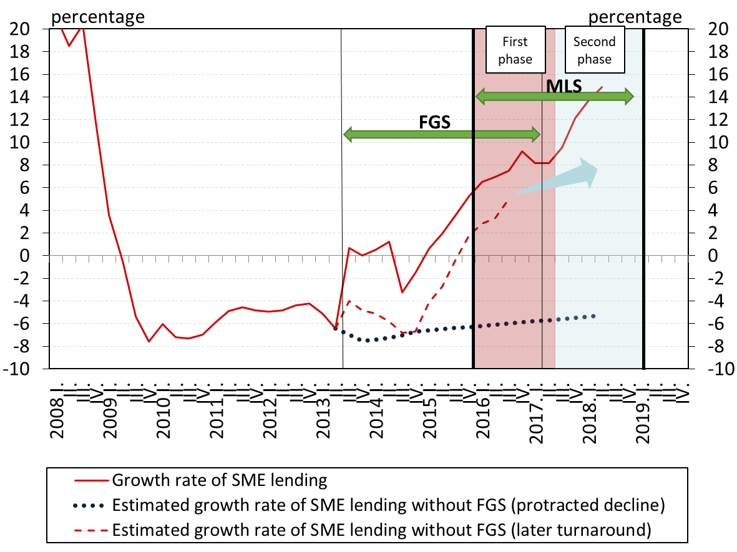
The MLS has contributed to keep SME lending dynamic even after the phasing out of FGS

Slide 44
Monetary policy instruments affecting long-term yields
  MIRS (Monetary policy interest rate swap facility):
      From January 2018, with 5-year and 10-year maturity, available at no conditionality
      Phased-out at the end of 2018 (total volume reached 1100 billion forint)
  Mortgage-bond purchase programme:
      Secondary market purchases (from mid-January 2018 till September 2018)
      Primary market purchases (from March 2018 till December 2018)
      To support the development of the Hungarian mortgage-bond market the MNB set the terms of the programme in order to increase liquidity and transparency of this market
Objectives:
supported the extension of loose monetary conditions to long-term marturities and the long-term maintenance of the central bank base rate
supported the market stability by their market presence during a global market turbulance in spring and summer 2018
contributed to the development of mortgage-bond market
Contributed – with other monetary policy instruments and regulations - to the decrease of banks’ interest rate risk thereby further spreading long-term, fixed-rate mortgage loans

Slide 45
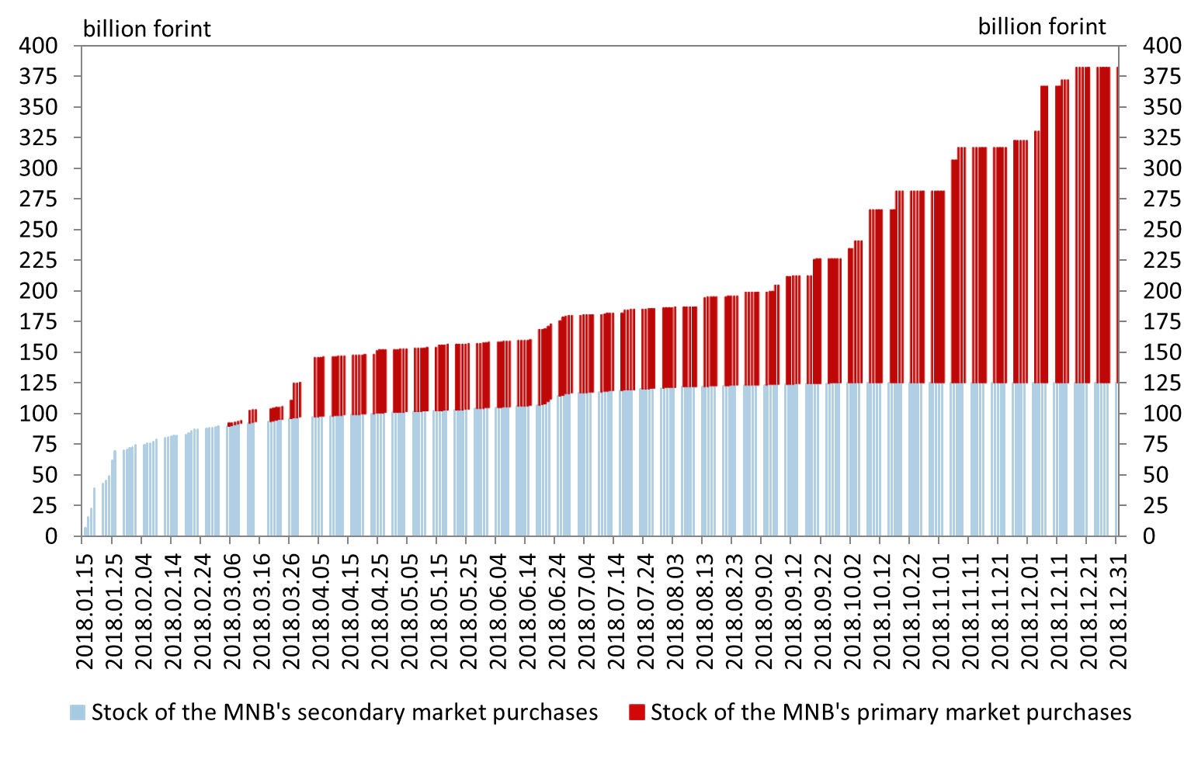
Mortgage-bond stock of the MNB

Slide 46
TOPICS
Monetary policy instruments from January 2019
Modification of monetary policy instruments in the 2013-2018 period
Determinants of interbank liquidity, shocks hitting the liquidity of the banking system and their management
Role of monetary policy instruments in the inflation targeting regime

Slide 47
Components of interbank liquidity
Interbank liquidity is determined by the following factors:
    Incoming and outgoing transfers from the Treasury Single Account
    Cash in circulation
    Monetary policy instruments of the central bank (including the associated interest rate incomes and expenditures)
    Central banks can steer the interbank liquidity by two ways:
    On a discretionary basis, they set the amount of liquidity that will be absorbed or lent into the market time to time,
    Direct influence, through the standing facilities the central bank defines the interest rates on which the banks can place or withdraw the necessary liquidity.
Autonomous factors*
*Autonomous factors: nor the MNB neither banks can infuence their evolution

Slide 48
Liquidity shocks of the banking system
There is fundamental difference between liquidity shocks hitting individual banks and the banking system as a whole:
  On the individual bank level risk takes the form of unpredictable customer transactions (inflows and outflows as well)
  Individual liquidity shocks are manageable in the interbank money market in general
Shocks hitting the banking system as a whole reach all individual banks at the same time (in a different extent).
  Autonomous liquidity factors: transactions of Treasury account, currency in circulation
  MNB transactions: tenders, FX transactions, interest payment
  Central bank instruments support the management of system-wide liquidity shocks (minimum reserves, interest rate corridor, overnight and longer term loans)

Slide 49
One of the sources of shocks hitting the banking system is the variability of the Treasury Single Account (TSA)
Government expenditures increase, revenues decrease the liquidity surplus of the banking system:
  Majority of government expenditures (e.g. wage disbursements of the public sector, pension payments) arrive to current accounts held at banks, therefore they increase the liquidity of banks through the intermediation of payment systems (the liabilities side of the MNB balance sheet is restructured)
  In the case of tax income and social security contributions, enterprises transfer money from their bank accounts to the Treasury account reducing the liquidity of the banking system
  Debt financing items have a similar effect on the liquidity of the banking system: interest payments and redemptions related to public debt mean government payments to bank customers and thus increase liquidity, while the issuance of government securities decreases the liquidity of banks

Slide 50
Volatility of treasury accounts is the most important autonomous liquidity factor
Daily movements in the Treasury Single Account (TSA) are hardly predictable and imply a significant (HUF 400-500 billion a day in some cases) liquidity effect.
Smoothing of the Treasury account supports the reduction of the volatility of money market yields:
  When the available liquidity of the banking system increases and the Treasury account balance decreases due to government expenditures (e.g. pension payments), borrowing by the ÁKK (passive repo) elevates the balance on the Treasury account and decreases the liquidity surplus of the banking system at the same time
  When government income (e.g. VAT) increases the Treasury account balance and the liquidity surplus of banks decreases, equilibrium is achieved by money market lending (active repo) by the ÁKK

Slide 51
Other source of shocks affecting the aggregate liquidity of the banking system is the change in demand for cash
Changes in the demand for cash cause minor liquidity shocks (daily HUF 40-50 billion maximum), and some of its factors are well predictable:
On the one hand the demand for cash is driven by seasonal factors:
  Weekly seasonality: demand for cash decreasing in the first half of the week and increasing in the second
  Seasonal patterns within a year: hike in the demand for cash holding before end-of-the-year and mid-year multi-day holidays, while decreases after holidays
On the other hand economic growth and inflation also affect the demand for money
  Opportunity cost of holding cash as non-interest bearing instrument varies with inflation. The decrease (increase) of inflation is generally accompanied by the rise (drop) of the growth rate of cash holdings of the public

Slide 52
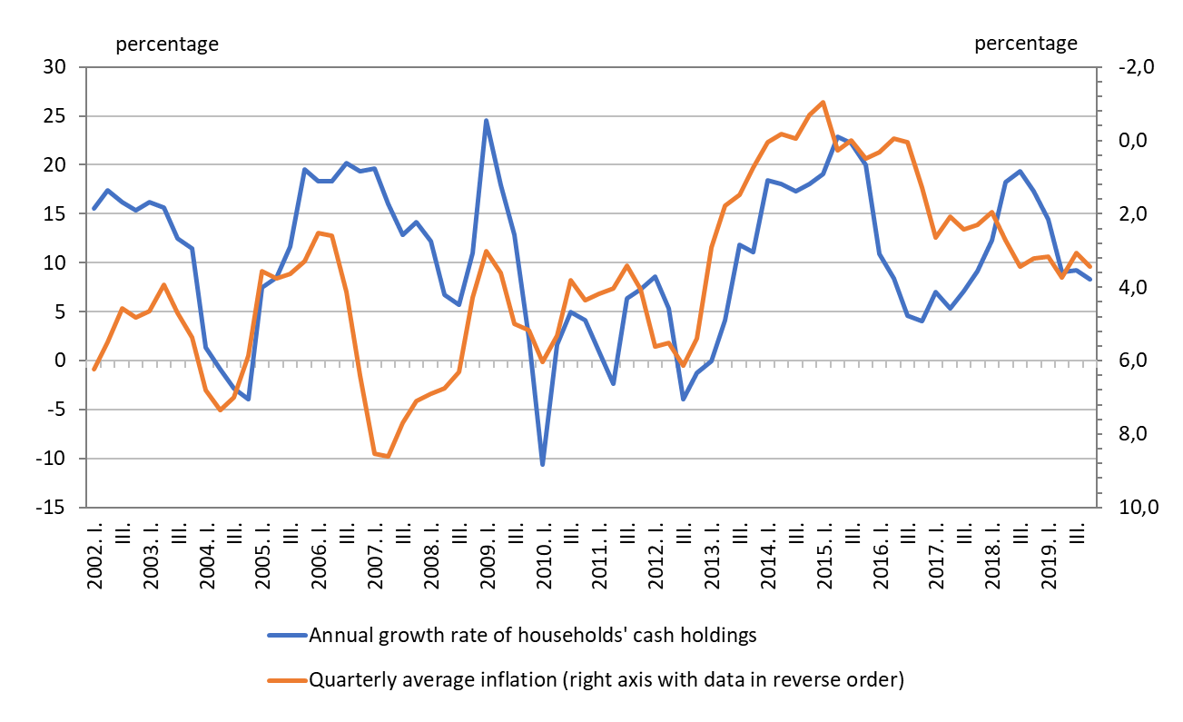
Year-on-year growth of cash holdings of the public and inflation (quarter/corresponding quarter of previous year) between 2002 and 2019Q4

Slide 53
Opportunities of interbank liquidity management
Expected weekly average liquidity
  Liquidity prognosis published by the MNB on a weekly basis to support banks’ liquidity management
      Every Wednesday at 9 am, the central bank publishes its prognosis that captures the average total level of all factors that impact the interbank liquidity in the next 7 days. The publishing date can vary in case of holidays.
Practices to handle intraweek liquidity shocks
  Change of balance of bank account (reserve requirements need to be met on a monthly average),
  Change of preferential deposit account (banks have a daily limit on their preferential deposit accounts)
  Short term lending or deposit taking on the interbank market
  Use of overnight standing facilities (O/N deposit or collateral loan)
  Participation on the MNB’s regular FX-swap tenders

Slide 54
Bibliography
Magyar Nemzeti Bank Jelentés 2013-2019
Future strategic framework for the set of unconventional monetary policy instruments affecting short-term yields (18. September 2018)
The Hungarian Way – Targeted Central Bank Policy (2017)
Modern jegybanki gyakorlat (2017)
Pál Péter Kolozsi – Mihály Hoffmann: Reduction of External Vulnerability with Monetary Policy Tools (2016)
Márton Nagy – Dániel Palotai: The MNB further reduces Hungary’s vulnerability by reforming its policy instruments (2015)
Pál Péter Kolozsi – Ádám Banai – Balázs Vonnák: Phasing out household foreign currency loans: schedule and framework* (2015)
The Magyar Nemzeti Bank’s self-financing programme (April 2014 – March 2015)
Csaba Balogh: Monetary policy instruments of the Magyar Nemzeti Bank (2009)
Further literature is available under the following links:
https://www.mnb.hu/en/monetary-policy/monetary-policy-instruments/studies-presentations-and-handbooks-about-the-operational-framework/studies
https://www.mnb.hu/en/monetary-policy/monetary-policy-instruments/studies-presentations-and-handbooks-about-the-operational-framework/handbooks

