Slide 1
Financial stability report
November 2020
Bálint Dancsik | Head of Department
Financial System Analysis Directorate
Press conference | 30 November 2020

Slide 2
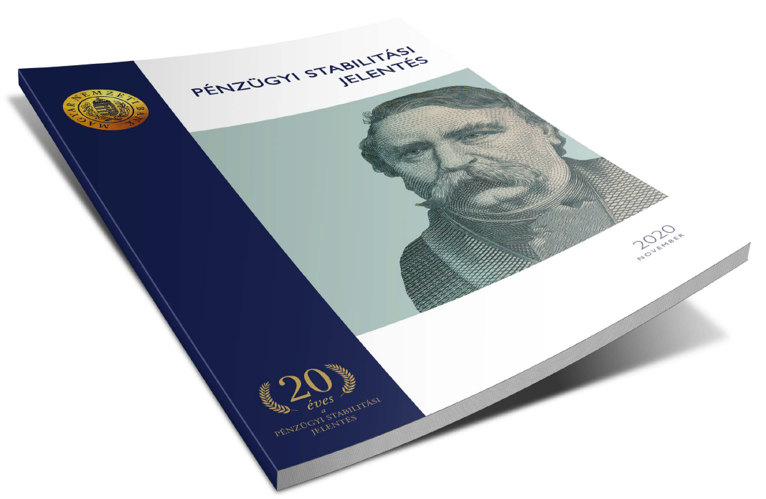
This year marks the 20th anniversary of the Financial Stability Report

Slide 3
the last 20 years in numbers
2000
Total assets:
HUF 9,000 Bn
Private sector deposits:
HUF 4,700 Bn
2020
H1
Total assets:
HUF 47,000 Bn
Private sector deposits:
HUF 20,000 Bn
Private sector loan portfolio:
HUF 3,800 Bn
Private sector loan portfolio:
HUF 16,400 Bn
Equity:
HUF 823 Bn
Equity:
HUF 4,700 Bn
12-month profit after tax:
HUF 82 Bn
12-month profit after tax:
HUF 304 Bn
Note: data refers to the entire credit institutions sector.

Slide 4





the last 20 years in numbers
2000
Max/min
2020Q2
Retail
loans / GDP*
FX
5%
31%
16%
HUF
Corporate Loans / GDP*
FX
24%
29%
19%
HUF
Return on equity
12%
24%
-17%
6.8%
Rate of loans overdue for 90+ days
1.8%
19.6%
1.7%
Loan-to-deposit ratio
82%
145%
75%
Note: *only taking loans received from credit institutions into account

Slide 5
The main messages of the report
External environment is characterized by a protracted and divergent recovery by industry and profession, so economic support measures have remained in the forefront.
Central bank and government programmes maintain lending. After corporate lending stalled, SME lending gained new momentum in the third quarter, while the mortgage market picked up.
The moratorium provide temporarily support in portfolio quality, although credit risks as well as forward-looking impairment increase.
Despite the higher risk costs, the banking system is characterized by a net profit in the first-half of the year and a strong capital position.
The liquidity and capital position of the domestic banking system has improved in the last six months, strengthening its resilience even to a longer recovery.
Risks from the commercial real estate market are significant due to deteriorating fundamentals, however, the ratio of banks' exposure to the capital is low.
Even in the severe stress scenario, where the growth of the economy lags behind the baseline trajectory by 6-7 percentage points cumulatively in two years, the banking sector would have only a small amount, a manageable need for additional capital.

Slide 6
Trends in lending
Liquidity position
International environment
Real estate markets
Credit risks and capital position

Slide 7
Recovery may be slower than expected and heterogeneous in pace among sectors
The crisis affects the economic sectors and the segments of the labour market to varying degrees. Instead of a „V” shaped bounce back, upturn might be diverging, „K”-shaped, in parallel with how individual sectors are impacted.
Change in sectoral employment and sectoral gross value added in the European Union between 2019 Q2 and 2020 Q2
Eurozone and global growth forecasts
Note: The size of the bubble represents the number of employed persons in each sector in 2020 Q2. Seasonally and calendar adjusted data for gross value added. Source: Eurostat, OECD, IMF, European Commission, S&P, Thomson Reuters Datastream, ECB, Fitch

Slide 8
Government and central bank interventions mitigated first-wave impacts
Escalating second wave and protracted recovery might require additional economic support measures, which may be challenging in some countries due to increased debt levels and the declining leeway for monetary policy actions.
Expected change in gross government debt as a proportion of GDP in 2020 in the EU Member States
Central bank balance sheets as a proportion of GDP
Note: (Left-hand chart) MNB calculations, based on the European Commission's forecasts for 2020. Source: Eurostat, national central banks

Slide 9
Trends in lending
Liquidity position
International environment
Real estate markets
Credit risks and capital position

Slide 10
Abundant Liquidity reserves are supported by central bank measures
The expanding liquidity of the banking system was also reflected in the development of the liquidity coverage ratio (LCR), which rose to 175 percent.
Operational liquidity reserves of the banking sector expanded by more than HUF 3,000 billion compared to the February level.
Distribution of individual institutions' LCR levels weighted in proportion to the balance sheet total
Source: MNB

Slide 11
As a result of liquidity-providing measures, the banking sector’s liquidity underwent a transformation
More than two thirds of the deposits placed with the central bank are one-week deposits
Holdings amounting to some HUF 2,000 billion mostly with a 5-year maturity built up in the banking sector from the collateralized central bank loans.
Until October 2020 the total amount purchased by MNB:
- HUF 200 Bn mortgage bonds,
- HUF 400 Bn corporate bonds,
- HUF 600 Bn government bonds.
Developments in central bank deposits of banks and assets of the central bank providing liquidity
Source: MNB

Slide 12
The liquidity stress index fell close to its theoretical minimum
The vast majority of banks have a sufficient liquidity buffer to meet the regulatory requirements even in the event of a severe liquidity stress.
LIQUIDITY STRESS INDEX
Note: The indicator is the sum of the liquidity shortfalls in percentage points (but a maximum of 100 percentage points) compared to the 100-per cent regulatory limit of the LCR, weighted by the balance sheet total in the stress scenario. The higher the value, the higher the liquidity risk. The alternative results disregarding the spring 2020 changes to the monetary policy toolkit are marked with blue background. Source: MNB

Slide 13
Trends in lending
Liquidity
International environment
Real estate markets
Credit risks and capital position

Slide 14
2008 vs 2020: state programs (moratorium and loan programs) maintain the expansion of loans
Participation in the moratorium in proportion to the eligible loan portfolio (September 2020): Corporations: 41 per cent, Households: 57 per cent
Non-financial corporations
Households
Percentage change in the loan portfolio after the outbreak of the crisis in 2008 and the appearance of the coronavirus in Hungary
Note: Only taking into account the effect of transactions (disbursements and repayments). The impact of the moratorium and government/central bank loan programs has not been excluded from growth rates. t = 2008 September and 2020 March. Source: MNB

Slide 15
lending activity can recover quickly After a temporary halt in corporate lending
Annual corporate lending dynamics slowed to nearly half, to 7.8 percent in September, however, a 2.8 percent increase in the loan portfolio was observed in the third quarter.
FGS Q3:
HUF 570 billion in contracts
accounted for 69 per cent of corporate lending in the third quarter of 2020
The Monetary Council increased the FGS Go! budget by HUF 1,000 billion.
Growth rate of outstanding loans of the overall corporate sector and the SME sector
Note: Transaction based growth rates. Source: MNB.

Slide 16
A smaller proportion of banks tightened lending conditions than in the 2008 crisis
During the 2008 crisis, the liquidity situation of banks immediately led to a tightening of lending conditions for nearly 90 per cent of respondents, deepening the economic crisis. The 2020 shock hit banks in a much more stable state.
Changes in credit conditions in the corporate segment
Note: Net percentage of respondents tightening/easing credit conditions weighted by market share. Source: MNB, based on banks' responses

Slide 17
The size of new guarantee programs to GDP is significantly lower than the European average
A significant extension of state guarantee schemes supporting risk sharing could also facilitate banks’ willingness to lend and thus to increase the outstanding corporate loan portfolio.
Credit conditions eased in the first half of the year only in countries announcing high-volume guarantee programs.
The easing of conditions also affected credit dynamics in these countries.
The size of state guarantee programmes introduced as a result of the coronavirus in the member states of the European Union
Note: As a proportion of GDP in the first quarter of 2020 and outstanding corporate loans in the first quarter of 2020. Source: MNB, IMF, Bruegel

Slide 18
state-subsidised loan products support the expansion of household lending
Since mid-2019, one third of new retail lending has been state-subsidised. Stock of prenatal baby support loans approached HUF 1,000 bn in November 2020.
Annual growth rate of household loan portfolio in the credit institution sector in September 2020: 15.6 %
Disregarding the impact of the moratorium:
11.6 %
Disregarding the impact of the moratorium and the additional effect of prenatal baby support loans:
5.6 %
New household loans in the credit institution sector
Note: The effect of the early repayment scheme and the refinancing related to the FX-conversion are excluded. Consumer and other loans denotes vehicle loans, hire purchases and other loans, excluding prenatal baby support loans. Source: MNB

Slide 19
Banks tightened both consumer and housing lending conditions in 2020 H1
In the third quarter, the vast majority of banks perceived an increase in demand for housing loans, while there was no change in consumer credit.
Changes in credit conditions and credit demand in the household segment
Note: Net ratio is the difference between tightening and easing banks, and the banks indicating stronger and weaker credit demand, weighted by market share. Source: MNB, based on banks' responses

Slide 20
Forecast: Government programs continue to sustain stock expansion
The amortization of the loan portfolio is reduced by the moratorium, and new lending is supported by extensive state and central bank programs. In 2020, corporate loans may grow by 6-9 per cent and household loans by 8-12 per cent.
Forecast for lending to corporations
Forecast for lending to households
Note: Transaction-based, annual growth rates. In case of household loans, lombard loans are excluded from 2019 Q3 data. Source: MNB

Slide 21
Trends in lending
Liquidity position
International environment
Real estate markets
Credit risks and capital position

Slide 22
The continuous rise in house prices was already interrupted before the outbreak of covid-19
In terms of the value of bank collateral, it is favourable that there has been no sudden, large-scale fall in house prices, while market liquidity remained.
Deteriorating fundamentals:
High level of house prices compared to income
Unfavourable labour market prospects, confidence indices
Favourable financing environment:
Historically low interest rates
State subsidized loan products, new housing benefits
MNB housing price index by settlement types (2010 average = 100 per cent)
Note: The values of the price indices may be revised significantly in a year after the reference period, because the property transaction data used for the calculations are only available comprehensively with a considerable lag. Source: MNB

Slide 23
peaking commercial real estate developments in the cycle meet declining demand
Due to the time needed for developments commercial real estate market follows changes in real economy with a lag, which causes an oversupply at the end of the economic cycle, and late adaptation of supply in the upswing phase.
Uncertain prospects of international tourism are paralleled with intense development activity in Hungary, therefore there is a risk of oversupply in the hotel market.
The segment's loan portfolio to credit institutions:
HUF 181 Bn
Number of opened and planned hotel rooms in Hungary and annual changes in tourism nights in Hungary
Note: For changes in the number of tourism nights, the latest data is based on June 2020 and June 2019.
Source: Hungarian Hotel & Restaurant Association, HCSO

Slide 24
The banking system’s risky exposure to the real estate market is significantly lower than in the previous crisis
Mortgage loans with high loan-to-value ratio (70%+) to capital
2008:
137%
2020:
13%
Commercial real estate project loans to capital
2008:
66%
2020:
22%
Exposure of the banking system to risky real estate market assets
Note: In case of retail mortgage loans we consider those with a high above 70 per cent loan-to-value ratio as risky exposure. Source: MNB

Slide 25
Trends in lending
Liquidity position
International environment
Real estate markets
Credit risks and capital position

Slide 26
The moratorium temporarily prevents delays, but credit risks are increasing
(not an NPL forecast!)
Overall, we estimate that vulnerable loans
in the moratorium:
May account for 15-20 percent
of the corporate loan portfolio.
May account for 5-10 percent of households with credit.

Slide 27
The financial situation of those participating in the moratorium is worse
53 per cent of households in the moratorium have an income lower than HUF 300,000, while this proportion is only 35 per cent for those who opt out of the moratorium.
41 per cent of those who are participating in the moratorium have a maximum of one earner, compared to 34 per cent of those who opt out.
If all earners lost their jobs in your household, how long would your household be able to maintain its current standard of living?
Source: MNB household moratorium survey, August 2020

Slide 28


Credit losses will increase due to the forward-looking nature of impairment recognition
NPL-rates are at their 15–20-year minimum:
Corporate (90+): 1.5%
Household (90+): 2.7%
Both delinquency rates and credit losses are going to increase after the moratorium expires.
2019
2020
2021
Jún
Szept
Dec
Mar
Jun
Sept
Dec
Mar
Jun
Sept
Dec
Dec
General payment moratorium
Targeted payment moratorium
Ban on loan
withdrawal
Loan loss provision stock:
Corporate:
2019 Q4: HUF 247 bn
2020 Q2: HUF 312 bn
Household:
2019 Q4: HUF 225 bn
2020 Q2: HUF 254 bn
Estimated rate of participation:
Corporate loan portfolio: 14-17%
Household loan portfolio: 22-24%

Slide 29
Weak profitability may become a serious challenge for banks
After-tax profit according to non-consolidated data:
- end-2019 Q2:
HUF 266 bn
- end-2020 Q2:
HUF 68 bn
The drop in profitability is mainly attributable to impairment and provisions.
Distribution of 12-month rolling after-tax return on equity of credit institutions weighted by the balance sheet total
Note: Monthly data. Source: MNB

Slide 30
The release of capital buffers increased banks’ free capital significantly
Distribution of banks according to the level of own funds over the overall capital requirement weighted by the balance sheet total
Note: Q2* takes into account the easing of buffer requirements in place as of June 2020. The categories indicate the level of own funds above the overall capital requirement as a ratio of the total risk exposure amount. Own funds include total interim or year-end profits as well. Source: MNB

Slide 31
The sector’s capital adequacy would not be shaken even by outstanding NPL Ratios
The free capital of the banking system would not be depleted even in the extreme case of a 20 and 30 per cent NPL ratio for loans outside the moratorium and loans under moratorium respectively, assuming a 60 per cent LGD ratio.
CAR level of the Banking system at hypothetical non-performance parameters
Note: In the calculation of the CAR levels shown in the table, immediate sales of non-performing loans at various hypothetical NPL and LGD ratios were assumed on June 2020 data for the total bank loan portfolio of the private sector. Source: MNB

Slide 32
Scenarios of the solvency stress test
In the stress scenario, growth would be short of the baseline scenario by a cumulative 6-7 per cent over two years, accompanied by rising interest rate and weakening exhange rate.
Stress scenario assumptions:
severity of the COVID-19 pandemic,
slower than anticipated recovery of Hungary’s markets.
Consequences:
increased risk avoidance in the private sector,
businesses postpone planned investments and introduce lay-offs,
damage to production capacities.
GDP GROWTH RATE IN THE SCENARIOS
Source: MNB

Slide 33
only a small part of the sector would become vulnerable, Even in a severe stress scenario
Banks would need to increase capital by a manageable amount of about HUF 86 billion in order to meet all the currently valid capital adequacy requirements.
Distribution of the capital adequacy ratio based on the number of banks
Note: Vertical line: 10–90-per cent range; rectangle: 25–75-per cent range. Source: MNB

Slide 34
The main messages of the report
External environment is characterized by a protracted and divergent recovery by industry and profession, so economic support measures have remained in the forefront.
Central bank and government programmes maintain lending. After corporate lending stalled, SME lending gained new momentum in the third quarter, while the mortgage market picked up.
The moratorium provide temporarily support in portfolio quality, although credit risks as well as forward-looking impairment increase.
Despite the higher risk costs, the banking system is characterized by a net profit in the first-half of the year and a strong capital position.
The liquidity and capital position of the domestic banking system has improved in the last six months, strengthening its resilience even to a longer recovery.
Risks from the commercial real estate market are significant due to deteriorating fundamentals, however, the ratio of banks' exposure to the capital is low.
Even in the severe stress scenario, where the growth of the economy lags behind the baseline trajectory by 6-7 percentage points cumulatively in two years, the banking sector would have only a small amount, a manageable need for additional capital.

Slide 35
Thank you for your attention!

