Slide 1
What does it cost to pay? Sweden 2009
ECB-MNB Budapest, November 15
Björn Segendorf och Thomas Jansson

Slide 2
Agenda
Background
Problems
Results
Expected and actual choice b/w cash and debit card

Slide 3
Background
Objective: estimate the costs for P2B payments
Cash, cards, credit transfers, direct debits
Common methodology, 13 EU MS
Data from 2009
Riksbank, CITs, banks and firms (2010)
Direct and indirect costs
Consumer costs calculated theoretically
Notes:
Länder som deltar: DK, EE, ES, FI, GR, HU, IE, IT, LV, NL, PT, RO, SE

Slide 4
Background – social costs
Value of consumed resources
Differ from private costs
Payments & fees between actors should not be included …
Seignorage
Kickbacks
Value of stolen cash
Fraud

Slide 5
Background - obstacles
Data: costs, value, volume
”Small” problems for CB, CITs and banks. Large market share
Firms: small sample (11) but lengthy interviews
Check for internal consistency and with other data
No official transaction data for cash to benchmark against
Aggregation of data
Easy for CB, CITs and banks
Difficult for firms
Small sample
Aggregation weights from household consumption data
2009: an extreme year?

Slide 6
Background – value and volume P2B
Notes:
Kontanter används förhållandevis lite. Knappt 40% av POS är kontant medan motsvarande i både NE och CA är ca 60-70 %
2,8% relativt BNP är lågt internationellt sett.
Vi använder mycket kort (höga siffror internationellt) och mycket överföringar men inga checkar

Slide 8
Cards, cash and efficiency
Different cost structure for cash and cards
Cards: ”fixed cost” per transaction
Cash: cost increases with transaction size
Conclusion: Threshold in transaction amount where the cost for cards equal the cost for cash
Below threshold: Cash is cheaper
Over threshold: Card is cheaper
However, private incentives of consumers are different

Slide 9
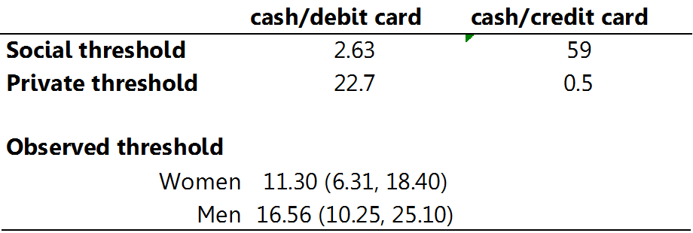
Calculated and observed thresholds
(USD)
(USD)
Conclusions
Large difference b/w social and private thresholds
Consumers does not act in accordance to social thresholds
Too much cash
Not clear that consumers act in accordance to economic incentives

Slide 10
Thank you!

