Slide 1
Outline
Does ‘globalisation’ affect monetary policy?
Unconventional monetary policy (UMP) – small open economy perspective
What do we know about deflation?
A few thoughts on the ‘new’ central banking paradigm

Slide 2
How much does increasing globalisation affect monetary policy?
    Global economy has become increasingly interconnected
    Evidence of a global financial cycle? (H. Rey)
    Global pool of liquidity through interconnected financial sector leads to monetary policy spill-overs
    Avenues for shock propagation and amplification are more open than ever before – in CEE also thru banking system integration
    Financial fragility leakages
    To what extent has globalisation moderated inflation pressures?

Slide 3
Great moderation of inflation?
    Globalization and increased trade integration have reduced barriers to market access
    Globalization has led to the relocation of production → the relative price of tradable goods declines → their fall has contributed to lower overall inflation
    More intense global competition prevents firms from raising prices and puts downward pressures on wages in many sectors;
    Broad productivity gains, or
    Cyclical conditions?

Slide 4
Last 15 years have seen broad productivity gains in EM
Source: The Conference Board.

Slide 5
..monetary conditions are becoming more influenced by non-dometic factors..
    Globalization may have reduced the strength of the cyclical response of inflation to output fluctuations
      prices of many items that are produced or consumed at home are increasingly determined by foreign demand and supply factors rather than local factors.
      financial integration allows for larger trade balance deficits or surpluses and, thereby, weakens the relationship between domestic output and demand
    International capital flows transmit monetary conditions globally, even under floating exchange-rate regimes
    More of an issue for small open economies, than for a few big ones

Slide 6
UMP – Small Open Economy Perspective
Is it possible to run countercyclical monetary policy in a small open economy with stable exchange rate regime?
  According to conventional wisdom – NO!
  But, in real life – YES – financial market imperfections limit perfect capital mobility, so can CBs, behaviour of economic agents is path dependent...
      central banks can widen their space for maneuver with the use of unconventional monetary policy and/or macroprudential measures
What have we learned from the crisis
  It is absolutely critical to act in time
  It is impossible to make-up for a delay, but better to act at any time than not to act at all
  In order to act in time, one should often try to think out of the box (reading from history helps)

Slide 7
(Unconventional) Monetary Policy
- pre-crisis -
Bank (regulatory) capital adequacy ratio (CAR)
U(M)P in the pre-crisis period
  CNB – one of those central banks that acted early to take care about financial stability and external vulnerabilities build-up
  use of UMP and macroprudential measures to fight against excessive capital inflows (capital inflow tax, high fx liquidity requirements,tax on credit growth, increasing risk-weights for lending to unhedged borrowers...)
  success in moderating banks’ credit growth
  success in curbing banks’ foreign indebtness
  creation of sizeable f/x liquidity buffers
  doubling of banks’ Tier 1 capital
  significant, although limited, impact on curbing overall external vulnerabilities

Slide 8
(Unconventional) Monetary Policy
- post crisis -
U(M)P in the post-crisis period
  At the strike of the crisis, critical objectives were:
    to preserve confidence (exchange rate stability)
    to facilitate refinancing of all domestic sectors, since foreign markets were effectively temporary closed (LOLR)
  huge relaxation of domestic currency and f/x liquidity (approx. 13 percent of GDP)
  possible thanks to the pre-crisis creation of buffers
  After initial strike, objective turned to facilitate credit activity
  creation of structural excess liquidity
  corporate lending programs to banks syndicated with HBOR – 2010-14 (the early Croatian version of Funding for Lending)
    incorporates risk sharing element
  corporate lending programme to banks without HBOR – from November-2013

Slide 9
Pre and post crisis

Slide 10
Countercyclical monetary policy post crisis - high(est) cumulative growth of corporate lending...
Changes of loans to enterprises, in % (8/2008 – 3/2014)
Note: EU15 = Finland, Ireland, Sweden and United Kingdom (north), Austria, Belgium, France, Germany and Netherlands,
(continental), Greeece, Italy, Portugal and Spain (south). EU 12 = Estonia, Latvia(north) Czech Republic, Hungary, Poland,
Slovakia and Slovenia(continental), Bulgaria and Romania (south)
Source: ECB and national central banks
EU 15
north

Slide 11
...and the second strongest GDP decline
Real gross domestic product,
(GDP change, average 2009-2013)
Note : EU15 = Denmark, Finland, Ireland, Sweden and United Kingdom (north), Austria, Belgium, France, Germany and Netherlands, (continental), Greece, Italy, Portugal and Spain (south). EU 12 = Estonija, Lithuania, Latvia (north), Czech Republic, Hungary, Poland, Slovakia and Slovenia(continental), Bulgaria and Romania (south)
Source:Eurostat

Slide 12
Broadening of Central Banks’ Mandate – Lessons Based on CNB’s Pre-Crisis Experience
Taking care about financial stability and external vulnerabilities
  hardly possible to make clear separation among policy instruments in relation to goals
    synergy among various policy tools (monetary / macroprudential / microprudential)
    banks’ supervision at the central bank helps
  before the crisis CNB was heavily criticized for its measures
    intrinsic problem – financial stability is difficult to measure, but crises are evident
    without crises defending unpopular measures may become increasingly difficult
    in a way the global financial crisis helped CNB to prove its success on financial stability front
  important to resist pressures and stick to long-term policy goals
  however, neither monetary nor macroprudential policy can resolve key problems
    CNB’s success in reducing external vulnerabilities was limited
    only if all policies (fiscal, institutional, structural) play together it will be possible to create sustainable growth
  CNB’s success on financial stability front and in countercyclical monetary policy made other policy makers more lenient to push forward strong structural and fiscal reforms after the strike of the crisis

Slide 13
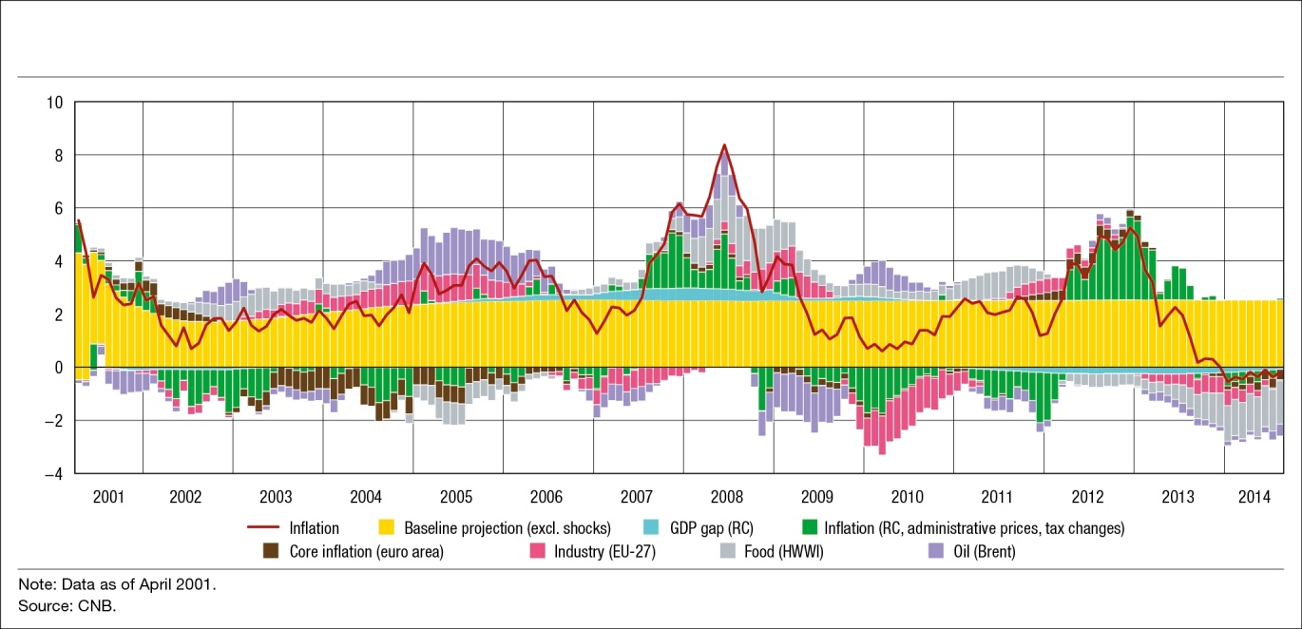
...current issue - CNB’s main objective is mainly externaly driven..
Inflation decomposition into baseline projection and domestic and external shocks in a small open economy (Croatia)
    Strong negative external shocks of prices of food raw materials and oil are primary causes of recent low inflation rates
    Unfavourable trends in the external real sector and domestic negative GDP gap contribute to deflationary pressures to a much smaller extent

Slide 14
What do we know about deflation in Croatia?
    Deflation pressure is coming from a fall of food and energy prices
    If the food and energy prices were at their five year average (2008-2013), inflation would have been at 2 per cent in 2014
    Inflation diffusion index shows that 20-30 per cent of the prices decline monthly - in line with the average of the last five years
    No deflationary expectations in real sector – no indication that consumers are postponing purchases of durable consumer goods due to expectations
    Indebtedness and debt service ratio for the household sector are declining in spite of the mild increase of real interest rates
    Decline in commodity, primarily energy prices, produces a significant positive terms of trade shock for the Croatian economy

Slide 15
What do we know about deflation in general?
    Not much, too few episodes, almost no recent ones
    Historical example of a ‘good’ deflation: deflation associated with broad productivity increases during the classical gold standard and industrial revolution in the late 19th century
    Study by Atkenson, A. and Kehoe P.J. (2004) finds that deflation and depression do seem to have been linked only during the 1930s (Great Depression), but in the rest of the data for 17 countries and more than 100 years, there is virtually no evidence of such a link
    They find many more periods of deflation with reasonable growth than with depression and many more periods of depression with inflation than with deflation

Slide 16
Is there any parallel between late 19th c. and early 21st?
    All through the late 19 century, deflation co-existed with growth due to:
      Rapid productivity growth
      Deep workforce pool
      Realocation of productive resources away from agriculture during the industrial revolution
    Until productivity gains were exhausted and workforce became scarce and inflation and wage pressures reappeared without any outside interventions
    Over the last 15 years broad productivity gains in emerging economies transmited globally
    World is closed economy – unexploited pools of workforce and potential productivity increases were unlocked over the last 25 years
    When that gets depleted, will inflation and wage pressures similarly reappear?

Slide 17
What do we know about “bad” deflation?
    Theory
      Declining long-term inflation expectations are indicator of the ‘bad’ deflation
      A prolonged period of low inflation rates might destabilise inflation expectations
      The monetary policy should response if a temporary shock is spreading through the economy and inducing downward shift in the long-term inflation expectations
    More indebted you are, more likely deflation will be ‘bad’ for you

Slide 18
    However, in the monetary union, due to the lack of exchange rate instrument, some deflation is necessary to adjust – ‘internal devaluation’
    Debt-deflation paradox?
      More indebted you are, more likely you’ll need to deflate in order to increase competitiveness, while, at the same time, you’ll need more inflation to keep debt sustainable
    Deflation could be relative, but can you rely on others to inflate as much as you need to have a positive inflation rate (say between 1-2%)?
    That’s more of a structural/institutional issue. Therefore, unlikely.

Slide 19
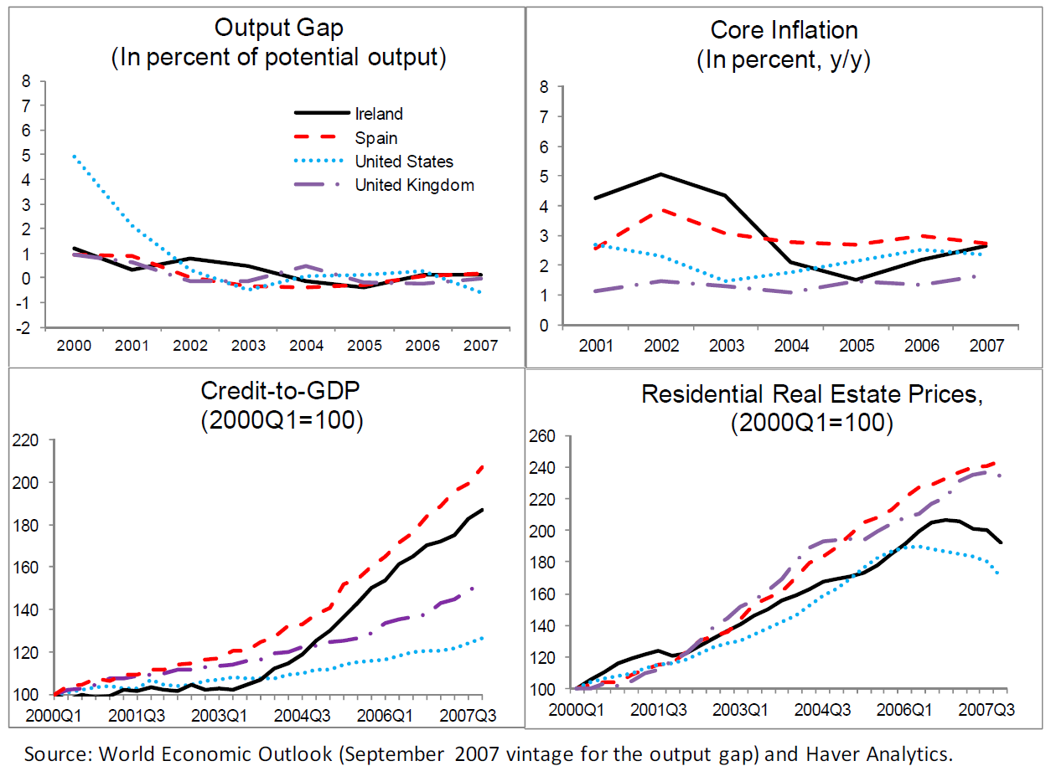
Financial stability issue – storm under the calm surface

Slide 20
New paradigm –
CB’s should look after financial stability
    Low inflation did not insure financial stability
    Predictors of financial crises: lending boom (historicaly good one), asset prices boom?
    Global monetary policy stance was inappropriate, and supervision was in many cases inadequate
    Lesson from the crisis: Imbalances can build up with seemingly low inflation and neutral output gap calculated by standard methodology, as asset prices were not included in the calculation of the output gap

Slide 21
However, still more questions than answers
    How to reconcile financial stability with ‘classic’ monetary policy goals? Who “plays the second fiddle”? (Eg. Bank of England Financial Stability Committee can suspend MPC decisions in Funding for Lending Program)
    Monetary policy still mainly concerned with price stability, asset prices not explicitly included, however they get closely monitored
    Some important, still open, questions:
      how much should central banks worry about the asset price inflation? It seems that CB policies have more direct impact on asset prices than on CPIs?
      could unconventional monetary policy do more harm than good by trying to push thru the closed door (structural conditions in the economy that limit productivity/GDP growth)?

Slide 22
    It might have little effect on sustainable GDP growth, while, on the other hand, much more effect on pricing and risk assesment in financial markets. If risks get overly mis-priced, that might create difficult conditions for exit strategy.
    Is monetary policy already overstretched?
    Could that endanger central bank independence?
    Do we properly measure inflation and output gaps?
    Is there a case for new monetary policy targets, i.e. ‘path dependent’ ones?
    Is it time for some old medicine like capital controls, particularly for small open economies exposed to global monetary cycles?

Slide 23
So, is there a New Paradigm appearing?
    Except when it comes to financial stabilty, which is now widely accepted as a new goal of central banking policies, there are still too many open questions that need answers before one can build a New Paradigm.
    Actualy, given all uncertainities, it seems that today’s monetary policy is even more an art than a science, than was the case before.
    And, as usual, when it comes to the art – the beauty is in the eye of beholder...
    ...until we get better evidence

Slide 24
Thank you!

