Slide 1
Financial stability report
May 2023
Bálint Dancsik | Head of Department
Financial System Analysis Directorate
Press conference | 25 May 2023

Slide 2


Banks' shock resilience remains stable, previous risks have not materialised
The international bank failures have had a temporary negative impact on the valuations of European and Hungarian banks, but the fundamentals of the banking systems, with strict regulation and supervision, make them resilient to similar events.
Most severe risks:
Risk tolerance reduction
Possible additional sanctions, war exposures of parent banks
Potential decrease in deposits
Slowing credit dynamics
Tighter credit conditions
Real estate market risks, overvaluation
Financial stability indicators of the Hungarian banking system
Source: MNB

Slide 3
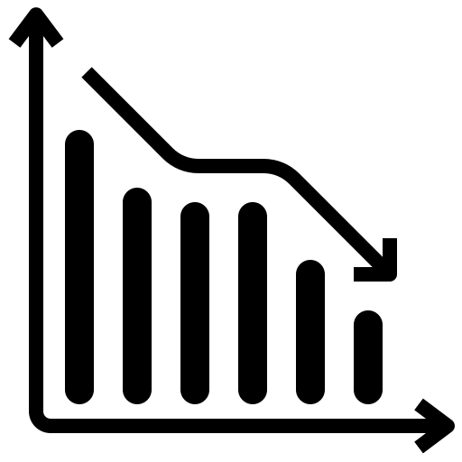

Main takeaways of the report
The Hungarian banking system has a stable, strong capital position and significant liquidity reserves in the complex and challenging period.
The sector's ability to withstand shocks is strong, and its liquidity and capital position are robust even assuming a severe crisis.
Loans of the private sector increased in 2022, but at the same time, similar to regional trends, a general decline in demand can be felt.
There are signs of a turnaround in the real estate market, which is gradually reflected in the valuation as well. The average price of houses decreased nominally in the second half of 2022, and several segments of CRE are surrounded by increasing risks.
The tightening of credit conditions is mainly due to cyclical factors, the lending capacities of banks are adequate.
The increasing impairments, the settlement of the extra profit tax, and the profit impact of the interest cap measures were almost completely compensated by the increase in the net interest income.

Slide 4
External environment
Corporate and household lending
Bank profitability and portfolio quality
Bank shock resilience

Slide 5
Risks stemming from the International environment remained elevated in the last half-year
Slow global economic growth, elevated inflationary environment, tight monetary conditions, persistent geopolitical risks.
Dynamically changing expected interest rate paths at major central banks.
Energy supply problems in Europe have proved milder than expected.
Expected interest rate paths of the central banks of developed countries based on market pricing
Note |Expected interest rate paths are based on interest rate swaps in the case of the Fed and EONIA forward yields in the case of the ECB. Source | Bloomberg

Slide 6
Bank interest and liquidity risk management and its regulation came into focus following the American bank failures
Concentrated clients, high proportion of deposits not covered by deposit insurance, interest rate risk
Outflow of deposits
Sale of held-to-maturity securities at a loss
Low quality risk management, weak regulatory control
Negative news, social media „catalyst” effect
Deterioration of capital position
Main factors leading to the failure of silicon valley bank
Source |MNB.
The topic is covered in Box 1 of the report.

Slide 7
bank failures have reassessed the impact of the rising interest rate environment on the banking system
When monetary tightening was started, the general view was that rising interest rates would be benign for banks.
Stress indices rose in March, but the elevated levels were below those recorded during the coronavirus outbreak and the energy crisis.
After the initial fall in share prices following the SVB's bankruptcy, a correction was observed.
Changes in the valuation of European and US banks compared to the development of major stock indices
Note | 03-01-2022=100%. Source | Yahoo Finance, Marketwatch

Slide 8
The IMF estimates that banks' potential losses on securities could be much higher in the US than in Europe and emerging markets
The European and the domestic banking regulation is much stricter than overseas, therefore it can prevent the occurrence of bank failures similar to the case of Silicon Valley Bank.
The liquidity coverage ratio (LCR) requirement applies to all banks.
Domestic regulations require additional liquidity to be maintained after large deposits.
The MNB monitors the level of interest rate risk for all banks and, if necessary, imposes extra capital requirements on institutions (Pillar II).
Estimated impact on CET1 ratio from unrealized gains and losses on held-to-maturity securities
Source | IMF Global Financial Stability Report

Slide 9
EU banking system is stable, and shows improving profitability
Profitability in the EU banking system improved as net interest income increased
In several countries, the above-average income has been or is planned to be deducted with special taxes.
(HU, CZ, ES, [LT, IT])
This is discussed in Box 2 of the report.
Contribution of changes in certain profitability components to the annual change in average ROE in the EU banking system
Note | *Contributions to deposit guarantee schemes and resolution funds. Source | EBA

Slide 10
External environment
Corporate and household lending
Bank profitability and portfolio quality
Bank shock resilience

Slide 11
Corporate loans outstanding nominally increased by 14 per cent in 2022, partly as a result of large individual transactions
Until the end of 2023, several state loan programmes will help the SME and corporate sector with discounted funds.
The subsidized programmes can partly cover the renewal needs of SME loans. Among the outstanding bank loans of SMEs at the end of 2022, loans maturing in 2023 have an outstanding principal amount of around HUF 1,120 billion.
7.1 per cent (2023Q4)
The stock of corporate liquid assets in Hungary has grown significantly in recent years: the value of liquid assets as a share of GDP reached 20 per cent in 2013, in line with the regional average, and exceeded 32 per cent by the end of 2021.
Forecast for the corporate loan portfolio
Note | Transaction-based annual growth rate based on data from the financial intermediary system. Source | MNB

Slide 12
compared to 2021, corporate loan demand has shifted towards foreign currency and short-term loans
As a result of declining corporate investment activity and mounting liquidity needs, banks perceived a decrease in demand for long-term loans and an increase in demand for working capital loans
The demand for foreign currency loans also increased. At the same time, such loans were mostly taken out by companies with natural collateral in recent months.
Cumulative foreign currency loan contracts within a year by foreign trade activity of the corporate borrowers
Note | Exchange rate adjusted values. Source | NTCA, MNB

Slide 13
The lending capacity of the banking system is historically high, and its willingness to lend is around the equilibrium level
In the last two quarters, a small group of banks tightened their corporate loan terms. In the first quarter, only a net 9 percent of banks indicated their capital situation and liquidity situation as factors influencing the tightening of credit conditions.
Meanwhile, almost two-thirds of them indicated the economic outlook.
According to our financial conditions index, the impact of the banking system on the real economy is overall neutral: neither cools nor heats the economy.
Changes in credit conditions and factors contributing to the changes in the corporate segment
Note | Net ratio is the difference between tightening and easing banks weighted by market share. The indicated ratios are the net ratio of the institutions indicating the given factor, so the sum of the parts is not 100 per cent. Source | MNB based on banks' responses

Slide 14
Market slowdown is clearly visible In household lending
New disbursement:
The volume of new household lending fell by 10 per cent in 2022.
In the first quarter of 2023, new housing loan disbursement decreased by 67 per cent y-o-y.
2,4% (2023Q2)
Loans outstanding:
The slowdown in lending dynamics continued at the beginning of 2023, with the annual growth rate of households’ bank loans outstanding at only 5.1 per cent in the first quarter.
Household lending forecast
Note | Transaction-based annual growth rate based on data from the financial intermediary system.
Source | MNB

Slide 15
the deceleration of credit market is a widespread phenomenon in the whole region
Uncertain growth prospects and tightening of monetary conditions set back housing loan demand in the whole region.
A general slowdown in credit markets is apparent, which is a natural phenomenon, an adjustment to the changing economic outlook both at the demand side and at the supply side.
See more on the topic in Box no. 4 of the Report.
Annual change in new housing loan contracts in an international comparison
Source | MNB, ECB.

Slide 16
Banks perceived decreasing demand for housing loans and stronger demand for consumer loans
Housing loan conditions
Banks did not change credit conditions and do not plan to change them looking forward
Net 11 per cent of banks tightened the consumer loan conditions, 32 per cent plan to tighten them further
2023 Q1
0 %
2023 Q2-Q3
0 %
Housing loan demand
2023 Q1
-76 %
Net 76 per cent of banks perceived the drop in demand, but 27 per cent envisage the appreciation of it looking ahead
Net 42 per cent of banks saw an upturn in demand for consumer loans
2023 Q2-Q3
+27 %
Note: Net percentage balance of respondent banks indicating stronger/weaker demand and tightened/eased credit conditions, weighted by market share. Source: MNB, based on banks’ responses.

Slide 17
External environment
Corporate and household lending
Bank profitability and portfolio quality
Bank shock resilience

Slide 18
The surge in interest income also covered several extra expenses
Net interest income of the banking system increased by HUF 675 billion in 2022 compared to 2021.
Its main source is interest income on deposits with the MNB.
While the average interest rate on HUF demand and time deposits held by households and corporates in banks has increased by only 3.6 percentage points since June 2021.
Annual changes in the after-tax income components of the credit institution sector
Note | Nominal values of income components at the end of 2022 are shown on the right-hand side. Interest income - MNB does not include interest income on derivative transactions with the MNB. *Bank levy includes the combined change in the ‘normal’ bank levy and the extra profit tax. Source | MNB

Slide 19
The repricing of retail term deposits lags significantly behind the increase in short-term interbank yields…
… and also from the expected level based on the previous relationship between interbank and deposit interest rates, which topic we deal with - statistical methods - in the highlighted chapter of the report.
Why is the transmission different?
Possible reasons:
abundant liquidity,
competition (difficulties switching bank accounts),
residential government bonds,
financial awareness,
government measures(interest stop, windfall tax)
In the medium term, the low level of interest increases the risk of a decrease in the deposit stock, but at the same time there is still considerable room for maneuver due to the high liquidity reserves at the system level.
The average annualized interest rate of the HUF deposits of the private sector and the development of the average monthly level of the 3-month BUBOR
Source | MNB

Slide 20
Banking Sector's return on equity did not change significantly compared to the previous year
RoE (2022): 9%
The profitability of banks was well below the cost of equity for nearly one third of the sector on a balance sheet total basis.
Distribution of 12-month rolling after-tax return on equity of credit institutions weighted by the balance sheet total
Note | Monthly time series based on non-consolidated data. The yield premium is the difference between the 12-month rolling ROE and the yield on the one-year Discount Treasury Bill. Backward-looking yield for the ROE, forward-looking yield for the Discount Treasury Bill. Source | MNB

Slide 21
Credit risks have not yet materialised, Which is supported by the stable labour market
 | Dec. 2021 | Dec. 2022 | Feb. 2023
Corporate NPL | 4.1% | 3.9% | 3.7%
Household NPL | 4.2% | 4.4% | 4.3%
Corporate 90+ days delinquency | 0.7% | 1.2% | 1.2%
Household 90+ days delinquency | 1.3% | 1.5% | 1.5%
Corporate delinquency below 90 days | 3.5% | 5.2% | 3.4%
Household delinquency below 90 days | 4.1% | 4.5% | 4.5%
Non-performing loan volume and npl-ratio of the private sector towards the credit institution sector
Source | MNB

Slide 22
Household interest rate cap measure has a limited debt-service effect on the macro level, it should be targeted towards the most affected
The effect can be significant on the micro-level:
Median instalment would have increased by one and a half time (from 41 thousand HUF to 63 thousand HUF), had the interest rate cap been phased out at the end of June 2023. This would have resulted in financial stress for certain households (especially in the case of longer remaining maturities).
Debt-service of the households as a ratio of their sectoral disposable income and interest rate on mortgage loans outstanding with and without the interest rate cap
Note | Calculated with an interest forward path as of 19 April. Interest repayment burdens and principal repayments are calculated as a proportion of the disposable income of the household segment. The excess repayment burden without the interest rate cap was calculated ceteris paribus, i.e. only the interest rate on mortgages was changed compared to the scenario with the interest rate cap, everything else was assumed unchanged. The interest rate time series on the outstanding mortgage loan portfolio is a volume-weighted average interest rate, which is calculated from 2020 Q1 onwards on the basis of micro-data from the Credit Registry. Source | MNB

Slide 23
Increase in credit risks: signs of a housing market turnaround are visible in many EU countries
The housing loan market and housing market decline may point in the direction of a turnaround that can be linked to economic uncertainty, a high inflation environment, tight monetary conditions and (in some countries) housing market overvaluation.
There is no close correlation between the increase in loan interest rates and the degree of contraction of the credit market in EU countries. Based on the latest data, there was a 40-70 percent drop in housing loan disbursements in many EU countries, where the increase in average loan interest rates was "only" 150-250 basis points.
Quarterly change in housing prices and the annual change in the disbursement of new housing loans in the EU
Source | ECB, Eurostat, MNB

Slide 24
stability effects of the correction in housing market overvaluation are limited
15.4 per cent of the portfolio
We estimate that, with a full correction of housing market overvaluation, 15.4 per cent of the mortgage stock would be above 80 per cent LTV, which does not represent a significant risk.
The topic is presented in Box 5 of the report.
Distribution of the mortgage loan portfolio according to the current and adjusted LTV for housing market overvaluation
Note | December 2022 stock. The overvaluation was calculated based on the percentage deviation of the house price-to income-ratio from its long-term average. Housing prices of 2022 are calculated based on the first three quarter. Source | MNB

Slide 25
banks’ conservative collateral valuation practice also contributed to the moderate risks
Financial institutions gradually increased the value of residential real estate collaterals behind the mortgage loans on their balance sheets considering the housing market price increase. At the same time, the revaluation of collateral was carried out conservatively.
Revaluation of mortgage collateral and the rate of increase in house prices between the date of conclusion of the contract and 2022 Q4
Note | Based on the outstanding mortgage loan portfolio at the end of December 2022. The housing price increase is based on the MNB housing price index. Source | MNB

Slide 26
Bank exposure related to commercial real estate is moderate
Risks in the office market:
Valuation: based on the development of prime office yield and rent, Budapest's prime offices may have depreciated by 14 per cent, which is higher than the regional average, but significantly less than the level and dynamics of the change after 2008.
„Hidden vacancy”: due the prevalence of remote work, there are many workstations that are not actually used, which can mean cost reduction potential for tenants and an upward risk in the vacancy rate.
The signifcance of commercial real estate project loans in the banking system
Note | Credit institutions excluding affiliates, based on non-consolidated data, increased by the real estate Bond Funding for Growth Scheme (BGS) portfolio. Source | MNB

Slide 27
External environment
Corporate and household lending
Bank profitability and portfolio quality
Bank shock resilience

Slide 28
the liquidity position of the banking system remains robust
The liquidity surplus at the sector level provides sufficient coverage even for a severe stress scenario.
Banks have an operational liquidity reserve (OLR) of around HUF 16,000-18,000 billion supplemented with. mandatory reserves, which is currently around 60 percent of the deposit portfolio
During our liquidity stress test, the level of liquidity deficit occurring at the sector level remains close to the theoretical minimum.
Development of the LCR and its components in the banking system
The topic is dealt with in Box 3 of the report
Source | MNB

Slide 29
In our stress test, substantial credit risk losses can be realized in the vulnerable external environment
The narrative of the stress test is primarily determined by the uncertainties of the international environment.
Stresstest assumptions:
The protracted Russian-Ukrainian war and the European energy crisis, as well as the potential spillover from the international financial markets, continue to surround the operating environment of the domestic banking sector with substantive downward growth risks.
In the stress scenario, GDP growth falls behind the first and second years of the baseline forecast by a cumulative 6 percent and 10 percent, respectively.
Annual GDP growth rate in the scenarios
Source | MNB

Slide 30
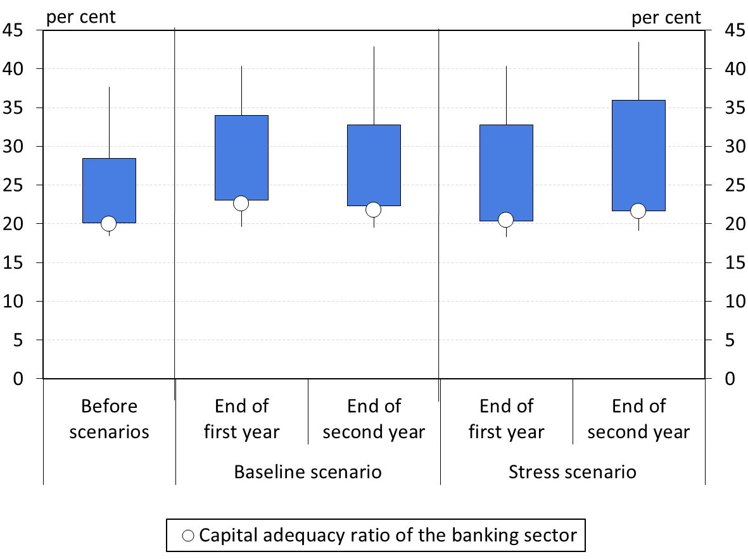
banks would maintain their lending capacity even in the event of a severe stress
The sector-level capital adequacy ratio was 18 percent at the end of 2022.
Overall, at the end of the first and second year of the stress scenario, there is no capital shortage in the case of any institution, but the level of free capital buffers decreases significantly even with the diminishing asset portfolio.
On the one hand, the smaller credit dynamics of the dynamic balance sheet assumption and the resulting lower total risk exposure value play a role in this, but at the same time, banks would maintain their lending capacity even in the event of severe stress.
Distribution of the capital adequacy ratio based on the number of banks
Note | Vertical line: 10–90 per cent range; rectangle: 25–75 per cent range. The banking sector average is weighted by the total risk exposure. Source | MNB

Slide 31
Main takeaways of the report
The Hungarian banking system has a stable, strong capital position and significant liquidity reserves in the complex and challenging period.
The sector's ability to withstand shocks is strong, and its liquidity and capital position are robust even assuming a severe crisis.
Loans of the private sector increased in 2022, but at the same time, similar to regional trends, a general decline in demand can be felt.
There are signs of a turnaround in the real estate market, which is gradually reflected in the valuation as well. The average price of houses decreased nominally in the second half of 2022, and several segments of CRE are surrounded by increasing risks.
The tightening of credit conditions is mainly due to cyclical factors, the lending capacities of banks are adequate.
The increasing impairments, the settlement of the extra profit tax, and the profit impact of the interest cap measures were almost completely compensated by the increase in the net interest income.

Slide 32
Thank you for your attention!

