Slide 1
Report on Financial Stability
Vonnák Balázs
director
12th November 2014

Slide 2
Content
Settlement of FX loans
The asset management agency
Vulnerability – results of the stresstest
Lending developments

Slide 3
I. Settlement of FX loans

Slide 4
Settlement of the FX loan problem has a significant impact on every aspect of financial intermediation
Source: MNB

Slide 5
Fx loan measures
5
Source: MNB

Slide 6
What will change in case of a typical foreign exchange debtor?
6
Source: MNB

Slide 7
The impact of the settlement arising from nullification of the exchange rate spread and unilateral contract modifications on the profitability of the financial institutions
Source: MNB,CCIS

Slide 8
Substantial heterogeneity is expected in the reduction of borrowers’ debt
Estimated distribution of debt reduction of performing CHF-denominated mortgage loans following the settlement
Source: MNB

Slide 9
Expected details and effects of FX loan conversion to HUF
Only mortgage loans will be affected
Official MNB exchange rate on 7th November (EUR: 309, CHF: 256,5) OR average exchange rates since the decision of the Curia on June 16th – whichever is lower;
Banking clients have the right to terminate within 60 days if conditions change according to the framework of the ”fair banking system”
Household's open foreign currency position disappears
External debt and currency swaps decrease as open foreign currency position closes
MNB provides the necessary foreign exchange liquidity
Systemic HUF liquidity decreases
Due to the FX loan conversion competition may arise in
  Pricing of HUF loans according to the framework of the ”fair banking system”
  HUF funding, i.e. for HUF deposits

Slide 10
Households’ FX debt significantly decreases due to the conversion into HUF
Households’ debt structure by currency and in percent of GDP
Source: MNB

Slide 11
Household's open foreign currency position decreases
Open FX position of the main sectors in the balance sheet as percentage of GDP
Source: MNB

Slide 12
The ”fair banking system” creates transparent pricing for long term loans…
Effects of the ”fair banking system” on the pricing of long term loans
Source: MNB

Slide 13
...and also for short term loans
Effects of the ”fair banking system” on the pricing of short term loans
Source: MNB

Slide 14
Banks with outstanding levels of liquidity and capital buffer are expected to benefit the most from the conversion
Estimated level of capital adequacy and deposit coverage ratio after the settlement, by banks – the bigger the bubble, the bigger the loss born
Source: MNB

Slide 15
Hungary is expected to be among the less efficient countries in international comparison
Cost to income ratio in international comparison
Source: MNB

Slide 16
II. The asset management agency

Slide 17
Following a continuous decrease for almost two years, the NPL-ratio increased in 2014
Share of non-performing corporate loans of the banking sector
Source: MNB.
17

Slide 18
The deterioration of the corporate loan portfolio can be clearly linked to real estate project loans
Non-performing project and other corporate loans within the banking sector
Source: MNB.
18

Slide 19
The high NPL portfolio lowers the efficiency of the lending channel
Change in loans outstanding and NPL ratio in the corporate segment
Source: Jones Lang LaSalle.
19

Slide 20
The asset manager proposed by the central bank could efficiently remedy the distressed corporate portfolio
The main characteristics of the asset management agency initiated by the Central Bank
Source: MNB.
20

Slide 21
III. Vulnerability – result of the stress test

Slide 22
Ratio of non-performing FX mortgage loans are still increasing
Household NPL ratio by products
Source: MNB.
22

Slide 23

The banking system’s resilience to shocks will decline considerably after the settlement
Capitalisation of the banking sector in stress
Source: MNB.
23

Slide 24
FX risk disappears from households’ loan portfolio after FX conversion to HUF
Consolidated capital buffer and capital need along the stress scenario
Source: MNB.

Slide 25
IV. Lending developments

Slide 26
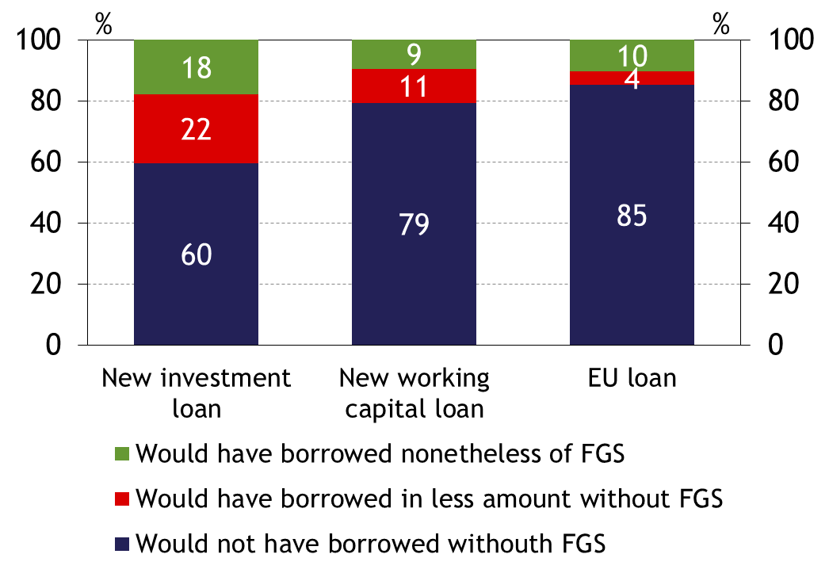
The FGS generated new demand for loans
Would has the client borrowed for the same purpose if there was no FGS?
Source: MNB, Survey

Slide 27
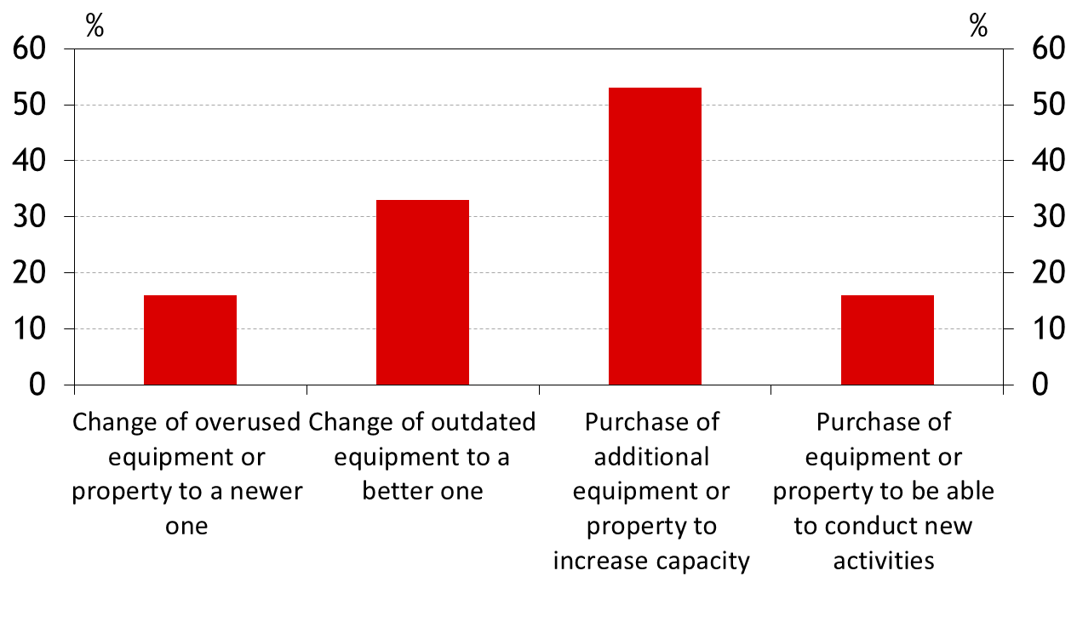
It was primary spent on capacity extension
Investment loans by their purpose according to a corporate survey
Source: MNB, Survey

Slide 28
Corporate lending has improved significantly as a result of the FGS
Forecast for corporate lending in different periods (cumulative transactions)
Source: MNB.
28

Slide 29
Market-based lending still has not recovered yet
12-month cumulative corporate loan transactions vis-à-vis the government and privatly-owned institutions
Source: MNB.
29

Slide 30
Corporate lending is expected to accelerate further on the forecast horizon
Forecast for lending to non-financial corporations
(transaction-based, year-on-year data)
Source: MNB.
30

Slide 31
After a drop due to settlements, yoy growth rate predicts slowing deleveraging of households
Forecast for lending to households
(transaction-based, year-on-year data)
Source: MNB.
31

Slide 32
Thank you for your attention!

