Slide 1
Financial Stability report
May 2020
Tamás Nagy | Head of Department
Financial System Analysis Directorate
Press conference | 21 May 2020

Slide 2
Impacts of the Covid-19 shock
Risks, vulnerable debtors
Stress test results
Banks’ position in light of the shock
Forecast, latest data

Slide 3
Covid-19: Unexpected, massive and novel shock
The emergence of Covid-19 resulted in a global supply- and demand-side shock. The production chains have been disrupted, leading to demand-side shocks in many sectors.
Real GDP growth and forecast between 2019 and 2021
Evolution of Purchasing managers’ indices
Source: IMF, Thomson Reuters Datastream. Note (left chart): In the case of Hungary’s export markets, the growth rate of each country was weighted by its share in Hungarian exports. Note (right chart): Chinese data stems from the Caixin/Markit survey, covering SME-s. Data for the US, Germany and the euro area is based on the IHS Markit survey. Seasonally adjusted data.

Slide 4
risk appetite declined, Market volatility increased
The decline in risk appetite triggered violent market volatility in March. Investors withdrew capital from emerging regions, causing increase in yield and currency depreciation.
Evolution of volatility indices
Evolution of 10-year US yields and emerging market capital flows
Source: S&P Market Intelligence, Thomson Reuters Datastream, EFPR. Note (left chart): The value of the VIX (VSTOXX) index is calculated at the Chicago Board of Options Exchange (European Options Exchange) and shows the market’s expectation of the development of volatility for the next thirty days. MOVE measures bond market volatility (US Treasury yields).

Slide 5
market tensions increased in March, but started to subside gradually by April
The financial stress index compiles information from 17 variables into a single indicator. Although the index increased, it was well below the levels seen in 2008–2009 and 2011–2012.
Development of the Factor-based Index of Systemic Stress (FISS)
Source: MNB. Note: For methodological details, see Szendrei, T. - Varga, K. (2017): FISS - A Factor Based Index of Systemic Stress in the Financial System. MNB Working Papers 9, Magyar Nemzeti Bank.

Slide 6
Unprecedented Fiscal and Monetary actions
Both governments and central banks introduced sizable crisis management packages. Some countries may experience elevated fiscal difficulties.
Fiscal measures taken to counteract the effects of the coronavirus (see Box 2 of the Report)
General government net lending/borrowing and general government gross debt as a per cent of GDP
Source: IMF. Note (left chart): Below the line measures include equity injections, asset purchases, loans, debt assumptions, quasi-fiscal operations, use of extra-budgetary funds. The chart does not include state government measures in federations, deferral of payments to the government and advance pay of liabilities by the government.

Slide 7
Impacts of the Covid-19 shock
Risks, vulnerable debtors
Stress test results
Banks’ position in light of the shock
Forecast, latest data

Slide 8
The Hungarian banking system has resolved the legacies of the previous crisis
The balance sheet of the banking system has become a lot sounder in recent years. The banks have a favourable funding structure, low NPL ratios and robust capital position.
Regulatory support
Conversion of foreign currency loans
„Debt cap” rules
Certified Consumer-friendly Housing loans
Funding for Growth Scheme, Market-based Lending Scheme
Bond Funding for Growth Scheme
LCR, FFAR, FECR, MFAR, IFR
Systemic Risk Buffer
Capital buffer for Other Systemically Important Institutions
Capital Conservation Buffer
Indicators of the Hungarian banking system in 2008, 2012 and 2019
Source: MNB. The ratio of variable-rate mortgage loans for 2008 and 2012 is based on expert estimates.

Slide 9
The central bank eases the availability of capital
Banks have achieved a total profit of HUF 2,100 billion between 2016 and 2019, a significant portion of which was reinvested into banks’ capital. Total equity increased by half since 2015.
The banking system's own funds and capital requirements in place at the end of 2019
Source: MNB.

Slide 10
The central bank eases the availability of capital
Banks have achieved a total profit of HUF 2,100 billion between 2016 and 2019, a significant portion of which was reinvested into banks’ capital. Total equity increased by half since 2015.
The release of capital buffers is the realisation of countercyclical macroprudential policy.
The measures taken ensure that banks are able to use the accumulated capital to absorb losses.
Releasing the buffers increases banks’ lending capacity.
The banking system's own funds and capital requirements in place at the end of 2019
Source: MNB.

Slide 11
Liquidity reserves are ample and are supported by central bank measures as well
The LCR of the banking system was 147 per cent at the end of March. The Central Bank responded to the situation caused by the virus with swift measures. The Central Bank’s instruments are adequate to handle potential liquidity needs of individual institutions.
Introduction of collateralised loan facilities
Inclusion of large enterprise loans in the list of eligible collateral
HUF 2,500 bn
Release of the mandatory reserve
HUF 250 bn
Moratorium on FGS refinancing loans
Payment moratorium
Up to HUF 3,600 bn
Distribution of individual institutions' LCR levels weighted in proportion to the balance sheet total
Source: MNB.

Slide 12
Impacts of the Covid-19 shock
Risks, vulnerable debtors
Stress test results
Banks’ position in light of the shock
Forecast, latest data

Slide 13


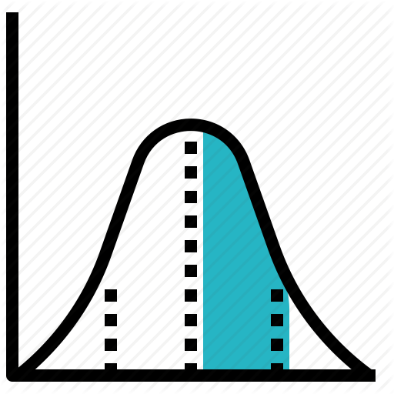
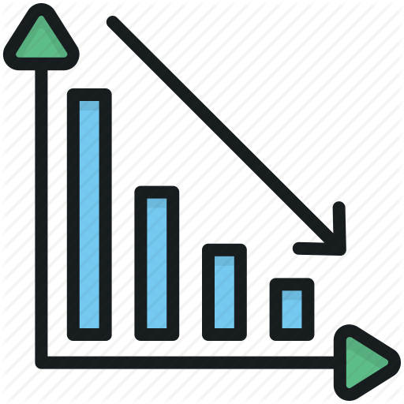
The coronavirus pandemic will have a significant impact on banks
Demand effect: lockdowns, mass layoffs, consumption reduction | Supply effect: supply chain disruption, production downtime
Lending effects of the coronavirus epidemic
=
×
×
Expected loss
Exposure at default
Probability of default
Loss given default
The banking sector is well capitalized and could also withstand the effects of a major economic contraction
Credit card and overdraft drawdowns may increase
We expect new lending to slow this year
Amortization of the principal of loans may slow down (e.g. due to the moratorium)
Companies and debtors exposed to the effects of the coronavirus are more likely to default
Mass layoffs that may potentially occur could pose a substantial risk
A possible decline in property prices may also affect bank collateral values
The banking system's exposure to the real estate market has declined substantially in recent years

Slide 14
Banks are most likely to be hit by loans of vulnerable debtors
Vulnerable exposures were identified at the micro level (debtor, contract data level).
Corporate segment: we identified the vulnerable sectors.
  Granular (company level) analysis instead of focusing only on the sections of economic activities
  Of the 615 sectors (NACE Rev. 2 Classes), 104 were identified as vulnerable
Household segment: vulnerable occupations were identified.
  Debtor level analysis, based on 2017 data
  Similarly to the corporate analysis, we did not classify entire sectors vulnerable here either
  Of the 485 occupation categories, 166 were identified as vulnerable
For details, see the methodological annex at the end of the report.

Slide 15
We consider about one-third of the corporate loan portfolio to be vulnerable
The most vulnerable portfolio (HUF 7-800 billion) accounts for 9% of the total portfolio. The share of the total vulnerable portfolio is 32 percent of the total corporate loan portfolio.
Most vulnerable portfolio (directly affected):
Sectors which have become immediately affected by the shutdowns, restrictions and isolation measures taken against the coronavirus epidemic and its spread.
Total vulnerable portfolio:
It also includes those sectors that have been severly affected by the decline in aggregate demand as a secondary effect of epidemic control.
The role of vulnerable sectors in corporate debt
Note: Based on the 2019 data for the credit institution sector. Vulnerable loans are the loans taken out by debtors with vulnerable activities (Hungarian NACE Rev. 2). A detailed description of the vulnerability calculations is provided in the methodological annex at the end of the report. Bubble size corresponds to the value added of the whole sector. Source: MNB, NTCA.

Slide 16
Within vulnerable companies, those with weaker balance sheets imply greater credit risk
Half of the vulnerable exposure, about 16 percent of the total corporate loan portfolio, is considered highly risky based on companies’ indebtedness and liquidity position.
Loans of vulnerable companies by liquidity position and indebtedness as a share of total corporate credit
Note: Indebtedness: low if debt/EBITDA indicator is below 1, moderate if the indicator is between 1 and 4 and significant is the value of the indicator exceeds 4 or is negative. Liquidity position: adequate if the personnel expenses/cash indicator is below 0.5, moderate if the indicator is between 0.5 and 2 and significant if the value of the indicator exceeds 2. Based on tax declaration data from 2018 and loan data from end of 2019. Source: MNB, NTCA.

Slide 17
Other debts which are not subject to the moratorium pose a risk for default rates
Other liabilities significantly exceed bank loans in several sectors. These obligations may lead to liquidation and bankruptcy proceedings in the event of default.
Companies’ net liabilities and loans outstanding to credit institutions by sectoral breakdown
Note: Based on companies’ 2017 accounting balance sheets. Source: MNB.

Slide 18
One-third of the households’ loans outstanding are considered vulnerable
Manufacturing, tourism, catering and construction are among the most vulnerable sectors
Role of vulnerable sectors in household debt
Note: Based on 2017 data. Vulnerable loans are loans taken out by debtors with vulnerable occupations. The size of the bubble is proportional to the number of people employed in the sector. ‚Other activities’ encapsulates the mining, energy, water supply and waste management, and finance and insurance activities sectors, none of which have identified vulnerable occupations. Source: Central Administration of National Pension Insurance, MNB.

Slide 19
The moratorium is going to ease liquidity tensions
In the case of both households and corporations, 30 to 50 per cent of debtors asked for continued repayment.
Debtors opt-outing from the moratorium until 7th of may
Note: Based on the answers of nine large banks. Lines depict the 20th and 80th percentiles, the rectangle depicts the 40th and 60th percentiles. Source: MNB.

Slide 20
Credit losses are expected to increase
The moratorium is going to prevent delinquency, but due to the forward-looking nature of loan loss provisioning, credit losses will increase.
After the expiration of the moratorium, both delinquency rates and credit losses are going to increase.
In case of those debtors who can not be reorganised, PERMANENT PORTFOLIO CLEANING will be required from banks
NPL-rates are at their 15–20-year minimum
Corporate (90+): 1.5%
Households (90+): 2.7%
December 2019
January 2021
March 2020
The MNB will do its utmost to ensure that the non-performing portfolio is not permanently stuck in the banks' balance sheets this time.
The payment moratorium prevents delinquencies.
The moratorium does not induce the reclassification of loans into Stage 2 under IFRS 9.
Expected losses are going to increase, however.
For more details, see Box 7 of the report

Slide 21
Impacts of the Covid-19 shock
Risks, vulnerable debtors
Stress test results
Banks’ position in light of the shock
Forecast, latest data

Slide 22
In the Financial StaBility Report, we present our stress testing exercise in every half-year
The stress test calculates the impacts of low-probability, but still plausible economic scenarios on the banking sector.
The stress testing scenarios are not forecasts.
Due to the high degree of uncertainty regarding the economic effects of the pandemic, in the solvency stress test, we estimated the impacts of two economic scenarios.
Stress scenario I:
GDP in 2020: -3.8%
GDP in 2021: -0.1%
In stress scenario number one, demand for Hungarian exports is subdued, investment activity declines, production capacities are impaired, household consumption declines, which – overall – result in a temporary decline in output.
Stress scenario II:
GDP in 2020: -7.1%
GDP in 2021: -2.9%
In stress scenario number two, we included a more substantial disruption of production capacities and a further decline in consumption, export and investment activity.

Slide 23
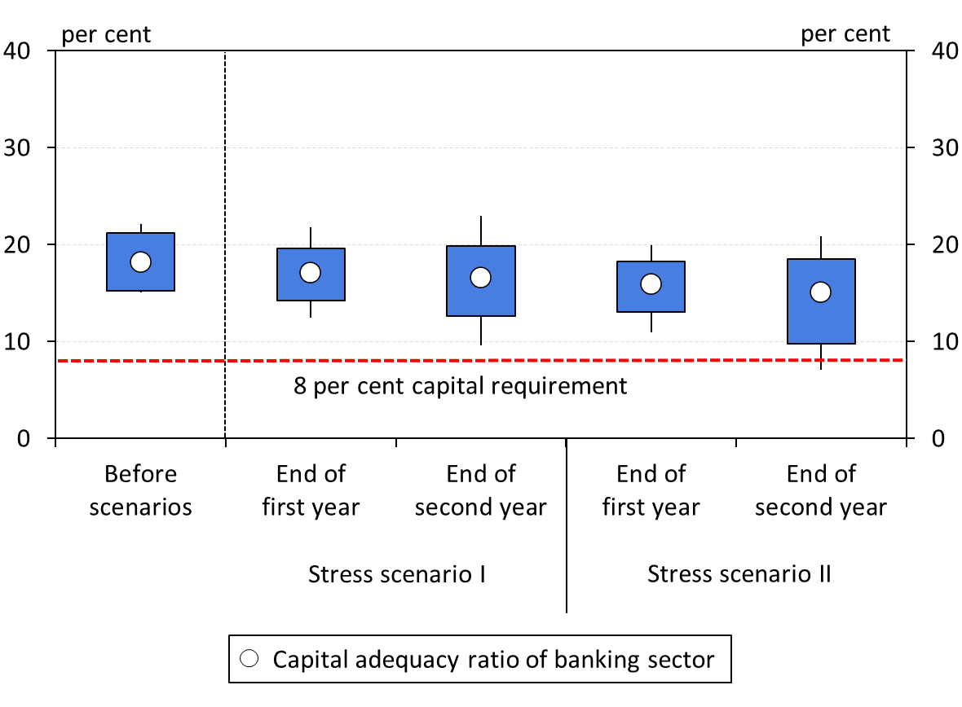
Manageable capital needs would arise even in the more severe economic scenario
Compared to all the capital requirements currently in effect, in the more severe stress scenario, arising capital injection needs would amount to HUF 106 billion. Taking into account the Pillar I 8-per cent requirement, needs amounting to HUF 39 billion would arise.
Risks are mitigated by the precautionary capital programme announced by the Hungarian government, with a HUF 150 billion overall amount.
Details can be found in Box 11 of the report.
Distribution of the capital adequacy ratio based on the number of banks for the two stress scenarios
Note: Vertical line: 10–90 per cent range; rectangle: 25–75 per cent range. Source: MNB

Slide 24
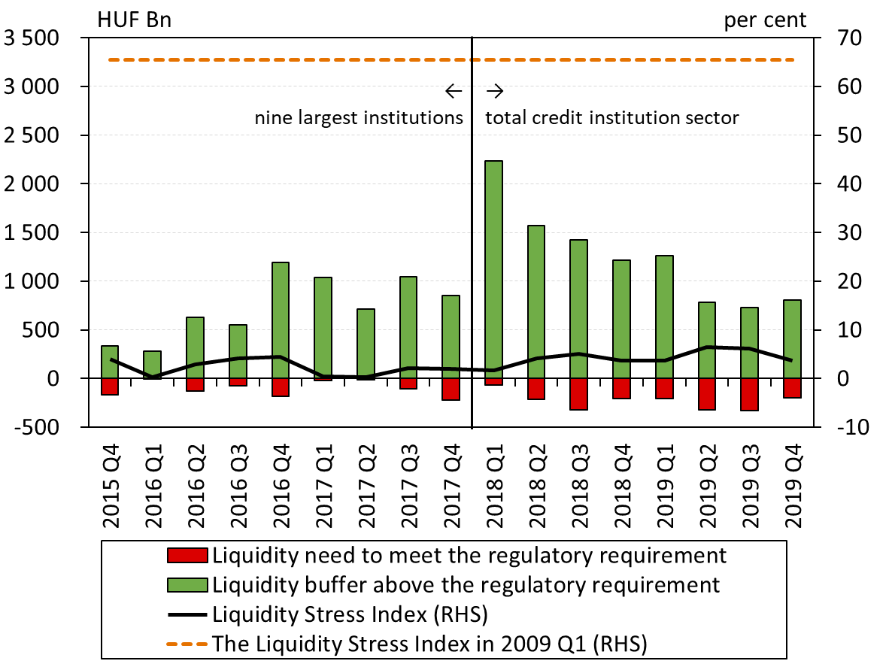
Only modest liquidity needs would arise even in the case of a severe shock
The post-stress liquidity needs of the banking sector required to meet the regulatory requirement totaled HUF 195 billion in 2019 Q4, showing a substantial decrease.
Regarding the impact of the moratorium and central bank measures on liquidity, see Box 9 of the report.
The Liquidity Stress Index
Note: The indicator is the sum of the liquidity shortfalls in percentage points (but maximum 100 percentage points) compared to the 100-per cent regulatory limit of the LCR, weighted by the balance sheet total in the stress scenario. The higher the value of the indicator, the greater the liquidity risk. The index value in 2009 Q1 is based on the liquidity shortfalls compared to the balance sheet coverage ratio. For the exact calculation method, see Banai et al. (2014): Stress testing at the Magyar Nemzeti Bank. MNB Occasional Papers No. 109. Source: MNB

Slide 25
Impacts of the Covid-19 shock
Risks, vulnerable debtors
Stress test results
Banks’ position in light of the shock
Forecast, latest data
Lending
Housing Market
Savings

Slide 26
corporate lending was hit by the coronavirus During a double-digit growth
Growth rates in the first quarter did not yet reflect the effect of the pandemic.
Growth rate of the MFI’s total corporate and SME loan portfolio
Note: Transaction based, prior to 2015 Q4 SME data is estimated based on banking system data. SME data for the first quarter of 2020 based on preliminary data.

Slide 27
tightening of lending conditions has already begun
More than 80 percent of banks indicated that they are planning to tighten corporate lending conditions by the second and third quarters of 2020.
Changes in credit conditions in the corporate subsegments
Note: Net percentage balance of respondents tightening/easing credit conditions weighted by market share. Source: MNB, based on banks' responses.

Slide 28
Demand for long-term loans may decline, while demand for short-term loans may increase
In 2020, two-thirds of those intended to invest with credit plan to postpone their investment or implement it in a smaller amount. Forty percent of the respondents plan to take out a loan within a quarter to temporarily finance wages.
Is it expected that the business will need to take out an overdraft facility (or make greater use of the existing framework) in order to retain employees?
Investment borrowing plans based on a questionnaire-based survey
Note: The question was completed by 3563. Source: MNB survey.

Slide 29
Government programmes support bank lending in a counter-cyclical manner
FGS GO!
New guarantee programmes
New Széchenyi Card Programme
MFB Crisis Loan Programme
MFB Competitiveness Loan Programme
SME Technology Loan Programme
+ BGS, capital programmes, release of bank capital buffers
The interaction of the real economy and lending without and with the launch of government programmes
Source: MNB.

Slide 30
The FGS may ease the funding constraints of companies
New FGS Fix and FGS GO! contracts in 2020 on a weekly basis
Note: *based on a survey of the 9 largest credit institutions. Source: MNB.

Slide 31
The pandemic hit the household credit market during a dynamic expansion
In 2019, lending picked up significantly, largely due to government programmes. Prudent indebtedness was supported by debt cap rules.
Nominal new disbursements reached the levels seen before the global financial crisis.
Subsidised products significantly supported the credit market in 2019
Annual growth rates (2020Q1)
  Loans outstanding: +19%
  New disbursements (annual): +57%
  Big picture: dynamic expansion, but credit-to-GDP is still low, and the indebtedness is strictly controlled by the debt cap rules.
New household loans in the credit institution sector
Note: Loan refinancing indicates only refinancing related to the early repayment scheme and the FX-conversion. Other consumer loans include vehicle loans and hire purchase and other loans, without prenatal baby support.

Slide 32
Credit Conditions are also tightening in the household segment, and demand is declining
In the first quarter of 2020, more than 50 per cent of banks tightened household credit conditions.
Changes in credit conditions in the household segment
Credit demand in the household lending segment
Note: The net ratio is the difference between tightening and easing banks, and banks perceiving stronger and weaker demand, weighted by the market share. Source: MNB, based on banks' responses.

Slide 33
The volume of newly disbursed loans decreased significantly
Compared to the same period of the previous year,* the average weekly housing loan disbursements decreased by 1 per cent and personal loan disbursements by 65 per cent.
Household lending vis-a-vis the total financial sector
Note: Preliminary data calculated on the basis of the extraordinary data service of BISZ from 16 March, based on the date of recording in the CCIS. *Between 16 March and 8 May 2020. Source: HCSO, MNB.

Slide 34
State-subsidised lending programmes may support household credit market
After the announcement of the emergency, the number of prenatal baby support contracts fell, but rose again in May. In 2019, 35-40 per cent of the retail loan market was provided by state-subsidised products.
Weekly disbursement of the prenatal baby support loans
Source: Ministry of Human Capacities, MNB.

Slide 35
Forecast: Declining dynamics in lending
The amortization of the loan portfolio will be reduced by the moratorium, and new lending will be supported by extensive state and central bank programmes. In 2020, corporate loans may grow by 6-10 per cent and household loans by 5-8 per cent.
Corporate lending forecast
Household lending forecast
Note: Transaction-based annual growth rate for the whole financial system. In the household segment, 2019 Q3 data adjusted for transactions of lombard loans. Source: MNB.

Slide 36
Impacts of the Covid-19 shock
Risks, vulnerable debtors
Stress test results
Banks’ position in light of the shock
Forecast, latest data
Lending
Housing Market
Savings

Slide 37
Significant drop in transactions
The extent of drop was the most outstanding in the first two weeks of April, when transactions were down by 78 per cent in Budapest, and 68 per cent in the countryside year-on-year. The number of transactions declined by 58 per cent annually in April as a whole.
Monthly and annual number of transactions closed by housing agents
Note: Continuous lines are based on 12 month rolling sums, while dashed lines are based on actual monthly transactions. Source: MNB, housing agent database.

Slide 38
Based on preliminary data prices also fell
Based on data available in April the negative impacts of the pandemic is already observable. The house price index calculated on housing agent’s data declined by 3.4 per cent at a national level and 2.7 per cent in Budapest in quarter-on-quarter terms.
Annual growth rate of house prices
Whole country
2020 Q1: 12.3%
2019 Q4: 16.2%
Budapest:
2020 Q1: 9.5%
2019 Q4: 14.1%
More details in the 2020 June Housing Market Report
Monthly house price indices (2010 average = 100%)
Note: Smoothed indices are based on 3-month averages. Source: MNB, housing agent database.

Slide 39
The Banking system is resilent against a drop in house prices
Even if house prices were to drop by 30 per cent, the loan-to-value ratio would only rise above 100 per cent in the case of 16 per cent of the mortgages.
Distribution of outstanding mortgage loans by the current and the shocked LTV ratio
Note: Distribution by volume of contracts. Source: MNB.

Slide 40
Impacts of the Covid-19 shock
Risks, vulnerable debtors
Stress test results
Banks’ position in light of the shock
Forecast, latest data
Lending
Housing Market
Savings

Slide 41
Sales of retail government securities fell sharply only for a short time
The Hungarian Government Security Plus increased by HUF 280 billion in net terms from early March to mid-May, net sales were negative for only 4 days.
Gross Weekly Hungarian Government Security Plus sales
Source: Government Debt Management Agency

Slide 42
The outflow of capital was also temporary for public real estate funds
A total of nearly HUF 95 billion in capital was withdrawn from public real estate funds this year.
Net capital flows of domestic open-ended public real estate funds from 1 January 2020
Source: MNB

Slide 43
The main messages of the report
The coronavirus hit the world economy unexpectedly and in a novel form. Production chains began to falter, demand collapsed in several sectors. Market uncertainty has increased significantly, but the region and Hungary have more stable fundamentals.
The tightening of credit conditions started already in the first quarter. Countercyclical government and central bank programmes can help maintain bank lending. We expect lending dynamics to slow down.
Although the defaults cannot, credit losses could increase as early as this year. From 2021, the MNB expects continuous portfolio cleaning from banks for exposures where there is no chance of reorganization.
About one-third of the loan portfolio is considered vulnerable to the coronavirus shock.
Based on the results of our stress test, even in the event of a very severe, lasting downturn, the sector's need for capital replenishment could be managed.
The Hungarian banking system has strengthened significantly since the outbreak of the previous crisis. Its appropriate financing structure and clean balance sheet make it resistant against the shock.

Slide 44
Thank you for your attention!

