Slide 1
Consultation following the Monetary Council’s interest rate decision in March 2020
Márton Nagy
Deputy Governor | Magyar Nemzeti Bank
Consultation| 24 March 2020

Slide 2
I. Effects of the coronavirus pandemic on financial markets and the economy

Slide 3
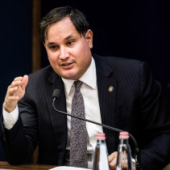
The Coronavirus has resulted in a global confidence crisis
…which has now become a financial and economic crisis
2020
Financial and commodity markets
Increasing volatility and risk aversion
Global
Plummeting oil prices
Local
Company
Group II
Global financial system
Factory shutdowns
Company
Group I
Supply chain disruptions
Households
Channels of confidence
Labour market

Slide 4
Breaking confidence is gradually spilling over towards consumers, turning into a self-amplifying spiral
BREAKING CONFIDENCE
Feedback
Short term
Financial markets, commodity prices (daily/weekly)
Confidence/leading indicators
(monthly)
Oil prices
Stock market indices
Foreign exchanges
ESI
Container and passenger traffic
Hard data
(monthly, quarterly)
Industrial production
Foreign trade
Retail trade
Labour market
Consumption
GDP
Balance indicators
(monthly/quaterly)
Current account
Private debt
Public debt
Longer term
Source | MNB

Slide 5
The sectors most exposed to the economic effects of the coronavirus
Tourism, catering
Vehicle industry
Electronics
Transportation
Source | MNB

Slide 6
The volatility has increased significantly in financial markets
Changes in risk indices
Note | The VIX index is a risk indicator for measuring the expectation of stock market volatility implied by S&P500 index options. The MOVE index shows the future volatility of US Treasury yields. The EMBI Global is the Emerging Market Bond Index.
Source | Bloomberg

Slide 7
Global Stock indices have fallen sharply
Developments in main stock indexes and MSCI stock market indices
Note | 1 Jan 2014 = 0
Source | Bloomberg

Slide 8
Long-term yields in advanced markets were stuck low
Change in advanced 10-year government securities yields
Source | Bloomberg

Slide 9
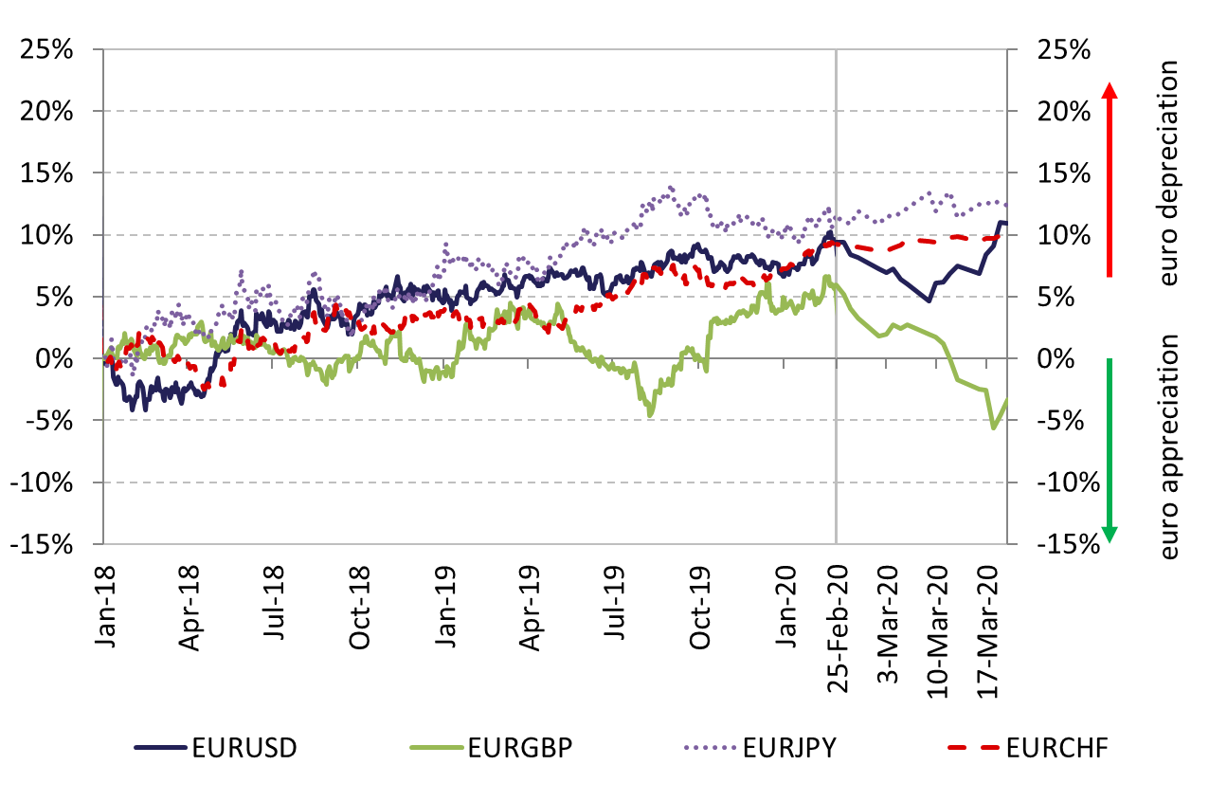
Developed foreign exchange markets were also characterised by volatile exchange rate movements
Change in the value of advanced currencies against the euro
Note | 1 Jan 2018 = 0
Source | Bloomberg

Slide 10
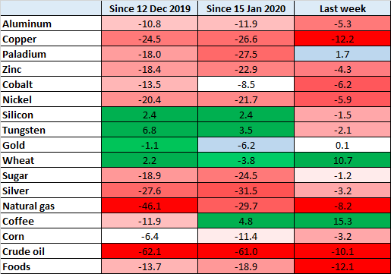
Coronavirus outbreak has caused a significant fall in commodity prices
Price changes on the commodities market
Source | Bloomberg

Slide 11
The February downturn in the Asian manufacturing sector reached Europe by March
Factory shutdowns
Evolution of Manufacturing PMI and the german IFO Business Confidence
Source | Bloomberg, IFO Institute

Slide 12
The impact of the pandemic has already been reflected in the significant rise in the USA unemployment Benefit claims
nUmber of Initial unemployment benefit claims filed in the US
Source | United States Department of Labour

Slide 13
Global tourism has been declining significantly in parallel with the pandemic
2020 between -1% and -3%
Annual changes in global Number of international arrivals
Source | World Bank, UNWTO

Slide 14
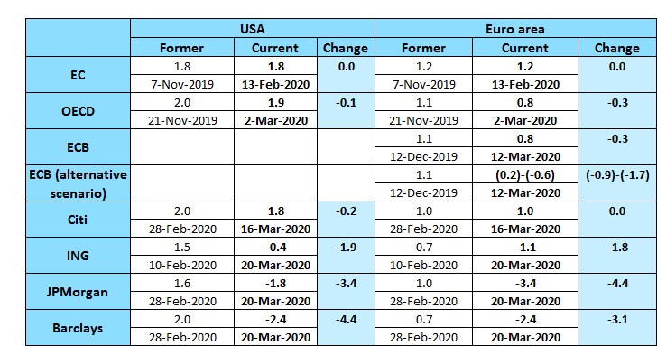
Economic effects of the coronavirus hold back this year’s gdp growth rates significantly
Changes in expectations to global economies’ gdp-growth for 2020
Source |Bloomberg, OECD, ECB, IMF

Slide 15
II. International monetary and fiscal policy measures

Slide 16
In response to the coronavirus Major central banks eased monetary conditions in a number of steps
Federal Reserve
Lowering the target range for the federal funds rate by 150 basis points in two steps (-50 bps, -100 bps) + cutting the interest rate of the O/N credit facility to 50 bps
Extension of the overnight and term repurchase agreement operations: O/N, 2 weeks, 1 month, 3 months
Purchases of Treasury securities and MBSs: USD 700 bn at first, then in the amounts needed
New credit facilities: Primary Dealer Credit Facility (PDCF), Commercial Paper Funding Facility (CPFF), Money Market Mutual Fund Liquidity Facility (MMLF), Term Asset-Backed Securities Loan Facility (TALF)
Cutting reserve requirements to 0 percent
European Central Bank
Bank of England
Provision of liquidity by conducting additional LTROs
Easing the conditions for TLTROs between June 2020 and June 2021
Additional net asset purchases of EUR 120 bn until the end of 2020 (with a large share of corporate bonds)
Pandemic Emergency Purchase Programme (PEPP): with an overall envelope of EUR 750 bn to counter the serious risks posed by the coronavirus
Cutting the base rate by 65 basis points to 0.1 percent
Measures to support businesses: Term Funding Scheme with additional incentives for SMEs (TFSME), Covid Corporate Financing Facility (CCFF): providing unlimited liquidity
Increasing the central bank’s holdings of UK government bonds by GBP 200 bn
Reducing the countercyclical capital buffer to 0 percent
Flexible macroprudential policy requirements
Provision of liquidity via swap line arrangements (ECB, Fed, BoJ, BoE, SNB, BoC)

Slide 17
In the region The national bank of Poland, romania and czech republic cut interest rates by 50 basis points
On 6 February the Czech National Bank increased the interest rate by 25 basis points to ease inflationary pressures
At an unscheduled meeting on 16 March the CNB decided to cut the base rate by 50 basis points and in addition:
The CNB stands ready to ease further;
Liquidity-providing repo operations will be announced three times a week instead of the current weekly frequency;
Postponement of the increase of the CCyB;
CNB stands ready to react to any excessive fluctuations of the koruna exchange rate.
On 17 March the National Bank of Poland cut the base rate by 50 basis points to 1.0 percent
In addition, the NBP decided:
To cut the required reserve ratio from 3.5 to 0.5 percent;
Purchase government bonds on the secondary market;
Offer bill discount credit aimed at refinancing new loans granted to economic entities by banks;
Provide liquidity to the banking sector using repo transactions.
On 20 March the National Bank of Romania cut the base rate by 50 basis points to 2.0 percent
In addition, the NBR decided:
To purchase leu-denominated government securities on the secondary market;
Provide liquidity to credit institutions via repo transactions
The NBR stands ready to cut the minimum reserve requirement ratios.

Slide 18
Base rates and interbank rates in the CEE region
Base rates 3-month interbank rates
ROBOR: 2.61 %
Romania: 2.00 %
Czech Republic: 1.75 %
PRIBOR: 1.78 %
Poland: 1.00 %
WIBOR: 1.08 %
Hungary: 0.90 %
BUBOR: 0.58 %
Source | Bloomberg

Slide 19
In addition, A number of other central banks have eased monetary conditions recently
Interest rate
Liquidity measures
Targeted loan programmes
Easing of prudential regulations
Norges Bank: -125 bp
Reserve Bank of Australia: -50 bp
People’s Bank of China: -10 bp
Bank of Canada: -100 bp
Central Bank of the Republic of Turkey: -100 bp
Reserve Bank of New Zealand: -75 bp
Bank of Japan: repo operations (USD 4,5 bn)
People’s Bank of China: repo operations (USD 58 bn)
Central Bank of Russia: repo operations (USD 6 bn)
Sveriges Riksbank: unlimited 3 month liquidity
Bank of Korea: targeted SME loan programme
Bank of Japan: corporate financing programme
Sveriges Riksbank: corporate loan facility and increase of asset purchases
People’s Bank of China: decrease of reserve requirement ratio
Norges Bank: decrease of anticyclical capital buffer
Sveriges Riksbank: decrease of anticyclical capital buffer
Asset purchases
Reserve Bank of Australia: asset purchase programme to reduce the yield on 3-year Australian Government bonds to 0.25 per cent
Reserve Bank of New Zealand: Government bond purchases in an amount of USD 30 bn

Slide 20
Most countries fight virus fallout with fiscal stimulus
4.2%
17%
Percentage of GDP
Germany
21.2%
2%
16%
Czechia
18%
1.1%
16%
Spain
17.1%
0.5%
14%
UK
14.5%
1.9%
12.4%
France
14.3%
2.2%
7.3%
Austria
10%
3%
6%
Poland*
9%
3.7%
1%
USA
4.7%
Romania
Fiscal measures
2%
Corporate loan and loan guarantee program
Italy
1.4%
Distribution is not available
Note | The corporate loan and loan guarantee program also includes central bank measures
Source | MNB

Slide 21
Comprehensive measures are taken worldwide to mitigate the effect of the crisis
Employees
Corporations
- Wage subsidies in case of retention of employees
- Benefits for isolated workers and for parents who need to take care of their children during school closures
- Increased social spending, sickness benefits for employees in the affected sectors
- Simplification of labour rules (part-time work, holidays)
- Moratorium on loan repayments for individuals
- Loan guarantees, interest-free or preferential loans for SMEs
- Gas, power bill payment holidays for some clients
- Temporary benefits for self-employed
- Holidays for social security contribution and personal income tax payments
- Support the introducing of home office
- Targeted sectoral support
- Moratorium on loan repayments
- Tax deferral or moratorium
Health care expenditures
Public investment
- Financial support for medical equipment and
medicines
- Higher wages for health care workers
- Increased R&D expenditures
- Financial support for quarantines
- Local infrastructure development (eg. roads)
- Modernization of schools
- Environment protection
- Renewable energy
- Digitalization
Source | MNB

Slide 22
III. Assessment of the domestic economic situation

Slide 23
The impact of the pandemic will be reflected in march economic data
From March 23 domestic vehicle factories have shut down (Audi, Opel, Mercedes, Suzuki)
Suzuki has fired 600 agency contracted employees
Disruptions in supply chains – from March 21 Denso’s factory in Székesfehérvár has shut down
Vehicle industry
Tourism, catering
Hotels and thermal baths have closed in Budapest
No new reservations, continuing cancellations
Catering establishments have been closing
Construction projects have stopped
From March 21 IKEA closed all of its Hungarian stores
Compulsory leave, redundancies in domestic SMEs
Non-food retail sector is in steep decline
Services with personal contact are plummeting
Other
sectors
Source | MN based on press infromations

Slide 24
Economic growth may temporarily slow down, then we expect lost activity to recover
V-shaped recovery!
Evolution of gdp projection
Source | HCSO, MNB projection

Slide 25
A one-month shutdown in the most exposed sectors could significantly restrain GDP growth
 | GDP weight (percent) | GDP weight with connected sectors (percent) | Impact of a one-month shutdown (percentage point)
Vehicle industry | 4.3 | 4.5 – 6.0 | (-0.3) - (-0.4)
Tourism | 1.8 | 6.0 – 7.0 | (-0.4) - (-0.5)
Cultural services | 1.5 | 1.5 – 2.0 * | (-0.05) - (-0.15)
Transport and storage | 5.1 | 4.0 – 6.0 * | (-0.15) - (-0.25)
SUM | 12.7 | 16.0 – 21.0 | (-0.9) - (-1.3)
Impact of a one-month shutdown on domestic economic sectors
Note | The direct weight of the sectors based on the corresponding NACE codes. Weight with connected sectors are own estimates based on input-output tables and detailed national accounts data. Tourism-related transport and cultural services were considered in the second column as suppliers of tourism, thus avoiding double counting.
Source | MNB calculation

Slide 26
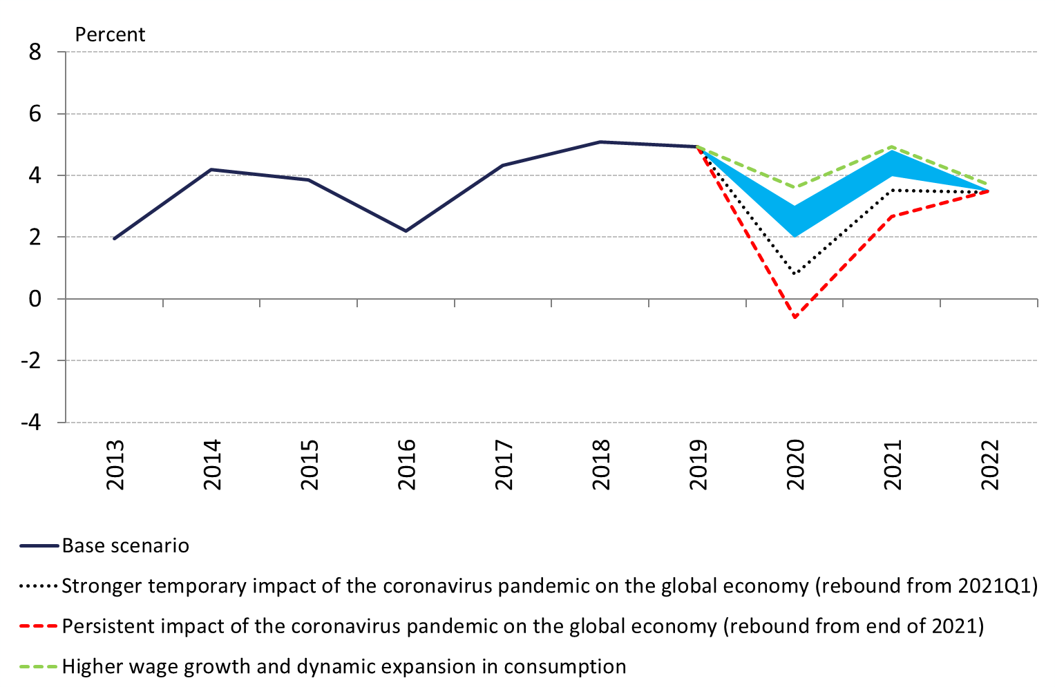
Growth effects of downward risks are more significant
Effects of alternative scenarios on hungarian GDP forecast
Source | MNB

Slide 27
Our forecast for oil price is significantly lower than in December
Changes in our assumptions for Brent oil prices since the december 2019 inflation report
Source | Bloomberg, MNB

Slide 28
Inflation may stabilize near the 3 percent inflation target by the end of the forecast horizon
4.5
4.0
3.5
3.0
2.5
2.0
1.5
Forecast range
Inflation
Our inflation forecast
Source | MNB

Slide 29
Core inflation excluding taxes will be lower in 2020 and 2021 comparing to our december forecast
4.0
3.5
3.0
2.5
2.0
1.5
Our core inflation (excluding taxes) forecast
Note | The range is formed by two different forecast scenarios.
Source | MNB

Slide 30
We expect an increasing current account balance in the coming years
Evolution of net lending and borrowing
Note | In percent of GDP.
Source | MNB

Slide 31
FX-Swap and bubor rates decreased at the end of the period, T-bill yields converged
25-Feb-20
Short-term rates
Source | Bloomberg

Slide 32
Parallel with advanced bond yields, long-term yields increased in the region as well
10-Year government bond yields in the region
Source | Bloomberg

Slide 33
Amount of government bonds held by foreign investors did not change significantly
Stock and share of foreign holders of huf denominated government bonds
Note | Stock of government bonds (HUF and FX) issued by central government is HUF 30.492 billion, share of foreign holders HUF 9.040 billion, 29.6%. (31. January 2020)
Source | MNB

Slide 34
Liquidity decreased on the main domestic financial markets
Parallel with the weakening liquidity on the global financial markets, liquidity weakened on local financial markets as well:
HUF spot markets: price-type indicators worsened, bid-ask spread widened by 3-4 times, however the turnover is high with trades smaller than usual
Short-term FX-swap market: bid-ask spreads also widened, sometimes reached hundreds of basis point
On the government bond market, spreads also widened, but turnover and size of contracts are above the historical average
Short-term interbank depo market: liquidity condition rather improved, widening spreads were compensated by larger turnover and the stability of yields.

Slide 35
IV. The Magyar Nemzeti Bank’s measures so far

Slide 36
in accordance with The MNB’s recommendations, The Government ordered a payment moratorium
Subject
Households
Outstanding credit stock on 18th March 2020
Loans, credit
Non-financial corporations
Leases
Financial enterprises and investment funds
Period
The Government can extend the moratorium if needed
19/03/2020
31/12/2020
Process
Debtors can decide to continue contractual payments (opt-out)
No debt release: postponed payments must be paid later on
The maturity is extended automatically
Banks’ profitability is not affected substantially: postponed interest will be added to the obligation at the end of the moratorium
The MNB welcomes the Government’s decision, and supports it within its own authority with a moratorium on FGS* loans as well
*FGS: Funding for Growth Scheme

Slide 37
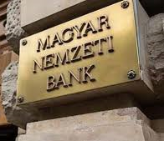
The moratorium on the payment of loan instalments results in practice in a liquidity risk transfer
In the case of full utilisation HUF 3,600 bn, in the case of an 80 percent participation rate HUF 2,900 bn of instalments will fall under moratorium
Customers
Liquidity shock
Total level of liquidity in the banking sector remains unchanged, it is the distribution within banks which will change and may necessitate liquidity help!

Slide 38
The steps taken by the MNB can ensure that the liquidity impact of the moratorium remains manageable
Household and corporate instalments subject to the moratorium until December 2020
~ HUF 3,600 bn
Ft
 | Postponed repayments monthly between April and December | Total postponed repayments until the end of December
If 50 percent of clients take the possibility of the moratorium | HUF 200 bn | HUF 1,800 bn (~ HUF 1,620 bn capital)
If 80 percent of clients take the possibility of the moratorium | HUF 320 bn | HUF 2,880 billion (~ HUF 2,590 bn capital)
Postponed repayments due to the moratorium
The domestic banking system has significant liquidity buffers
Potential negative effects are offset by the expansion of the central bank's monetary policy instruments
Note | Estimated values. In the table, instalments are shown without FGS loans; the instalments of Hungarian financial enterprises and investment funds are included. Source: MNB.

Slide 39
The impact of the moratorium on the interest income depends on the restructuring of instalments and the participation rate
 | In case 50 percent of customers make use of the moratorium option | In case 80 percent of customers make use of the moratorium option | In case 100 percent of customers make use of the moratorium option
Interest capitalised monthly as it falls due during the moratorium | 0 | 0 | 0
Interest capitalised at the end of the moratorium | HUF 3-4 bn | HUF 5-6 bn | HUF 6-8 bn
Interest capitalised on the payment date following the end of the moratorium | HUF 3.5-4.5 bn | HUF 6-7 bn | HUF 7-9 bn
Interest due during the moratorium paid over the residual life, linearly, i.e. in instalments | HUF 25 bn | HUF 40 bn | HUF 50 bn
Impact of interest foregone during the moratorium on profitability

Slide 40
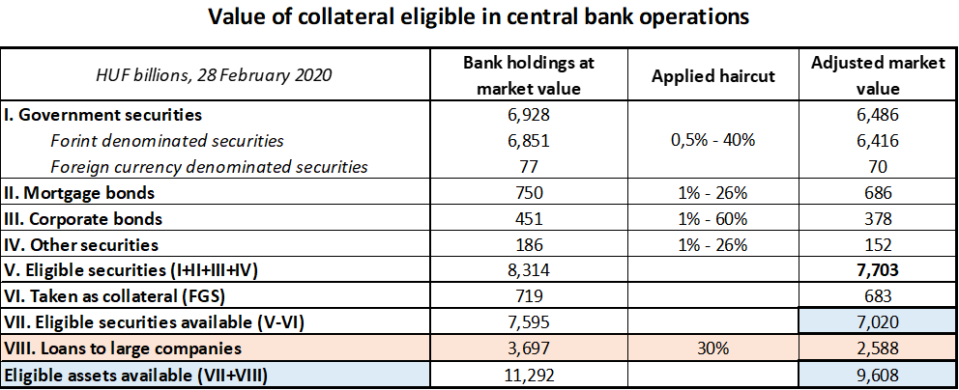
Magyar Nemzeti Bank accepts loans to large companies as collateral
Total value of available eligible assets for the banking system exceeds HUF 9500 billion.
The stock of available eligible securities stands at HUF 7000 billion.
Following the inclusion of loans to large companies, banks can access to additional HUF 2600 billion liquidity.

Slide 41
The MNB supports the mitigation of the pandemic’s effects on the banking sector with numerous steps
Loosening | Tightening
Exemption from the Systemic Risk Buffer Maintaining the level of Pillar 2 requirements Foregoing the steps that can be taken when violating the P2G capital guidance Postponement of MREL compliance by 6 months | Restriction on dividend payments
Postponement of the MFAR tightening scheduled for 2021 and suspending limitations on banks’ cross-ownership of mortgage bonds Assessing the possibility of restarting the mortgage bond purchase program | Tightening the Foreign Exchange Funding Adequacy Ratio (FFAR) and Foreign Exchange Coverage Ratio (FECR) regulations to maintain the level of stable FX funding
Suspending onsite ILAAP investigations until 31 Dec 2020 Rescheduling the inspection plan Easening residential mortgage processes (disregarding valuation and notarization) | Increased consumer protection requirements with regard to the temporary situation Increased reporting and monitoring requirements
Capital
Liquidity and financing
Other

Slide 42
V. The Monetary Council’s interest rate decision on 24 March 2020

Slide 43
Monetary Council did not change the interest rate conditions in March
„At its current policy meeting, the Monetary Council left the base rate, the overnight collateralised lending rate and the one-week collateralised lending rate at 0.9 percent and the overnight deposit rate at -0.05 percent unchanged.”

Slide 44
average amount of liquidity to be crowded out for 2020 q2 at a minimum of HUF 300-500 billion
Unchanged target for liquidity to be crowded out helps to achieve adequate level of short-term interest rates as well as the desired monetary conditions.
The target level ensures the necessary amount of liquidity for the banking sector at disposal.
Effectively smooth transitional market and liquidity shocks
Changes in the stock of the FX swap instrument aim to achieve the targeted amount of liquidity.
Unchanged target for crowding-out liquidity has a stabilizing effect on the markets

Slide 45
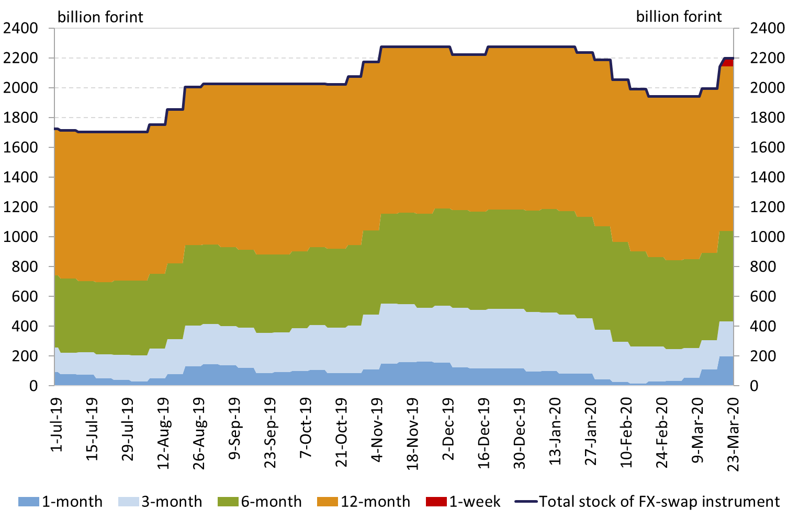
By increasing the stock of central bank FX swap instrument the MNB has raised the interbank liquidity since the beginning of march
During the tenders held on 9th and 16th of March the stock of central bank FX-swap instrument increased by 50 and 150 billion forint.
Beside the regular 1-, 3-, 6-, 12-month FX-swap tenders the MNB has been holding 1-week FX-swap tenders providing forint liquidity daily for counterparties since 17th March.
Outstanding stock of central bank fx swap instrument
Source | MNB

Slide 46
Monetary council decided to introduce the collateralised lending facility with maximum 5-year maturity
The global crisis caused by the coronavirus pandemic has impacted the domestic money markets, liquidity tensions arose on the market of Hungarian long-term government securities.
The Monetary Council decided to introduce the long-term collateralised lending facility with maximum 5-year maturity supporting the banks’ liquidity management on longer-term maturities and strengthen the functioning of the government securities market.
Stable funding source for banks
Banks can receive liquidity without scaling back of lending or sale of eligible securities
It can support the stabilization of government securities market

Slide 47
Parameters of the fixed-rate collateralised loan
Maturity:
Maximum 5-year maturity, including longer-term 3 and 5-year and short-term 3-6-12-month maturities
Amount:
Unlimited, while allotted amounts of each tender is based on current market developments
Interest:
Fixed interest rate during the whole maturity, which ensures that interest rate risk of banks do not increase in case of buying fixed-rate assets
Unconditionality:
Free use for either loans to private sector or FX and interest rate swaps, for buying Treasury bonds, interbank transactions

Slide 48
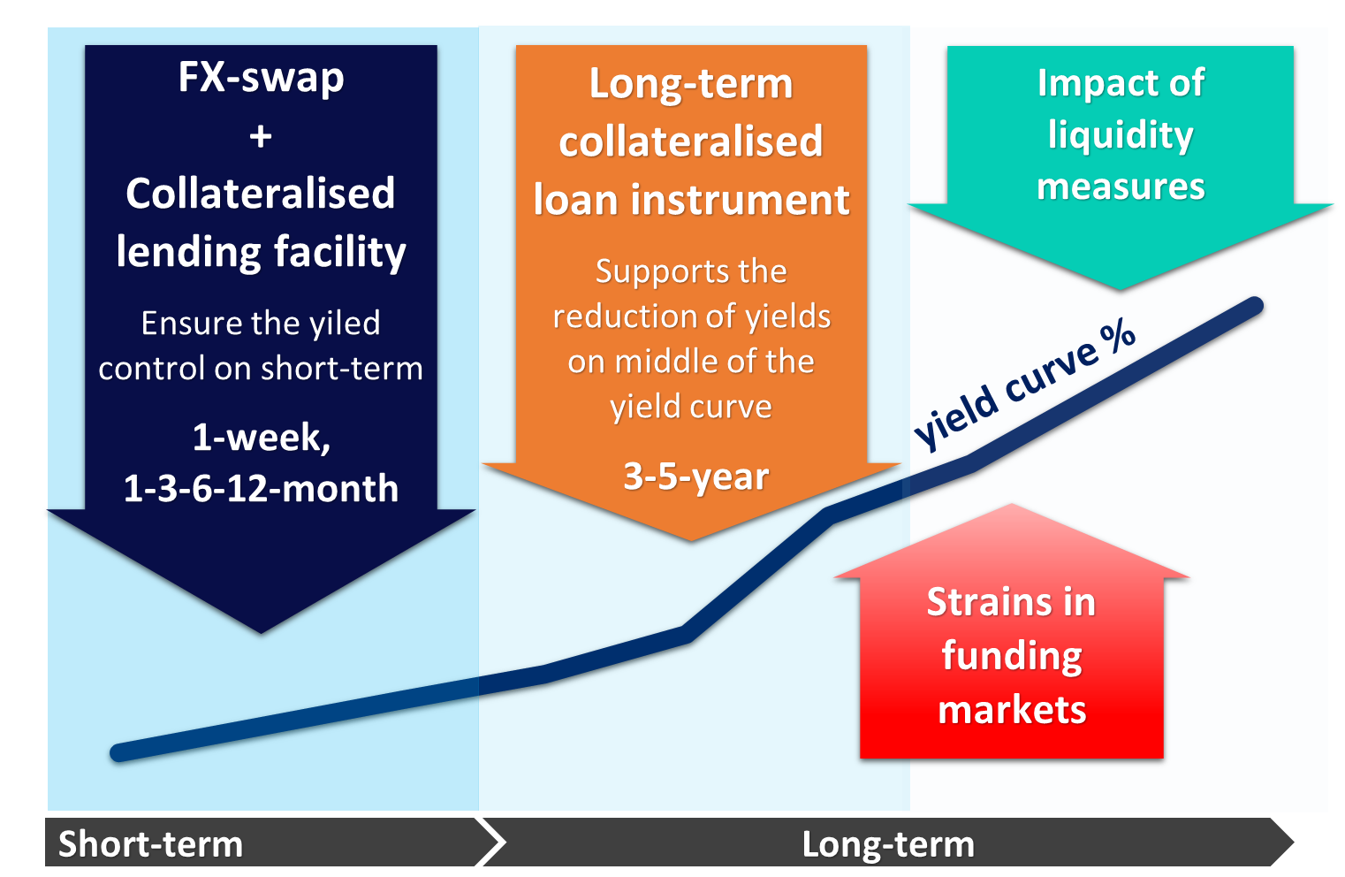
The impact of liquidity measures on yield curve
The impact of liquidity measures on yield curve

Slide 49
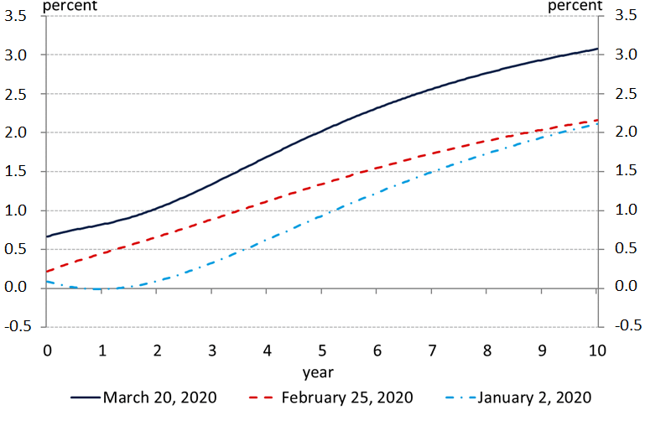
Priority is to ensure liquidity to the long-term treasury market as well
changes in spot treasury yield curve
Source | MNB

Slide 50
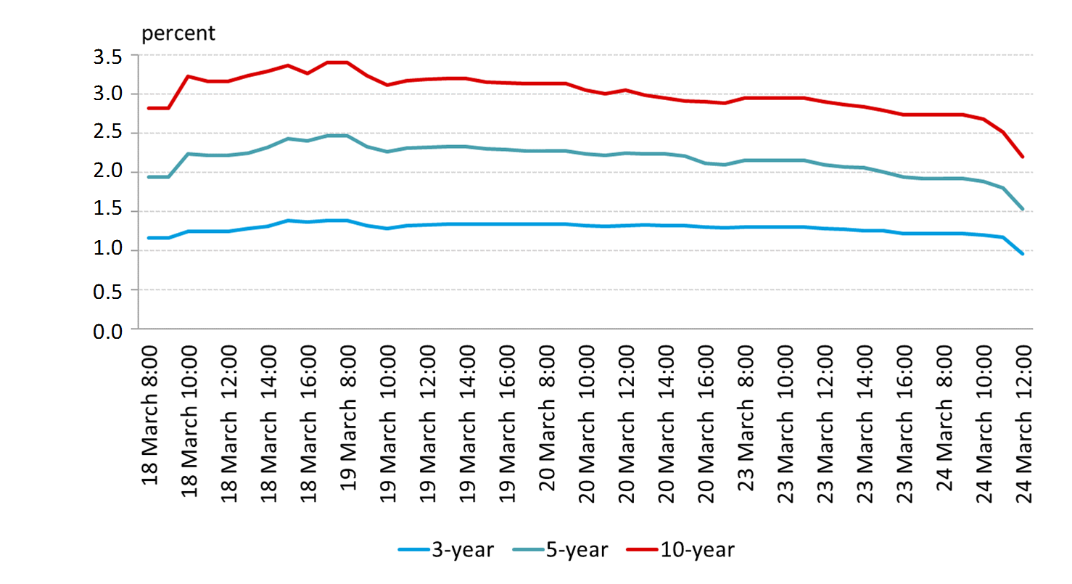
Local long-term government bond yields decreased considerably last week
3-, 5- and 10-year benchmark government bond yields
Source | Reuters

Slide 51
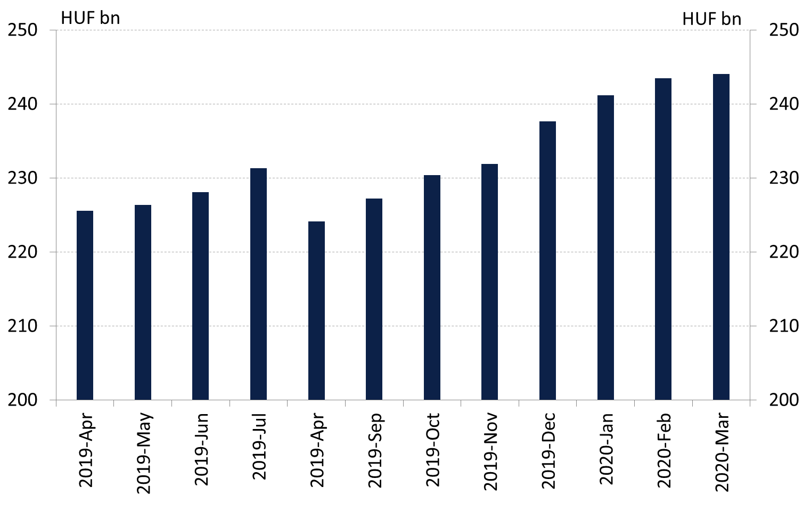
Exemption from reserve requirements
The sanctions on reserve deficiency are suspended.
Providing additional 250 billion forintliquidity
Required reserves will continue to be remunerated at base rate.
The interest on excess reserves remains the interest on the O/N deposit facility minus 15bps, while the sanction on reserve deficiency is the prevailing base rate.
The exemption from the reserve requirements is effective immediately and applicable for the reserve maintenance period of March 2020.
Reserve requirements of the banking system in the past one year

Slide 52
VI. The Monetary Council’s forward guidance

Slide 53
The Magyar Nemzeti Bank’s primary objective is to achieve and maintain price stability
„The Magyar Nemzeti Bank’s single anchor is inflation, its primary objective is to achieve and maintain price stability.”
Inflation is expected to fall below the central bank target in the coming months, before stabilising gradually at 3 percent.

Slide 54
The most important consideration now is to ensure the required liquidity for all sectors
Government budget
Corporates
Banking system
Households
In order to this, the MNB is ready to use every instrument at its disposal and take further measures to provide additional liquidity.

Slide 55
The Monetary Council’s forward guidance
„The Monetary Council monitors closely and assesses continuously the incoming data, as well as the effects of the coronavirus pandemic on the macroeconomy and the financial market.”
„In order to preserve effective monetary policy transmission, the Monetary Council is ready to take further measures to provide additional liquidity.”

Slide 56
Thank you for your kind attention!

