Slide 1
Financial stability report
June 2021
Bálint Dancsik | Head of Department
Financial System Analysis Directorate
Press conference | 3 June 2021

Slide 2



Press presentation:
https://www.mnb.hu/letoltes/press_conference_financial_stability_report_2021_june_EN.pptx
Figures of the report:
https://www.mnb.hu/letoltes/jelentes-abrai-tablai-charts-tables-of-report-2021-junius.xlsx
This Report is based on information in the period to 30th April 2021.
The extension of the payment moratorium after June was thus not taken into account.
Based on government communication: the moratorium can continue unchanged until August, then from September in a different form.

Slide 3
Trends in lending
Shock resistance
Credit risks
International environment
Profitability
Aspects to be considered when extending the payment moratorium

Slide 4




The moratorium was an effective element of the crisis management toolbox...
...but the proportion of the advantages and risks changes over time!
Households
Corporations
51 per cent of the eligible households’ outstanding loans participated in the moratorium, which is 39 per cent of the total portfolio.
36 per cent of the eligible corporates’ outstanding loans participated in the moratorium, which is 24 per cent of the total portfolio.
SHARE
I. HUF 600 billion postponed instalment until the end of 2020
II. HUF 300-400 billion instalment until June 2021
I. HUF 1100 billion postponed instalment until the end of 2020
II. HUF 400-500 billion instalment until June 2021
LIQUIDITY
Numerous vulnerable debtors have benefited from the program, on the other hand, also debtors who are not in need based on their income and financial situation.
Note: March 2021 data. Drivers of participating in the moratorium are explained in detail in Box 5 of the report. Source: MNB

Slide 5
In the case of high-interest products, the risk is higher in proportion
According to our survey, only 31 per cent of the debtors participating in the moratorium understood the consequences of the programme on the debt service.
Impact of a payment moratorium between March 2020 and June 2022 on the total repayable amount and the maturity of a HUF 15 million mortgage loan
Impact of a payment moratorium between March 2020 and June 2022 on the total repayable amount and the maturity of a HUF 1.5 million personal loan
The higher the current residual maturity and the interest rate under the moratorium, the greater the difference in the maturity and the total amount repayable.
Note: Term prolongation also includes the 27 months period spent in the moratorium. Source: MNB

Slide 6
The Higher residual maturity and the increase of the debt may pose a risk
In the case of a moratorium lasting until June 2022, the maturity would increase by more than three and a half years compared to the original maturity for more than half of these loans.
The total repayable amount will increase by over 10 per cent for more than half of the mortgage debtors, and by over 40 per cent for more than half of the personal loan debtors.
The extent of the term prolongation for mortgages and personal loans in moratorium, assuming a program sustain until 30 June 2022
Note: Term prolongation also includes the 27 months period spent in the moratorium. Source: MNB

Slide 7
The advantages of the moratorium are maximized if the extension is used only by those in need
Consumer protection aspects and risks
impacts related to changes in payment morale
Impacts on bank risks and lending activity
  Inaccurate assessment of the consequences of the programme for some debtors.
  Risk is higher in case of longer residual maturities and higher interest rates.
  Adaptation may be difficult after higher consumption.
  Temporarily higher income may lead to a deterioration in willingness to pay after the moratorium.
  At least 56 percent of the households particitpating in the moratorium would be able to pay their instalments.
  27 per cent of participating households would be able to repay, but would likely apply for further participation.
  Impairment may be required to comply with international regulatory, parent bank and auditor requirements.
  An increase in losses would also reduce banks' lending capacity through the negative impact on their capital position.
As a result of a further, generally available extension, the Humgarian moratorium would be unprecedented in Europe. This may impair the credit rating and investor assessment
of the country.
When extending the moratorium, the Magyar Nemzeti Bank considers it highly important that the majority of the debtors currently participating in the programme restart the repayment of their respective loans, and only those should take the opportunity offered by the extension of the programme who really need the backstop provided by the moratorium

Slide 8
Trends in lending
Shock resistance
Credit risks
International environment
Profitability
Aspects to be considered when extending the payment moratorium

Slide 9
The economic outlook has improved, but there are several risks to recovery
Of the G7 countries, only the US economy may exceed its pre-pandemic output this year.
IMF forecasts for changes in real GDP
Source: IMF WEO.

Slide 10
Global economic recovery and monetary and fiscal stimuli have pushed up inflation expectations worldwide
Fiscal measures have supported economies by 19 per cent of world economic output over the past year.
Developed economies can be characterized by supportive fiscal policies this year as well.
Inflation expectations in the Eurozone and in the United States
Note: Inflation expectations implied by the difference between the 10-year government bond yields and inflation indexed government bond yields. Source: Datastream, FRED

Slide 11
Rising advanced market yields have reduced and periodically reversed the direction of emerging market capital flows
Evolution of emerging market capital flows and 10-year US yields
Source: EPFR, Datastream

Slide 12
Trends in lending
Shock resistance
Credit risks
International environment
Profitability
Aspects to be considered when extending the payment moratorium

Slide 13
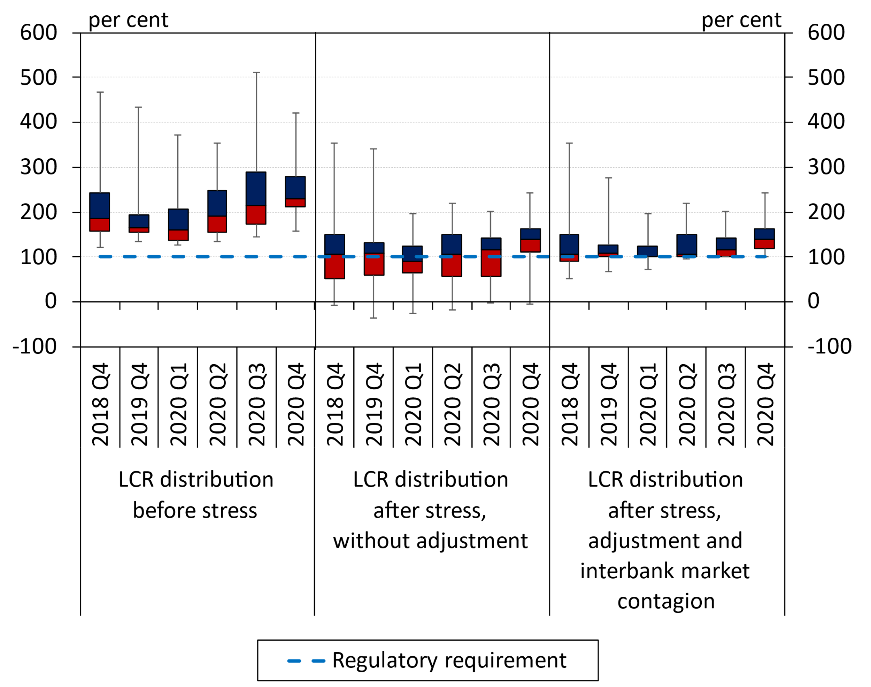
The sector has ample liquidity, even in a case of a severe shock scenario
In the second half of 2020, the liquidity situation of the banking sector improved further, the liquidity coverage ratio (LCR) rose to 206 per cent by the end of 2020.
Distribution of the LCR before and after stress, based on the number of banks
Note: The edges of the boxes mean the lower and upper quartiles of the distribution; the border of the colours means its median. The lower whisker of the plot shows the tenth percentile, while the upper shows the ninetieth percentile. Source: MNB

Slide 14
The easing of capital buffers significantly increased banks’ free capital
Capital adequacy improved by annual profits and regulatory easing.
Excluding the 2.5 per cent capital conservation buffer requirement (CCoB), currently not mandatory under the April 2020 easing introduced by the central bank, free capital stands at HUF 2,110 billion.
Consolidated capital adequacy of the banking sector
Note: Data prior to 2014 were prepared under different prudential and accounting standards. Data for December 2020 are included without the easings related to capital requirements. Source: MNB

Slide 15
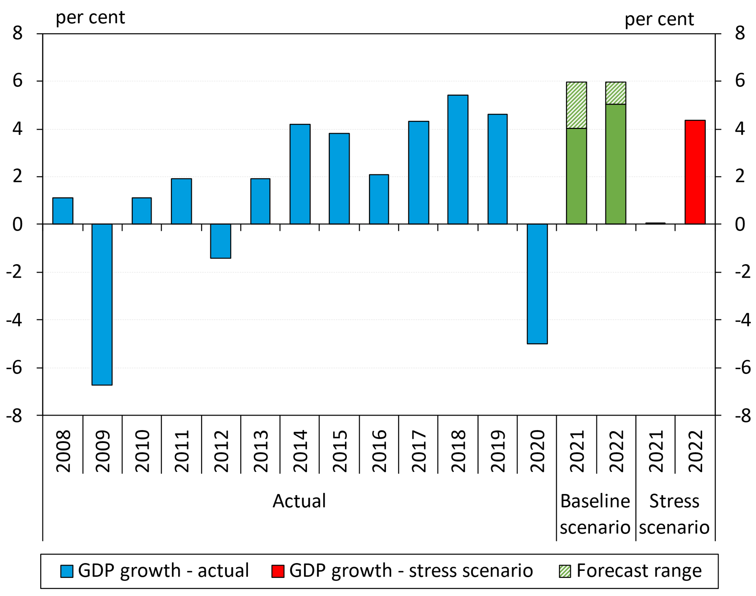
In our solvency stress test we assumed a worse-than-expected economic scenario
In the stress scenario, during two years in total economic growth falls short of the baseline scenario by 5-6 per cent, along with weaker exchange rate and a higher interest rate level.
Stress scenario assumptions:
the severe progress of the coronavirus pandemic,
Hungary’s export markets recover more slowly than previously expected.
payment moratorium lasting until June 2021
Consequences:
the private sector’s risk aversion increases,
companies postpone their planned investments, and start layoffs,
production capacities are also impaired.
GDP growth rate in the scenarios
Note: Year-on-year growth rate of yearly GDP, based on seasonally unadjusted data. Source: MNB

Slide 16
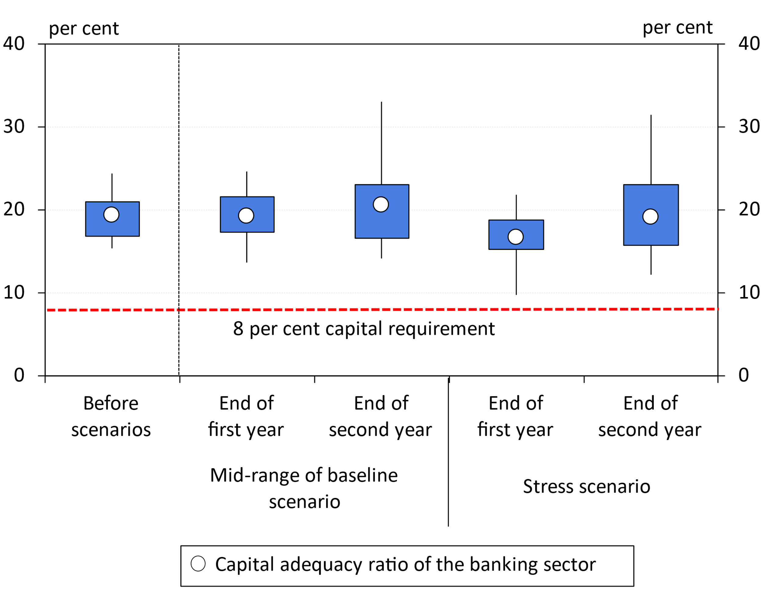
Even a severe stress would not trigger sharp adjustment needs
Weighted by risk-weighted assets, by the end of the stress scenario 0.6 per cent of the sector would breach the 8-per cent limit and a capital need of HUF 3.4 billion would arise. Considering all capital requirements currently in force, a capital increase of HUF 7.8 billion would be required.
Distribution of the capital adequacy ratio based on the number of banks
Note: Vertical line: 10–90 per cent range; rectangle: 25–75 per cent range. Source: MNB

Slide 17
Trends in lending
Shock resistance
Credit risks
International environment
Profitability
Aspects to be considered when extending the payment moratorium

Slide 18
The payment moratorium and state-subsidised products maintain corporate lending growth
Despite the pandemic, growth continued both in the overall corporate loan portfolio and in the SME sector, albeit the two rates diverged substantially from each other.
At the end of 2021 Q1, the annual growth rate was 6 per cent in the overall corporate segment, and 17 per cent in the SME segment, according to preliminary data.
Growth in loans outstanding can be considered balanced, despite the relatively high rate.
Growth rate of loans outstanding of the overall corporate sector and the SME sector
Note: Transaction-based growth rates based on credit institution sector data. Prior to 2015 Q4, data for SMEs are estimated based on banking system data. Source: MNB

Slide 19
Instead of “credit crunch”, leading credit expansion in European comparison
>3000 billion HUF
Contracts for new government and central bank loan programmes since their launch
~60 per cent
Weight of programmes in new corporate lending
41 per cent
FGS share of new corporate lending
Cumulative growth in corporate loans following the economic crisis of 2008 and the emergence of the coronavirus
Note: Transaction-based growth rates based on data from the credit institutions sector.
t = September 2008 and February 2020. Source: MNB

Slide 20
demand for investment loans has been sustained, partly due to the favourable government programmes
At the end of 2020, companies taking out subsidised loans with a headcount over five employed 4 per cent more employees than similar companies not taking advantage of the loan programmes.
The strongest effect can be identified at companies participating in FGS Go!, those taking out investment loans and for small enterprises.
Changes in credit conditions and credit demand in the corporate segment
Note: The impact of government and central bank lending programmes on employment is discussed in more detail in Box 4. Net percentage balance of respondent banks indicating tightening/easing and weaker/stronger demands, weighted by market share. Source: MNB

Slide 21
Those who opted out of the moratorium may have also been encouraged by the favourable interest rate loan programmes
Enterprises in the moratorium also received new credit
Enterprises that were able to opt out of the moratorium took out new loans at a higher rate: refinancing motivation!
Outstanding portfolio of corporate loans concluded before and after the announcement of the moratorium
Note: Based on data from the credit institutions sector. Source: MNB

Slide 22
the effects of the new family support subsidies are visible in the 2021 March disbursements
Despite the pandemic, demand remained buoyant for the prenatal baby support loans, they accounted for 30 per cent of the annual new disbursements.
The 536 bn HUF new loan volume disbursed in 2021 Q1 has been 15 per cent lower compared to the same period of the previous year, which has only been mildly affected by the coronavirus.
New household loans in the credit institution sector
Note: Loan refinancing indicates only refinancing related to the early repayment scheme and the FX conversion. Other consumer loans include vehicle loans and hire purchase and other loans, without prenatal baby support loans. Source: MNB.

Slide 23
The characteristics of personal loan contracts concluded in 2020 differ substantially from those issued a year ago
The ratio of customers with lower income has diminished.
The ratio of transactions concluded with a debt-to-income ratio of over 40 per cent – indicating relatively high income tightness – fell from 32 per cent to 27 per cent in 2020.
Characteristics of the new personal loans issued by credit institutions
Note: * At least 8-year maturity. ** At least HUF 3 million contract size.. Source: MNB.

Slide 24
Family support subsidies augmented in January 2021 boost demand for household loans
Changes in credit conditions and credit demand in the household segment
Note: Net ratio is the difference between tightening and easing banks, and the banks indicating stronger and weaker credit demand, weighted by market share. Source: MNB, based on banks' responses

Slide 25
Forecast: Government programmes continue to sustain growth in loan portfolio
At the end of 2021, we expect an annual growth rate of around 9 per cent in the corporate segment and around 11 per cent in the household segment. By the end of 2022, the credit dynamics in the corporate segment may be around 8 per cent, and in case of household loans it may gradually increase to 13 per cent.
Corporate lending forecast
Household lending forecast
Moratorium extension could increase the loan portfolio through lower repayments over the forecast horizon, but the restraint of new lending has the opposite effect.
Note: Transaction-based annual growth rate. For household loans, data for 2019 Q3 adjusted for transactions of lombard loans. Source: MNB

Slide 26
In contrast to the 2008 crisis, households entered the coronavirus crisis with stronger balance sheet
Debt cap rules support prudent indebtedness.
80 per cent of household loans outstanding (70 per cent of mortgage loans) has been contracted under the effect of these measures.
Based on our agent-based housing market model – modelling 4 million households – without the debt cap rules, we would have faced higher risks during the COVID-19 crisis.
Debt-to-income ratio of the household segment
Note: The effects of the debt cap rules during the COVID-19 crisis - based on the agent-based housing market model - have been analysed in detail in Box No.2. Source: ECB QSA

Slide 27
Trends in lending
Shock resistance
Credit risks
International environment
Profitability
Aspects to be considered when extending the payment moratorium

Slide 28
The moratorium masks repayment difficulties: NPL-ratio continued to decline in 2020
Ratio of non-performing corporate and household loans in the credit institutions sector
Note: The definition of non-performing loans changed in 2015. From then on, in addition to the loans over 90 days past due, loans less than 90 days past due where non-payment is likely are also classified as non-performing. Calculated by clients until 2010 and by contracts from 2010. Source: MNB

Slide 29
The ratio of highly risky corporate and household loan portfolio are 12 and 10 per cent, respectively
Credit institution sector’s corporate loans
Credit institution sector’s household loans
Moratorium participation rate (29%)
Moratorium participation rate (42%)
Vulnerable sectors (11%)
Non-vulnerable sectors (18%)
Stressed financially (6,1%)
Significantly stressed financially (5,5%)
Vulnerable sectors (10%)
Total: ~12%
3 aspects: sector + moratorium + financial tightness.
NOT NPL forecast! The NPL-ratios may peak at a lower level.
Note: For the classification of vulnerable sectors see Box 6. Estimation based on December 2020 data.

Slide 30
Banks perceive increasing credit risk in the loan portfolio
Loan loss coverage and distribution by quality
Note: Calculated by clients until 2010 and by contracts from 2010. Stage rating is available from 2020 onwards. Source: MNB

Slide 31
banks experienced a higher increase in credit risks in the case of loans in the moratorium in 2020 H2
Movements of corporate loans between loan loss categories between 2020 Q2 and 2020 Q4
Movements of household loans
between loan loss categories between 2020 Q2 and 2020 Q4
Note: Credit institutions' data. Ratios on the basis of outstanding amounts at the end of 2020 Q4. Source: MNB

Slide 32
Collaterals: Trends in rents and house prices are diverging
The subsidising environment is heating the demand, although signs of excessive lending are not yet being seen.
A maximum 14 per cent of the borrowers of mortgage loans have complemented their own funds through prenatal baby support or personal loans since July 2019.
Change in rents (left chart) and house prices (right chart) in the country as a whole and in certain groups of districts in Budapest (2015 = 100 per cent)
Note: Rents based on the HCSO-ingatlan.com house-rent indices, house price indices on the basis of MNB estimate. Buda mountainous district: I., II., XII., Buda other districts: III., XI., XXII., Pest inner district: V., VI., VII., VIII., IX., Pest transitional district: X., XIII., XIV., XIX., XX., Pest outer district: IV., XV., XVI., XVII., XVIII., XXI., XXIII.
Source: HCSO-ingatlan.com, MNB housing agent database

Slide 33
commercial real estate market exposure as a percentage of the regulatory capital is at a historically low level
High-volume development projects and uncertain demand characterise the commercial real estate market.
The highest portion of reclassification to a worse loan loss category took place for hotel and residential real estate project loans.
The interbank concentration of commercial real estate project loans can be considered moderate.
New volume of commercial real estate project loans and share of the outstanding stock to regulatory capital
Note: Banking sector data. Until 2010, the new disbursements also include loans to non-resident companies. We analyse the risks of commercial real estate loans in Box 3 of the Report.

Slide 34
Trends in lending
Shock resistance
Credit risks
International environment
Profitability
Aspects to be considered when extending the payment moratorium

Slide 35
Increasing credit risk is indicated by the level of impairment as well
In 2020, Hungarian banks recognised impairment of roughly HUF 260 billion, which corresponds to 0.5 per cent of the assets and may be regarded as prudent provisioning also by European Union standards.
In 2021, due to the deterioration in the risk rating of loans participating in the moratorium for more than 9 months the sector’s profitability may decline further.
Balance sheet total weighted distribution of credit institutions' net impairment to assets ratio
Note: Green categories represent net reversal of impairment, while red categories represent net recognition of impairment. For the 2017-2019 period, institutions are considered by their average balance sheet total in the category of their average net impairment as a percentage of assets. Source: MNB

Slide 36
The share of highly profitable credit institutions fell sharply during 2020
ROE 2019 Q4: 11.7 per cent
ROE 2020 Q4: 4.4 per cent
After-tax profit and loss of the credit institution sector
Note: At the end of 2020, the ratio of loss-making institutions in terms of total assets was 11 per cent based on consolidated data. Source: MNB

Slide 37
The improvement in cost-to-assets continued
The decline in cost-to-assets, which started in early 2019, continued in 2020.
The improvement in operating expenses is also shown by the fact that personnel expenses fell in nominal terms for the first time in years.
The gradual rationalisation of the branch networks has also contributed to this change.
A portion of this change can be attributed to the growth in total assets.
Development of operating costs, branches and employees
Note: Items expressed as a ratio of total assets exhibit 12-month rolling data. Source: MNB

Slide 38
Digitalization can mitigate the adverse effects of branch closures on access to financial services
There are already 2 million people living in a settlement without a branch. At the same time, distances from the nearest bank branch also increased.
There is a significant overlap between unfavorable branch availability and moderate internet use.
Public involvement plays an important role in the wider deployment and development of digital banking solutions.
Distribution of settlements without a bank branch by internet use
Note: A more detailed analysis of branch closures in Hungary can be found in Box 10. Colored by quartiles of internet usage distribution for all settlements. Source: HCSO, Ministry of Innovation and Technology, MNB

Slide 39
Magyar bankholding: concentration vs more balanced relative market power
The institution with the second largest market share in the household segment is established.
The concentration of the household credit market is expected to increase significantly in some counties and districts.
If the synergies of the merger are successfully exploited, more efficient operations may result in lower interest rates.
Market concentration by the balance sheet total of banks and their loan and deposit portfolios by segments
Note: Further information on the impact of the establishment of Magyar Bankholding on the concentration of individual sub-markets can be found in Box 8. The indicators of the balance sheet total are based on consolidated data, the other indicators are based on the aggregated stocks of banking groups from individual bank data. The circled sections indicate a significant increase in HHI of more than 250. Source: MNB

Slide 40
The main messages of the report
MORATORIUM
It is important that the majority of debtors participating in the programme start repaying their loans and that the extension is used only by those who really need the safety net provided by the moratorium.
SHOCK-ABSORBING CAPACITY
Liquidity reserves are abundant, and even in the event of severe stress, there would be only a minimal capital shortfall in the sector. Banks are able to support the relaunch of the economy.
VULNERABILITY
12 per cent of the corporate loan portfolio and 10 per cent of the household loan portfolio may be regarded as particularly high-risk portfolio. However, non-performing rates are expected to peak lower than that in the coming years.
CREDIT RISKS
Banks have started the provisioning for the expected deterioration in the portfolio. The increase in credit risk mainly affected the loans in moratorium. Bank profitability also deteriorated significantly as a result of the recognized impairment.

Slide 41
Thank you for your attention!

