Slide 1
Korea as World Economic Power
MNB (5 October 2023)
Byung-Yeon Kim
(Director, Institute for Future Strategy, Seoul National University)

Slide 2
Korean history in a nutshell
Three kingdoms were unified in 676.
Korea was colonized by Japan in 1910.
Korea was liberated in 1945 but separated between South and North Korea.
The Korean war occurred during 1950-1953.
A rapid economic development started from the early 1960s under President Chung Hee Park.

Slide 3
Korea as a Global Economic Power
 | FT’s Top 100 Companies (6.2020) | Fortune’s Global 500 (2023)
S. Korea | 3 | 18
United States | 47 | 136
China | 24 | 142
Japan | 3 | 41
Germany | 1 | 30

Slide 4
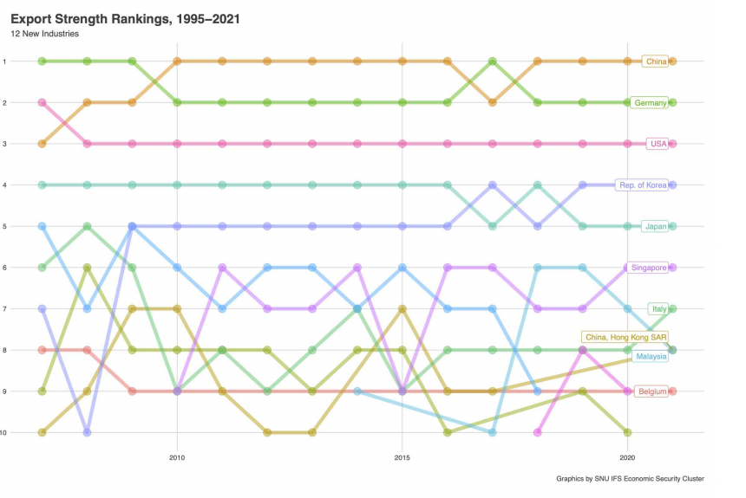
Korea as a Global Economic Power

Slide 5
Factors of Rising as a World Economic Power
Building & improving institutions
Export-oriented policies
Forward-looking management of enterprises
Overcoming technological entrenchment
Research & development
Education

Slide 6
Building & Improving Institutions
Democracy and market economy were transplanted but Koreans improved the quality of these fundamental institutions.
Political liberalization (PL) occurred in the late 1980s.
The quality of a market economy improved after the financial crisis in the late 1990s, which liberalized the economy further (EL).
S. Korea’s GDP per capita (real, 2015)
PL
EL

Slide 7
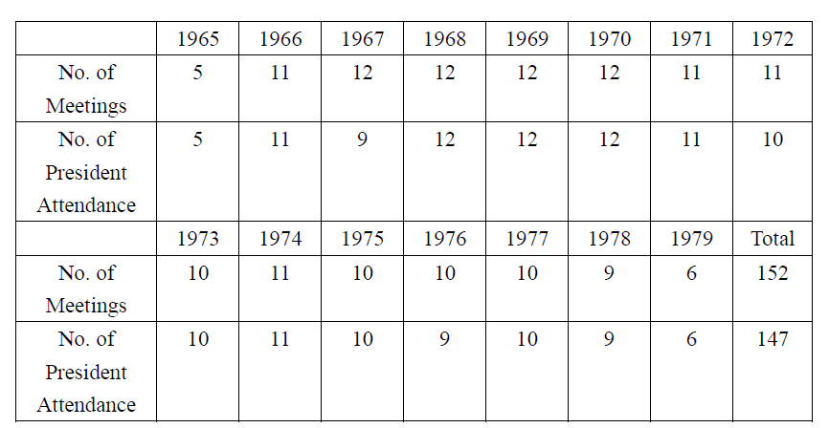
Export-oriented policies
During the 1960s and the 1970s, Chung Hee Park himself resided meetings for Export Promotion Committee (EPC) where not only government officials but also business leaders participated.
EPC was like a fast track approach to resolving binding constraints faced by businesses promoting exports.
Number of EPC Meetings and President’s Attendance

Slide 8
Future-oriented Management
Business owners took advantage of opening up and seriously considered what industry and products would be dominant in the future.
Samsung Electronics made investments in producing semiconductors the 1970s, believing it would be an important business opportunities in the future.
Such decisions became possible perhaps because of the combination of outward-looking attitude of business leaders, highly-knowledgeable individuals who had been educated in the US, and highly-skilled and committed labour force.

Slide 9
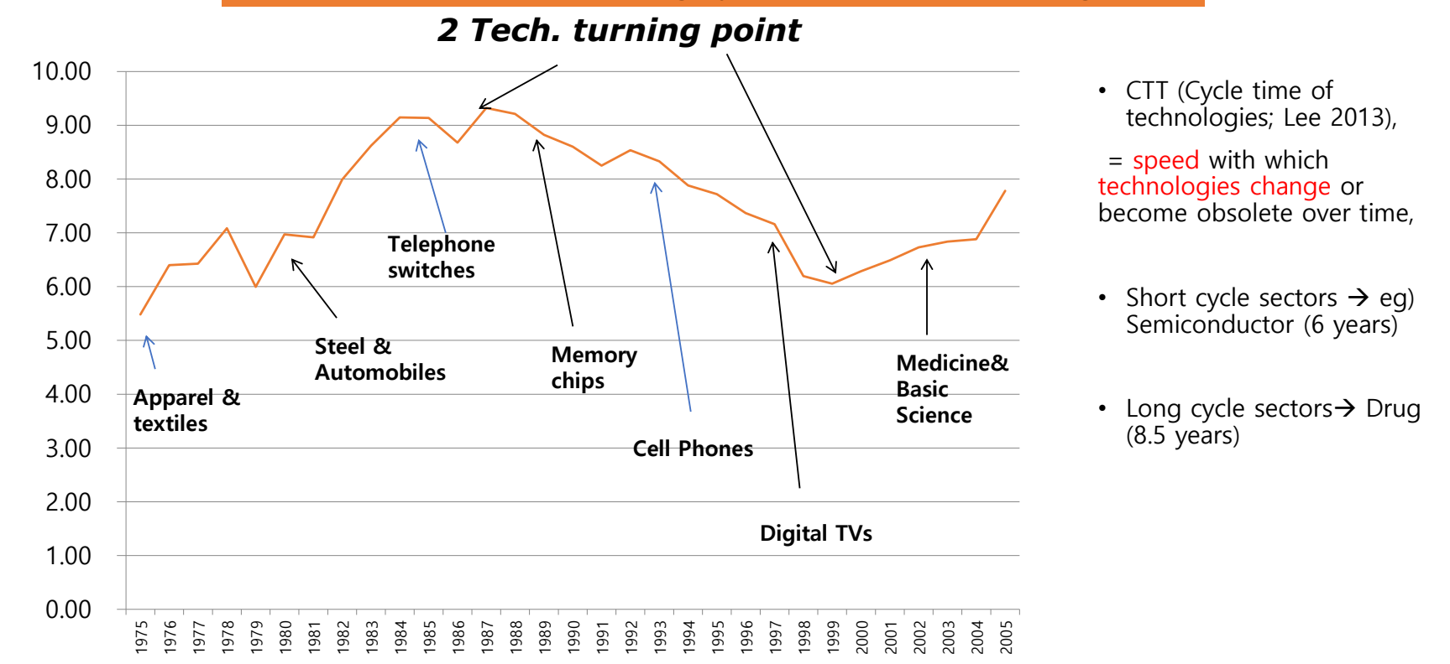
Overcoming Technological Entrenchment
Source: Lee (2022)

Slide 10
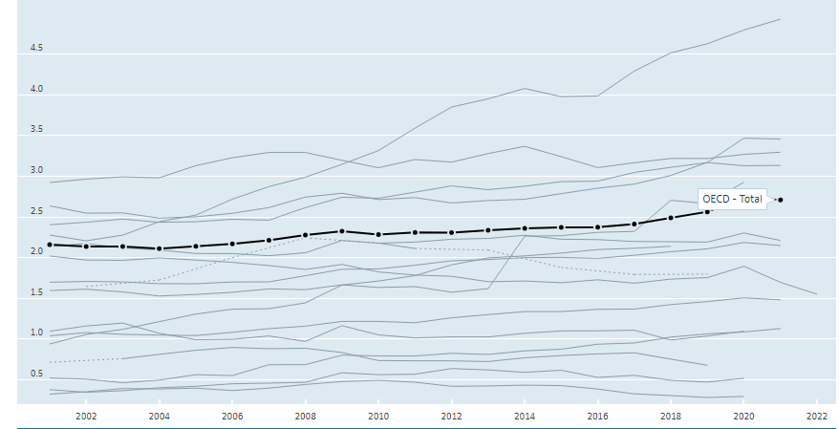
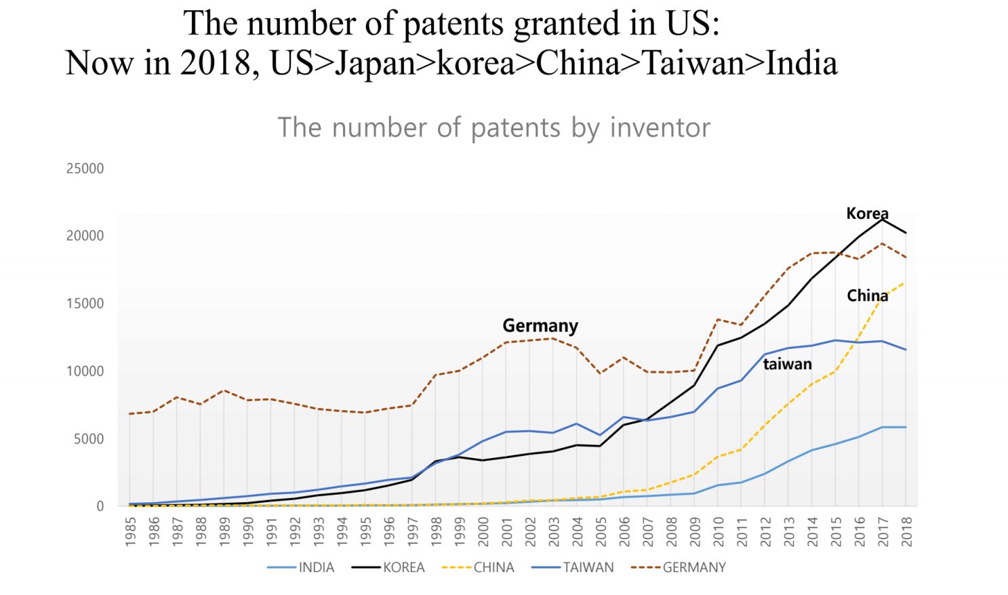
Research & Development
R&D (% of GDP)
KOR
US
JPN
GER
Source: OECD
Source: Lee (2022)

Slide 11
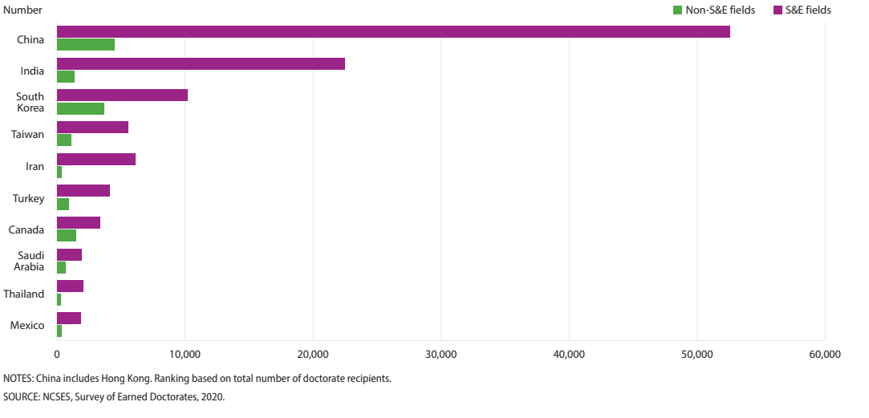
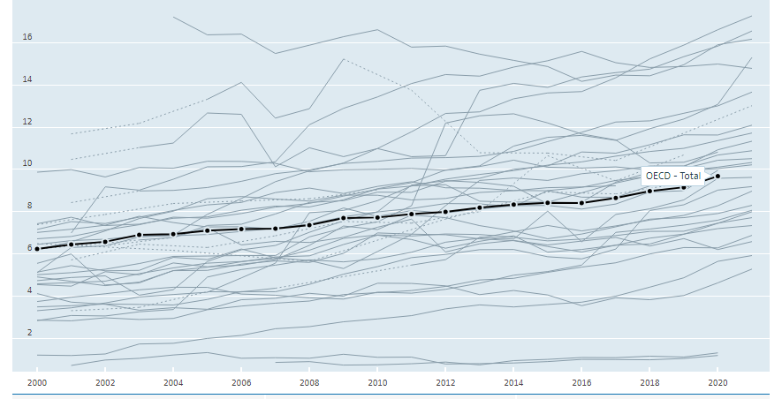
Education
PhD Recipients in the US by Country
Researchers per 1000 employed
KOR
SWE
FIN
Source: OECD

Slide 12
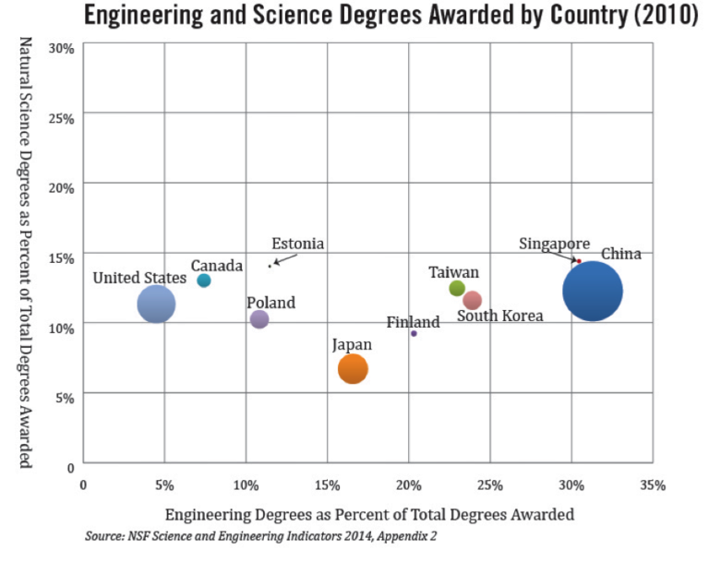
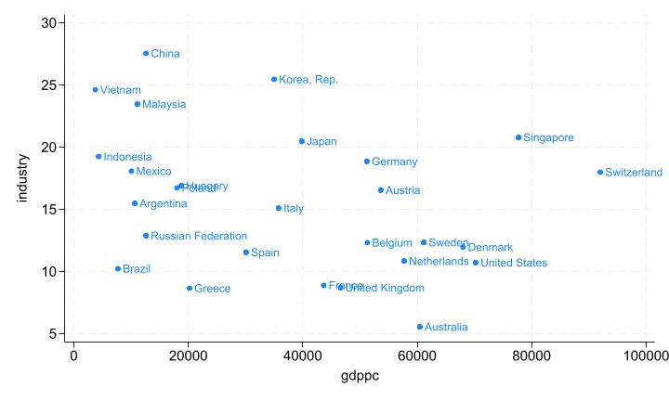
Education
GDP per capita and Share of Manufacturing
Source: Kim (2023)
Source: https://ncee.org/quick-read/statistic-of-the-month-engineering-and-science-degree-attainment-by-country/

Slide 13
Korea for the Future: AFTER
Anchor
Foreseeing
Technology
Economy
Resilience

Slide 14
Anchor
Anchor is identity.
Our fundamental anchor is democracy and market economy.
These should be the most important direction which our policies should follow.
At the same time, we need to improve the quality of these institutions.

Slide 15
Foreseeing
Foreseeing and preparation are key to survival and prosperity of a country in this rapidly changing world.
The Institute for Future Strategy (IFS) was founded to contribute to policy making with foresight.
We will ask “ifs”.

Slide 16
Technology
Korea’s prosperity depends on technological development.
We have some advantages. However, countries should pursue cooperative technological sovereignty rather than isolated one.
We should ask whether national allocation of talents is appropriate for technological development.

Slide 17

Economy
Innovation = Fair & flexible institutions X High quality of human capital X Capacity to converging technology
Korea suffers from very low fertility rate.
Excessive income inequality is enemy to the economy & society.

Slide 18
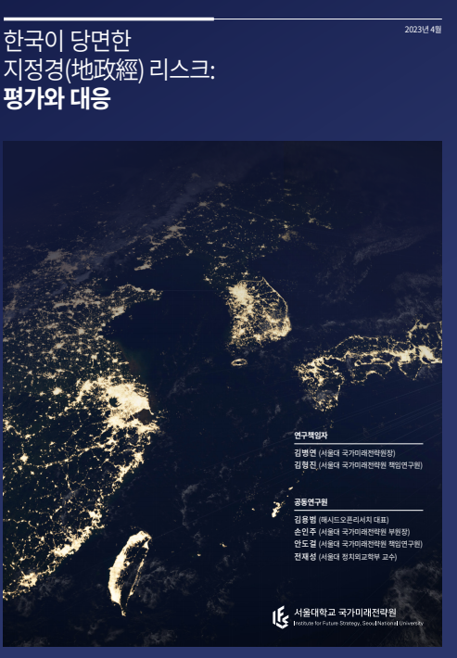
Resilience
Great challenges from geopolitics require resilience.
Resilience requires new ESG (energy, supply chain, grain).
Networking of trustful countries facilitate resilience.

